Slide 1
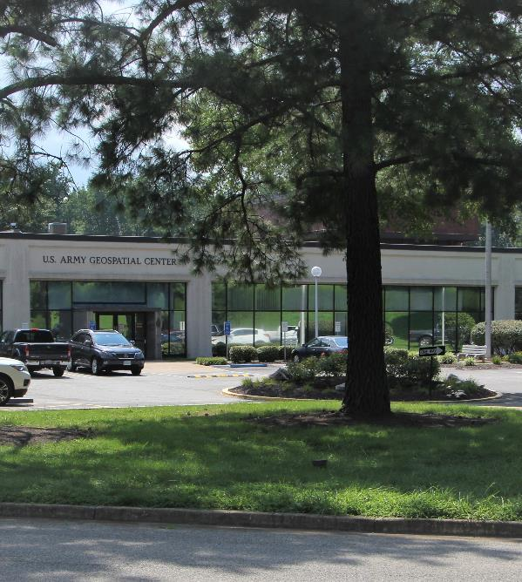
AGC RATE BOARD – 2024
David R. Hibner, SES
Director
US Army Geospatial Center
Susan Goodyear, SES
Director of Resource Management
Headquarters US Army Corps of Engineers
Thurs, 7 Sep 2023
Filename: FY22-24 Rate Board Template CEV06142023 (v7)

Slide 2
Overhead Rate methodology
AGC FY24
Overhead Rate - 59%
Process
Process accomplished twice per year: Jul for next FY and Feb for MYR
DTTL/Program Delivery and Indirect Budget is built and evaluated
All DTTL and Indirect Costs are individually reviewed
Risk and mitigation considerations are evaluated
Risk-Informed Rates are vetted with leadership and presented to the Director for a final decision
Director-approved rates are implemented for the FY and briefed to the Rate Board
AGC Hourly Rate Business Rules Methodology / Example
Base Hourly Rate $ 50.00 - Basic pay and Locality pay
Effective Labor Rate 57% - Applied to all AGC civilian labor
Effective Labor $ 78.50 - Government benefits and Fully
Hourly Rate funded leave account
Overhead Rate 59% - Applied to productive hours for direct touch civilian labor
- Direct funded labor (Self- Reimbursement)
- Reimbursable funded labor
(7600 agreement / project order)
Total Labor $ 124.82 - General & Administrative and
Hourly Rate Departmental Overhead
- Indirect labor
- Indirect non-labor - Departmental labor (not
attributable to project workload)
- Departmental non-labor (not
attributable to project workload)

Slide 3
DTTL Labor Rates
Average not burdened is based on Total DTTL/FTE (FY23 ex. $27,268M/141 FTE’s= $193K)
Average burdened is based on Total DTTL + OH Rate/FTE (FY23 ex. $27,268M+$16,989M/141 FTE’s= $314K)
Average Annual DTTLE FTE Cost (not hourly)
FY24 decrease is due to additional FTE’s which means a slightly larger labor base to spread costs

