Slide 1
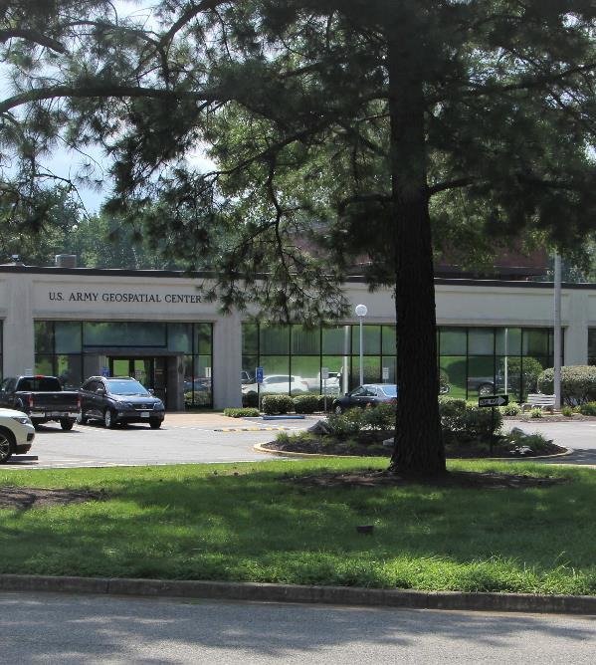

AGC RATE BOARD – 2023
Audrey Bruun
Deputy Director
US Army Geospatial Center
Scott Fabian
Directorate of Resource Management
Chief, Program & Budget Division
Headquarters US Army Corps of Engineers
Thurs, 25 August 2022
1530-1630
2022-08-15 - AGC Rate Board v1-RC-RB

Slide 2




Geospatial Integration
Multiple Roles of the Chief of Engineers
AGC’s mission overlaps with each of the prime areas of responsibility of the Chief of Engineers
  Army Staff
    AGC Director concurrently serves as
      Geospatial Information Officer on the Army Staff
      Exec Director of the 3-Star Geospatial Governance Board
    Validates and certifies geospatial systems and software used by the Army prior to deployment
    Direct support for Army Geospatial and GEOINT requirements
Chief of Engineers
Army Staff
Commander
USACE
  US Army Corps of Engineers
    Provides geospatial and mapping support for
      Disaster response and mitigation
      Major construction projects
      USACE partners and stakeholders requiring geospatial support
    BuckEye Program to support worldwide CCMD and ASCC operations
Chief of Branch
Engineer
AR 525-95, dated 26 July 2022
Army Geospatial Intelligence and
Geospatial Information and Services
  Engineer Branch
    Develop and implement a geospatial information enterprise, aligned with HQDA and DoD enterprise architectures, to ensure interoperability and connectivity between existing and future Army and National System for Geospatial Intelligence (NSG) systems
    Geospatial Subject Matter Expertise and advice to the Engineer School

Slide 3
Mission and background
Mission: The U.S. Army Geospatial Center collects, analyzes, manages, and delivers geospatial data and products, provides acquisition support, and develops innovative solutions to solve the toughest geospatial challenges.
Background:
AR 525-95, dated 26 July 2022 Army Geospatial Intelligence and Geospatial Information and Services codifies AGC support to the Army.
USACE centers and districts do not receive a specific appropriation act to finance its activities. Centers and districts are required to recoup all direct and indirect costs incurred from appropriations financing the projects, programs and activities they execute. The Civil Functions Appropriation Act of 1954, PL 83-153, 1st Session, approved 27 July 1953, established the Corps of Engineers Revolving Fund. The fund is available without fiscal year limitation, for expenses necessary for the maintenance and operation of the plant and equipment of the Corps of Engineers used in civil works functions. It is also used to capture and distribute costs for services and indirect costs benefitting projects, programs and activities ultimately charged to all Civil Works, Military Missions and Interagency reimbursable appropriations. The fund will be credited with reimbursements or advances for the cost of equipment, facilities, and services furnished, at rates which will include charges for overhead and related expenses, depreciation of plant and equipment, and accrued leave. This revolving fund operates similarly to an Army Working Capital Fund.
AGC has briefed FY21 and FY22 rates prior to start of both FY’s
HQDA Rate Board has approved rates for support provided by AGC during all previous briefs
Support provided includes:
  Geospatial Information Support
  Systems Engineering
  Acquisition Support
Execution of AGC's reimbursable mission in support of its customers is dependent on (1) communication of requirement expectations and (2) timely funding for this support
Timely signature of FS 7600A documentation and funding receipt is critical to ensure adherence to current OSD, HQDA and USACE policy regarding reimbursable program execution
• Indirect costs are charged through internal orders, which can only be credited as Direct Touch Time Labor (DTTL) hours worked and charged in support of direct and reimbursable customer missions.
Notes:
Capabilities:
1) The Army Geospatial Enterprise provides geospatial knowledge to the warfighter, as well as an understanding of the where and what of natural features, cultural features, and military capabilities. It is fundamental to the success of the Army.
2) The Army Geospatial Enterprise is an integrated system of governance, technologies, policies, processes, standards, data and organizations that are focused on geospatial capabilities. It is not a specific organization or fielded system.
3) The Army Geospatial Enterprise addresses standardization, interoperability, and geospatial certification for the more than 100 Army systems that either create or consume geospatial data. Managing these systems is a challenge, given that there are over 80 software applications, 200 geospatial data standards, and 350 data formats.
4) The Army Geospatial Enterprise improves mission planning, rehearsal, execution, modeling, simulation, and training for Army systems. It packs a punch by addressing location and situational awareness requirements, supporting the Army’s strategic goals of preventing conflict, shaping the environment, and winning decisively.

Slide 4
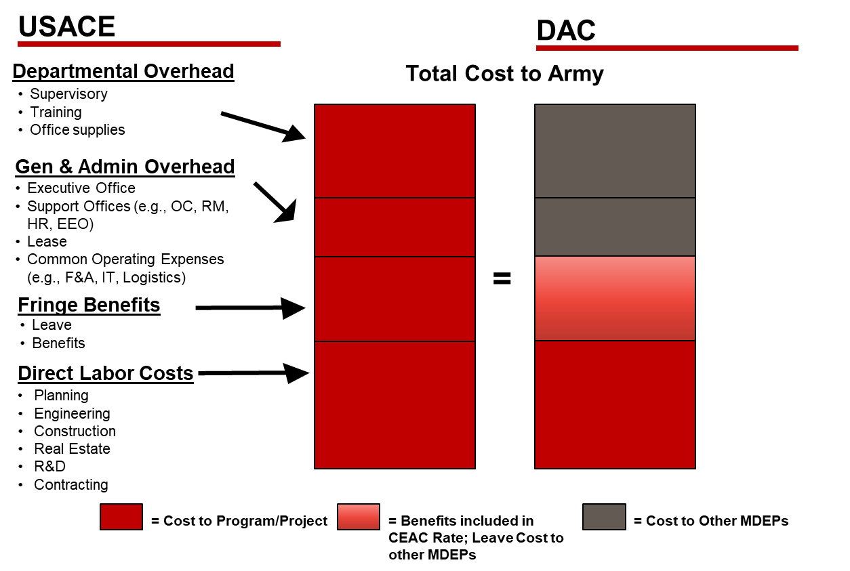
Overhead Rate methodology
Process
Process accomplished twice per year: May/Jun for next FY and Feb for MYR
All positions are individually reviewed and costed
Non-Pay requirements are reviewed and evaluated
Budget is built and evaluated
Risk and risk mitigation considerations are evaluated
Mathematical and Risk-Informed Rates are vetted with leadership and presented to the Director for a final decision
Director-approved rates are implemented for the FY
Direct Labor Calculation – FY23
(Reimbursable and Direct-Funded positions)
Total Projected Indirect Costs / Total Projected DTTL
Rate Includes:
Current/Projected Basic Pay thru to end of CY
Projections thru to end of FY
  Cost of living increase (est at 2.1% for 8-9 months)
  Step increase
  Career ladder promotions
  Scheduled retirements and subsequent hire lag
Government Contributions (35% of basic pay)
  OASDI
  Medicare
  Retirement – FERS/CSRS
  FEHB
  FEGLI
  TSP Basic and Matching
USACE Mandated Funded Leave Account (24% of basic pay)
  Annual (14%)
  All other leave (10%; e.g., Sick, Admin, Court, etc.)
Delivering Engineer Svcs: Total Cost Comparison
Labor rates do not include any non-pay factors (e.g., TDY, training, supplies, facilities, etc.)

Slide 5
INDIRECT
* Planned Labor Hours = 1728 per FTE for USACE
**All “Planned” values represent an entire 12 months. Actuals as of 31 Mar 2023.
Chart represents labor AND non-labor overhead requirements (USACE non-discretionary)
Overhead - USACE Unique Costs not paid by Army:
  Fully Funded Leave Account
  Unclassified IT and Networks (NIPR/CorpsNET)
  Classified IT and Networks (SIPR/JWICS)
  Finance, Accounting and Disbursing
  Facilities Rent/Utilities (BASOPS)
  Audit/Statement of Budgetary Resources
  Misc Spt to/from HQUSACE (e.g. Security, Safety,
  Health Program, EEO, etc.)
Any projected over/under collection of indirect cost will result in adjustment to rate
*in 21-22 we had some expenses programmed into the OH budget,
but were not included in the rates due to uncertainty of the timing.
We took risk in the rate that they would not actually happen.

Slide 6
Direct & Reimbursable
* Planned Labor Hours = 1728 per FTE for USACE
**All “Planned” values represent an entire 12 months. Actuals as of 31 Mar 2023.
Chart represents labor AND non-labor project requirements
AGC is funded with a mix of Direct & Reimb Customer Funding
Reimb funding comes from PEO’s as well as other DoD and Non-DoD Customers
All DTTL contribute to the rate equally
Approximately $10M of the total $26M DTTL is customer reimb
Execution does not occur along a perfect straight line due to changes in customer needs, workload increases in later fiscal qtrs, contracting surge

Slide 7
Backup

Slide 8
Bottom line
AGC Rates are calculated by dividing the Total Projected Indirect Costs by the Total Projected DTTL
  $15.7M / $26.2M = 59%
Overhead Rate of 59% is charged to all DTTL (down 3% from FY22)
Breakdown of that 59% is as follows: *Army does not fund this; based on projected oh expenses/projected DTTL
  38% is Departmental OH (DOH) and pays for the non-project specific administrative functions of the DTTL employee (awards, travel, training, small purchases, associated share of rent & utilities, IT life cycle management, etc.)
  21% is General & Administrative (G&A) OH and pays for the C2 and G-Staff equivalent functions of the organization (Labor for Executive Office, Resource Management, Legal, Security, awards, travel, training, small purchases, associated share of rent & utilities, IT lifecycle management, etc.)
Request Rate Board Approval to operate at 59% OH for FY23

