Slide 1


Army Budget
Overview
Professional Development Institute (PDI)
31 May 2017
MG Thomas A. Horlander
Director, Army Budget
As of 18 May 2017.v2

Slide 2
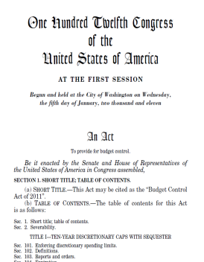
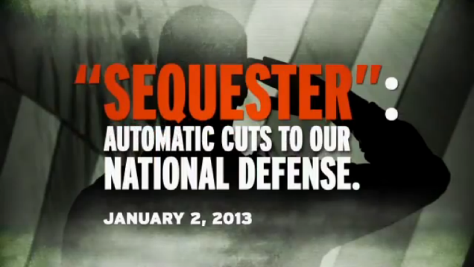
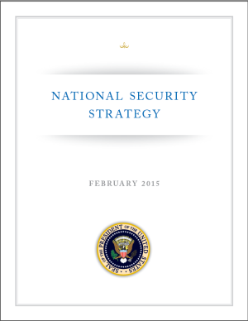


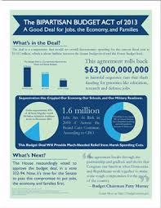
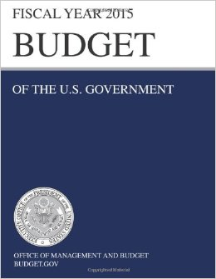

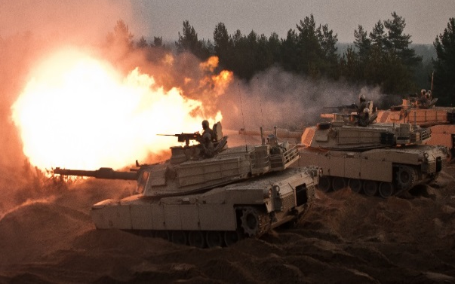





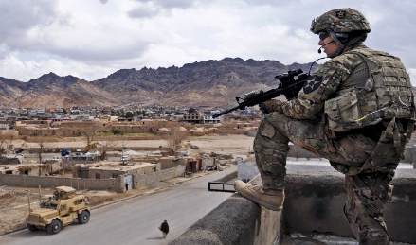
Unpredictable Environment
National Security Strategy
Defense
Planning Guidance
(DPG)
Budget Control Act
Bipartisan Budget Act (x2)
FY17/18 Budget
DETER RUSSIA
BUILD AFGHAN FORCES
DESTROY ISIS
ENGAGE ASIA / DETER NORTH KOREA
2

Slide 3
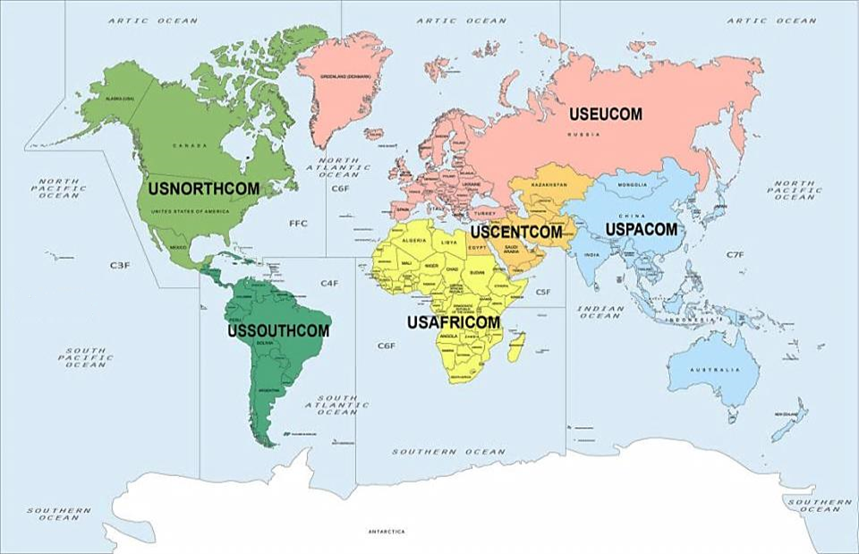
Current Army Operational Support
Other EUCOM Locations: ~29,000
Russia illegally annexes Crimea; strained relations with Georgia and Ukraine
Russia disputes Caspian Sea rights claims with Azerbaijan, Kazakhstan and Iran
OPERATION JOINT
GUARDIAN: ~550
OPERATION NOBLE EAGLE: ~350
ATLANTIC RESOLVE: ~7,400
DOMESTIC RESPONSE FORCES
(DCRF/C2CRE): ~17,000
Train and assist Afghan National Security Forces
OPERATION FREEDOM’S SENTINEL /RESOLUTE SUPPORT: ~6,500
USFK: ~20,000
GLOBAL RESPONSE FORCES: ~9,000
Terrorist activities in Sinai Peninsula
OPERATION INHERENT
RESOLVE: ~4,100
MFO SINAI: ~500
Other PACOM Locations: ~50,000
ISIS and ISIL terrorist activities in the Arab States
PACIFIC PATHWAYS: ~3,500
Detainee Operations at GTMO
CF-J: ~1050
Threats to the US from homegrown extremists and terrorist organizations
JTF – GTMO: ~1,500
Threats from Al-Qa’ida and Boko Haram in Libya, Mali and Nigeria
OPERATION SPARTAN SHIELD: ~16,000
Cyber attacks from China and North Korea
JTF – BRAVO: ~600
China and Japan dispute sovereignty claims over the Senkaku Islands
Other SOUTHCOM Locations: ~2,000
OCTAVE SHIELD / ONN: ~630
China and the Philippines dispute sovereignty claims over Reed Bank
Drug trafficking and counterterrorism missions
Al-Shabaab remains a threat in East Africa
JPAT - Philippines: ~770
Other AFRICOM Locations: ~7,600
Increased Chinese and Russian influence in Latin America
FOUO/SENSITIVE
3
AS OF 10 May 16
Notes:
This slide provides the audience an idea of the disposition of Divisions in the different COCOMs worldwide.
Below is what I can provide right now and some questions to clarify a couple of things where I am unsure what you are looking for. All numbers are estimates to maintain unclassified rating.
OPERATION NOBLE EAGLE - ONE only covers the units that support the NCR I believe and AOC does not track ONE specifically. We track support to NORTHCOM both assigned and allocated but not by operation. Are you looking for the NCR support numbers or something else?
ATLANTIC RESOLVE - This is not a SECDEF named operation so AOC does not track specifically for this CCMD named operation. I can provide you numbers for the 3 main units allocated ISO OAR (4 ID, 3/4 ID, 10 CAB). Do you want allocated numbers for OAR or actual numbers of who is in Europe from these units for OAR?
CF-J - Not sure what you are looking for. Are you looking for total numbers currently in Jordan? ~ 1050 currently in Jordan according to latest AOC slide.
OCTAVE SHIELD / ONN - Operation Octave Shield/Operation New Normal - ~ 630 allocated ISO these operations
OPERATION FREEDOM’S SENTINEL /RESOLUTE SUPPORT - OFS ~1940 ORS ~ 4560 according to latest AOC slide
OPERATION SPARTAN SHIELD - OSS ~ 16,000 (Kuwait, Jordan, Qatar, Bahrain, UAE)
OPERATION JOINT GUARDIAN - OJG ~ 550 in Kosovo according to latest OAC slide
PACIFIC PATHWAYS JPAT - Philippines - Pacific Pathways is not a SECDEF named operation, it is a PACOM exercise. If you want to know how many Soldiers are in Philippines for the Pacific Pathways exercise it is ~ 770 according to USARPAC on latest AOC slide.

Slide 4



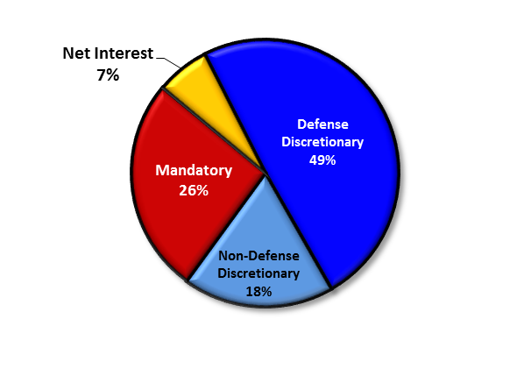



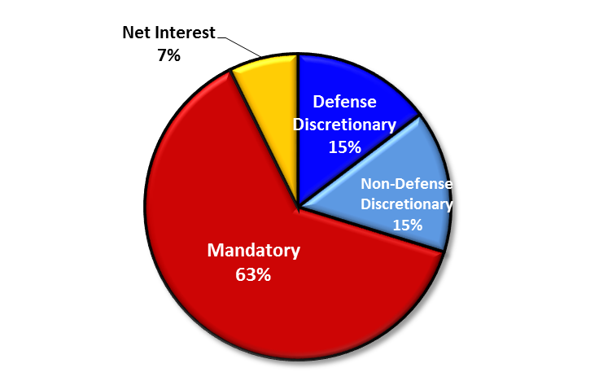

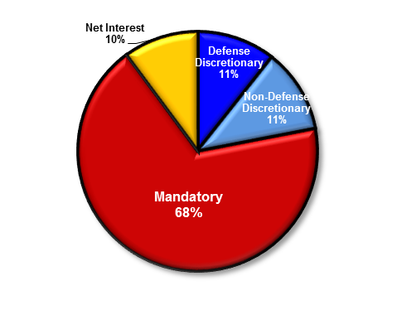



Federal and DoD Spending
FY 17 Federal Budget Request
Outlays
-4,147B
Interest on
the National
Debt
7%
Non-Defense
Discretionary
11%
Discretionary
-1,233B
Mandatory
-2,606B
Social
Security
23%
Other
Social
Aid 16%
Medicare
&
Medicaid
24%
Veteran’s
Benefits
4%
National
Defense
15%
Net Interest
-303B
Income Tax
+1,788B
Payroll Tax
+1,141B
Mandatory Spending = 70%
Discretionary
Spending = 30%
Corp Tax
+419B
Receipts
+3,644B
Other
+296B
Deficit
-503B
FY 62
FY 21 est
FY 17
4

Slide 5

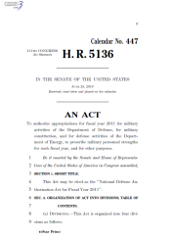

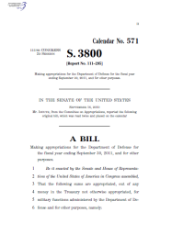
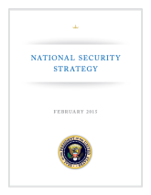

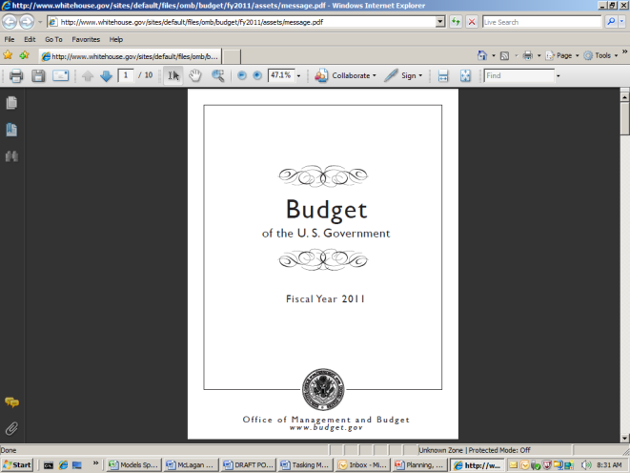


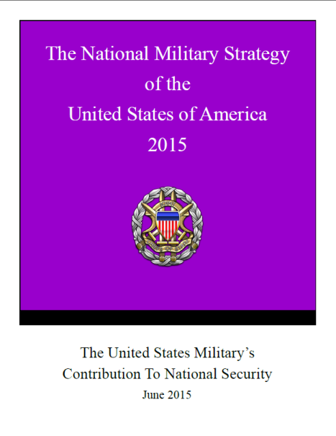
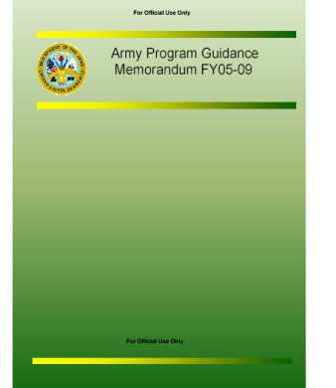
Federal Budget Process - Defense
National Defense
Authorizations Act
President
Congress
President Signs Acts
into Law
U. S. CAPITOL
WASHINGTON
Enactment
NSS
National
Strategy
Treasury Warrant
Feb 2015
OMB Apportionment
FY17
National Defense
Appropriations Act
DoD / Services Execute Budget Dollars
Appropriations
Closeout
Prior
Years
OSD
Defense
Strategy
Review
NDS
Defense
Strategic Guidance
FY
20-24
President’s
Budget
QDR
Jan 2012
SECRET
Defense Planning
Army
Planning Documents
Command Requirements, Senior Leader Guidance,
Other Inputs
FY
19-23
OSD
Program and Budget
Review
FY18
JCS
NMS
Defense
Planning Guidance
(DPG)
TAA
AV
ASP
APG
APGM
ACP
DoD
Budget
Nov 2016
CPR
Army Programming
& Budgeting
Army
POM &
BES
OMB
Issue
Teams
Integrated Priority List
RMDs
CPA
Combatant Commands
OSD Fiscal Guidance
5

Slide 6


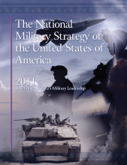
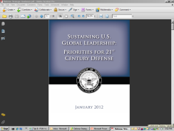
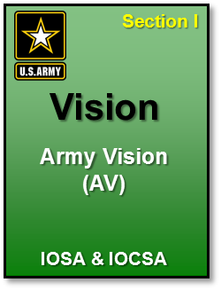
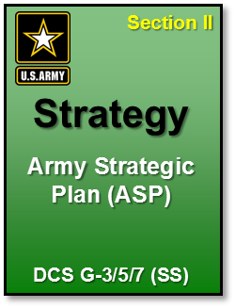
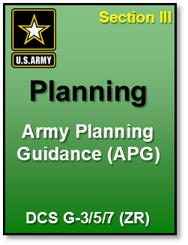
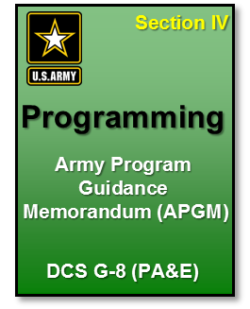
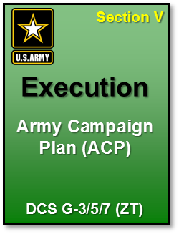
Planning
The Army Plan (TAP)
National Strategy
The Army Plan (TAP) aligns and nests the Army’s planning documents with joint guidance and capabilities, using a Title 10 lens
QDR
Army Title 10 Lens
The Army Plan (TAP)
ARMY VISION (AV)
Purpose: Provides the unified direction of the SecArmy and CSA for how the Army will transform over a 10-year period to support higher-level strategic guidance. Describes goals and objectives and informs the other TAP sections and the Army’s strategic communications to external audiences. Sets the strategic priorities for the Army as an institution to drive future change.
ARMY STRATEGIC PLAN (ASP)
Purpose: Nests Army institutional planning within national, DOD, and Joint strategic guidance. Lays out the Army’s institutional strategy for achieving the AV goals and fulfilling its statutory responsibilities. Provides strategic objectives, milestones, and decision points to achieve AV goals and highlights key assumptions and areas of risk.
ARMY PLANNING GUIDANCE (APG)
Purpose: Initiates the annual PPBE cycle and provides guidance on key enduring and emerging planning issues to inform program development. Addresses near, mid, and far term planning issues that apply to a specific budget year, later in the FYDP, or endure throughout it. Provides prioritization guidance addressing the hierarchy of functions for program development and budget execution.
ARMY PROGRAM GUIDANCE MEMORANDUM (APGM)
Purpose: Conveys the SECARMY’s intent and general guidance concerning acceptable levels of risk as outlined in the APG. It codifies the results of the adjudication actions on planning issues identified in the APG. Provides the initial guidance for Army POM and BES development. Translates requirements, identified to satisfy the Joint demand for Army capabilities and to support attainment of Army imperatives, into specific resource tasks.
ARMY CAMPAIGN PLAN (ACP)
Purpose: Focuses on current year strategy execution through management of strategic efforts (SEs). SEs are critical challenges or objectives that are of specific interest to Army Senior Leaders and impact the Total Army. Annually establishes and monitors these priorities and initiatives from the SECARMY and CSA that require measurable end states or decisions in the year of execution.
Notes:
The Army Plan (TAP) is the foundation of Army planning. It provides guidance in five substantively integrated sections issued and signed by the Secretary of the Army.
Army Vision, TAP Section I. The Army Vision (AV) provides the unified direction of the Secretary of the Army and Chief of Staff of the Army for how the Army will transform over a 10-year period to support higher-level strategic guidance.
Army Strategic Plan, TAP Section II. The Army Strategic Plan (ASP) nests Army institutional planning within national, DoD, and Joint strategic guidance. Building on the AV, it lays out the Army’s institutional strategy for achieving the AV goals and fulfilling its statutory responsibilities.
Army Planning Guidance, TAP Section III. The Army Planning Guidance (APG) initiates the annual PPBE cycle. It provides guidance on key enduring and emerging planning issues to inform program development. The APG will address near, mid, and far term planning issues that apply to a specific budget year, later in the FYDP, or endure throughout it.
Army Program Guidance Memorandum, TAP Section IV. The Army Program Guidance Memorandum (APGM) provides the initial guidance for Army POM and BES development. It conveys the Secretary of the Army’s intent and general guidance concerning acceptable levels of risk as outlined in the APG. It codifies the results of the adjudication actions on planning issues identified in the APG.
Army Campaign Plan, TAP Section V. The Army Campaign Plan (ACP) focuses on current year strategy execution through management of Strategic Efforts (SEs). SEs are critical challenges or objectives that are of specific interest to Army Senior Leaders and impacts the Total Army. The ACP will annually establish and monitor these priorities and initiatives from the Secretary and Chief of Staff that require measurable end states or decisions in the year of execution.
Title 10: > http://uscode.house.gov/download/title_10.shtml <

Slide 7
Thinking in Time
Planning, Programming, Budgeting & Execution
FY 12
Reconciling Milcon APPNs (5 yrs)
FY 13
Reconciling Milcon APPNs (5 yrs)
FY 14
Reconciling Procurement APPNs (3 yrs)
FY 15
Reconciling Procurement APPNs (3 yrs)
FY 15
Reconciling RDT&E (2 yrs)
FY 16
Reconciling RDT&E (2 yrs)
FY 16
Reconciling Single Year APPNs
FY 17
Reconciling Single Year APPNs
FY 17
FY 18
FY 19
OCT | NOV | DEC | JAN | FEB | MAR | APR | MAY | JUN | JUL | AUG | SEP | OCT | NOV | DEC | JAN | FEB | MAR | APR | MAY | JUN | JUL | AUG | SEP | OCT | NOV | DEC
2016 |  |  | 2017 |  |  |  |  |  |  |  |  |  |  |  | 2018
FY17 Amendment to Congress (16 Mar)
80/20
End of Fiscal Year Closeout
National Military Strategy
Defense Strategic Guidance
3-month CR
4-month CR
Multi-year Execution of FY17 Funds
FY 17
H.R. 5325
FY 17 Appropriation (1 Year)
Multi-year Execution of FY17: RDTE (thru FY18); PROC (thru FY19); MILCON (thru FY21)
FY17 Budget
House passes
FY17 Budget
FY 18 Budget Roll-Out Brief
80/20
End of Fiscal Year Closeout
Program Review
FY 18
BES
BES Review
Congressional Review
FY 18 Appropriation (1 Year)
Multi-Year
Execution of FY18 Funds
Posture Hearings
Multi-year Execution of FY18: RDTE (thru FY19); PROC (thru FY20); MILCON (thru FY22)
FY18 Program Budget Review (ASA FM&C)
FY18 BES
to OSD
OSD passes FY18
Budget to OMB
FY 19 Budget Roll-Out Brief
PB 19
Program Review
FY 19
POM19-23 Build
BES
BES Review
Congressional Review
FY 19 Appropriation
*
Multi-Year
Execution of FY19 Funds
POM Offsite (SA/CSA)
FY19 POM Approval
FY19 BES to OSD
(TBD)
Posture Hearings
Program Review
FY20
TAA20-24
POM Validation Requirement
POM20-24 Build
BES
BES Review
Today
Congressional
Action
ASA (FM&C)
Action
Army Senior Leader
Decision Point
POM Offsite (SA/CSA)
7

Slide 8











Multifunctional Relationships
OUSD
(Comptroller)
Cost Assessment
& Program Evaluation
(CAPE)
OUSD Legislative Affairs (LA)
Joint Staff
Defense Finance &
Accounting Service (DFAS)
SA, CSA, USA, VCSA
Secretariat
  ASA, AL&T
  ASA, M&RA
  ASA, FM&C
  ASA, IE&E
  ASA, CW
  AASA
ARSTAFF (G1-G8)
OCLL / OCPA / ACSIM /ANMC
OGC / TJAG / OTSG / DAIG / AAA
ARNG / USAR
Senate Appropriation
Committees (Defense and
Military Construction)
House Appropriation
Committees (Defense and
Military Construction)
Congressional Budget Office
Office of Management and Budget (OMB)
Government Accountability
Office
Army Commands
Army Service Component
Commands (ASCC)
Direct Reporting Units
Field Operating Agencies
PEO / PMs
Media
Non-Profit Organizations
NGOs
Executing Title 10 requirements while maintaining relationships across multifunctional domains to provide transparent and responsible stewardship of the Public’s Funds
8

Slide 9

Army Congressional Budget Liaison
Congress
Senate
SASC
SAC
House
Standing Committees (14)
Special/Select Committees (5)
SAC-D
SAC-M
Other Subcommittees (10)
HAC
Standing Committees (19)
HAC-D
HAC-M
Other Subcommittees
(10)
HASC
OCLL works authorizations with the Armed Services Committees. Budget Liaison (BUL) works funding with the Appropriations Committees.
8
Notes:
We have an inside the building role and an outside the building role.
Our Liaison officers are responsible to build relationships with and know their Members and staffers on the Approps Committees so that when we need to take our message to the Hill, we know who to contact.
We are responsible to know the Army’s priorities and programs and provide that information to the right staffers so we get full funding.
At the end of the day, it’s about fully funding the President’s budget request -- both base budget and supplementals.

Slide 10
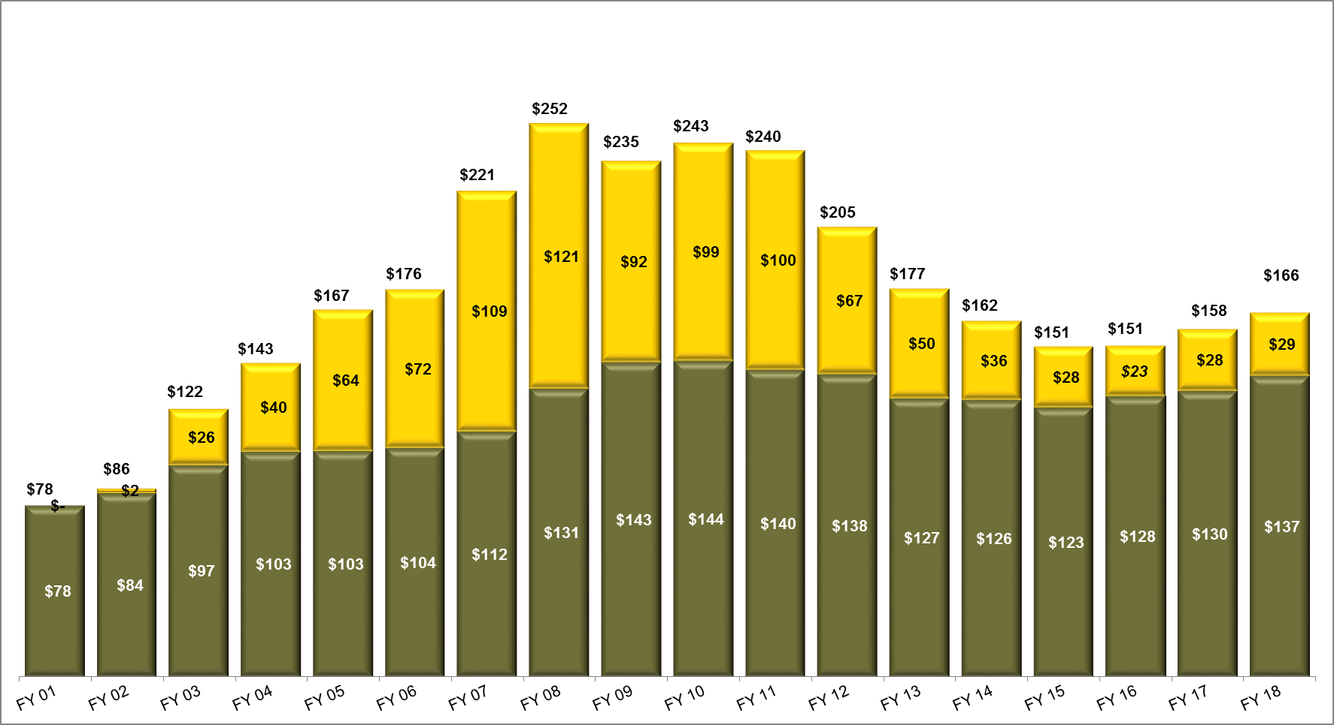
Army Budget Trends
FY2001 – FY 2018 ($B) Current Dollars
Change to annual POM
Contingency Funding transitions from supplementals to OCO funding
Start two POMs per year
Introduction of New Authorities
(CERP, IRRF, ASFF, ISFF, AIF)
New Authorities (ERI, ITEF, STEF)
New Authority (CTEF)
“Funding
Divot”
$3.1
$2.7
$6.2
$.85
($123 Base)
($3.1 OCO)
($122 Base)
($.85 OCO)
($125 Base)
($2.7 OCO)
($124 Base)
($6.2 OCO)
EXECUTION
Enacted
Request
Numbers may not add due to rounding
Base
OCO
OCO for Base Rqmts
Magnitude and Velocity of growth and reductions contribute to fiscal instability
10

Slide 11
The Army’s Oscillating Base Topline
  The two-year Bipartisan Budget Acts of 2013 (BBA13) and 2015 (BBA15) provided limited predictability but did not eliminate future BCA budget spending caps which, barring new legislation, return in FY18.
  The funding received through the FY17 RAA provided the Army additional base funding to support critical warfighter readiness requirements.
  BBA15 repeats the oscillating funding of BBA13 extending the time necessary to restore balance between readiness, end strength and modernization.
  OCO funding is an essential funding source for incremental wartime costs, but its continued use as a supplement for base funding requirements is now standard practice.
11

Slide 12
FY 2017/18 Budget
(Base Funding Program)
Request ($B) | FY16 Actuals | FY17 Enacted | FY18 Request
Military Personnel | 55.90 | 55.5 | 58.00
Operation and Maintenance | 45.4² | 46.2⁴ | 49.45
Procurement/RDTE | 24.3⁰ | 26.2 | 26.8⁰
Military Const/Family Housing/BRAC | 1.9⁰ | 1.5 | 1.8⁰
Other Base (CAMD/AWCF/ANC) | 0.9⁰ | 0.9 | 1.1
Totals | 128.4² | 130.3³ | 137.2
¹
Other Base: Chemical Agent and Munitions Destruction, Army Working Capital Fund, Arlington National Cemetery
1: Includes Environmental Restoration Account (ERA) funding
3: Includes $6.1B in OCO for base requirements 4. Amount adjusted for fuel rates and foreign currency fluctuation reductions
Base Request
2: Includes $2.7B Base-to-OCO Transfer
Base Request
$137.2B
$137.2B
In the FY18 Defense Budget Request, the Army’s topline base funding grew by 5.1% from the total FY17 enacted budget
Growth in the FY18 base budget funds the Army’s readiness requirements at the higher end strength, primarily in:
  Military Personnel ~4.6% ▲
  Operations & Maintenance ~6.7%▲
$137.2B
O&M Civilian Pay, $13.7
12

Slide 13
FY 2017/18 OCO Budget
1: MILPERS account does not include $63M in FY17 OCO request to comply with BBA15
2: O&M account does not include Base-to-OCO Transfers: FY14: $3,100M; FY 15: $850M; FY16: $2,200M. Does not include $3,797M in FY17 OCO request to comply with BBA15
3: RDA account does not include $1,876M in FY17 OCO request to comply with BBA15
4: MILCON account does not include $50M in FY17 OCO request to comply with BBA15
5: The Iraq and Syria Train & Equip Funds were combined into a single Counter-ISIS Train & Equip fund in FY17
6: The Joint Improvised Explosive Device Defeat mission has been assumed by a new DOD organization for FY17 and beyond. Partial FY16 and FY17 JIEDDF funding information can be found in the DOD Budget Materials.
◆ OCO Request
$28.9B
Operation FREEDOM’s SENTINEL (Afghanistan; Horn of Africa)
includes Operation Spartan Shield (CENTCOM)
Operation INHERENT RESOLVE (Iraq)
European Reassurance Initiative (Europe)
Afghan Security Forces Fund
Counter-ISIS Train & Equip Fund
62%
11%
9%
13

Slide 14
Current State of Play
Implementation Guidance for Budget Directives in the National Security Presidential Memorandum on Rebuilding the US Armed Forces – SECDEF Memo JAN 31 2017
  Phase 1: Improve Warfighting Readiness – FY 2017 Budget Amendment Request – 30 Day Readiness Review- Complete
    Received $132.3B (Base) and $28.7B (OCO) Total: $161B for FY17 Defense Appropriation
    Funded critical requirements to combat ISIS
    Restored some warfighter readiness
    Arrested the current readiness decline of America's Army
    Critical first step to set the conditions for improving future readiness
  Phase 2: Achieve Program Balance – the FY 2018 President’s Budget (PB) Request –
  60 Day Readiness Review- Complete
    Requests $137.2B (Base) and $28.9B (OCO) Total: $166.1B for FY18 PB
    Supports improve Warfighter Readiness, Achieves Program Balance and Increases Lethality
    Submitted to Congress on 23 May 2017
  Phase 3: Build Capacity and Improve Lethality – the National Defense Strategy and FY 2019-2023 Defense Program
    Objective readiness metrics due by FY19
    Fall strategic readiness review will assist us during POM 19-23
14

Slide 15











Fiscal Rules & Limitations
General & Special Transfer Authority: The DOD has cap limits on transfer authorities within year of execution directed by Congress
    General (Base): $4.5B
Below Threshold Reprogramming (BTR) – Within appropriation without obtaining Congressional prior approval (BTRs net to zero).
Intra-Appropriation Reprogramming – (MILCON/FH Specific) Within appropriation only. No authority to transfer or reprogram funds to/from other appropriations.
  Military/Family Housing Construction – Prior Approval required >$2M or 25%, whichever is less
  Family Housing Operations – Congressional notification required for reprogramming >10% of the base
Above Threshold Reprogramming (ATR) – Prior Approval Above Threshold Reprogramming (ATR) actions are required for any movement of funding between appropriations or in excess of prescribed thresholds:
Restricted SAGs: Transfers of greater than $15M out of the following O&M Sub Activity Groups (SAGs) require Prior Approval:
OCO Rules of Usage
    Special (OCO): $4.5B (FY16 increased $1B to account for OFS-A shortfall )
  Military Personnel - $10M per BA
New Starts: a program, subprogram, modification, project
not previously justified by DOD & funded by Congress
Operation & Maintenance - >$15M per Budget Activity (BA)
  Procurement - >$20M or 20% of budget line,
  whichever is less
  Research, Development, Test and Evaluation - >$10M or 20% of the appropriated amount in a line, whichever is less
Maneuver Units (i.e. ABCT/IBCT/SBCT)
Modular Support Brigades (i.e. Sustainment BDE)
Land Forces Operations Support (i.e. CTC Training)
Land Forces Depot Maintenance
Force Readiness Operations Support (i.e. Training Ranges, OCIE)
Base Operations Support (i.e. Installation Services)
Facilities, Sustainment, Restoration, and Modernization (i.e. Infrastructure)
80/20 Rule
FY14 Average: 3 Months
Reprogramming Approval:
HQDA
OSD(C)
OMB
Congress
Funds Flow (Treasury to Commands)
15

Slide 16






FY16 April Above Threshold Reprogramming (ATR) Timeline
Prepared by Army Budget Office, ASA(FM&C)
Mar | April | May | June | July | Aug | Sep
24 Mar
7 Apr
20 May
8 Aug
11
Aug
1 Sep
2 Sep
31 Aug
Congressional Committees (SASC/HASC/ HAC/SAC/HPSCI) approve/deny/ defer request(s)
Congressional Committees (SASC/HASC/ HAC/SAC/HPSCI) approve/deny/ defer request(s)
OSD and OMB conduct review of reprogramming request
OSD consolidates and submits to Congressional Committees on 20 May
OSD receives last/final Congressional Committee approval on 8 August
OSD sends request for Apportionment documents to OMB on 11 August
Receives approved Apportionment documents back from OMB on 31 August
CMDs submit requirements/ Funding requests
Requirements are validated by Army Staff
Sources and Uses identified
Prepare reprogramming packet and submit for review by Army Staff o/a 24 Mar
Brief Apr ATR to Army Senior Leaders on 6 Apr
Apr ATR submitted to OSD on 7 Apr
OSD and OMB review reprogramming request
Receives approved Apportionment documents back from OMB on 1 September
Received Dept. of Treasury warrants on 1 September
Army distributed funding to the field on 2 September
14 days
HQDA
43 days
OSD/OMB
80 days Congress
3 days
OSD
20 days
OMB
1 day
Treasury
1 day
HQDA
148 days Total from Request to Distribution

Slide 17
The Army’s Federated ERP Environment
Increment 1 fully deployed
Consolidates Army General Fund (GF) data for reporting, management and audit
Legacy
GCSS-Army
Legacy
Legacy
Legacy
Legacy
Legacy
Legacy
Legacy
Legacy
Legacy
Legacy
GFEBS
Deploying worldwide by 2017
Source of supply, maintenance and property book transactions
Leverages GFEBS financial template
Interfaces with GFEBS for GF execution
Legacy FM Domain systems
GFEBS-
Sensitive Activities
LMP
IPPS-A
Beginning development
Includes secure capabilities
Will interface with GFEBS
Fielding ~ FY 2020
Will provide military pay capability
Will be source of pay transactions
Will interface with GFEBS to trigger GF posting
  Legend:
  Global Combat Support System-Army (GCSS-A)
  Logistics Modernization Program (LMP)
  Integrated Personnel & Pay System-Army (IPPS-A)
Fully deployed to depots & PEOs
Enables some GF Procure-to-Pay and Asset Accounting processes
Interfaces with GFEBS to trigger GF posting
17

Slide 18
Keys to Accountability and Stewardship
“Stewardship programs pay for themselves over and over again and enhance the Army’s and DoD’s efforts to achieve auditability”
Leadership
Professional Development
Talent Management
Certification
Structured Programs
  Contract Reviews
  Supply Discipline
  Command Maintenance
  IG Inspections
  Command Inspection Program
End to End Business Processes
Prioritize-Focus on Big Cost Drivers
Auditability
Persistent Communication
Recurring Review and Analysis
  MICP
  JRP
  Current Year
  Be a Teacher and Mentor
A Full Spectrum fiscal stewardship program leads to
optimized purchasing power and maximized outcomes.
18

Slide 19
Final Thoughts
Experiences & Observations
UNPREDICTABILITY
FISCAL ENVIRONMENT
ERP SOLUTIONS
COMPLEXITY OF THREAT
ENVIRONMENT
5. FUTURE END STRENGTH
AND FORCE STRUCTURE
EMERGENT REQUIREMENTS
BALANCE BETWEEN READINESS,
END STRENGTH AND MODERNIZATION
CAPABILITIES VS. CAPACITY
NEW ADMINISTRATION PRIORITIES
19

Slide 20

20

