Slide 1
Army Cost Management
Cost Management & Financial Auditability Relationship
“It is my expressed intent to field a larger, more capable, and lethal Joint Force. It is incumbent on each of us to accomplish this task in the most cost-effective, efficient manner possible.”
- SECDEF DIRECTIVE (17 FEB 17)
Mr. Stephen Barth
Deputy Assistant Secretary for the Army –
Cost & Economics

Slide 2
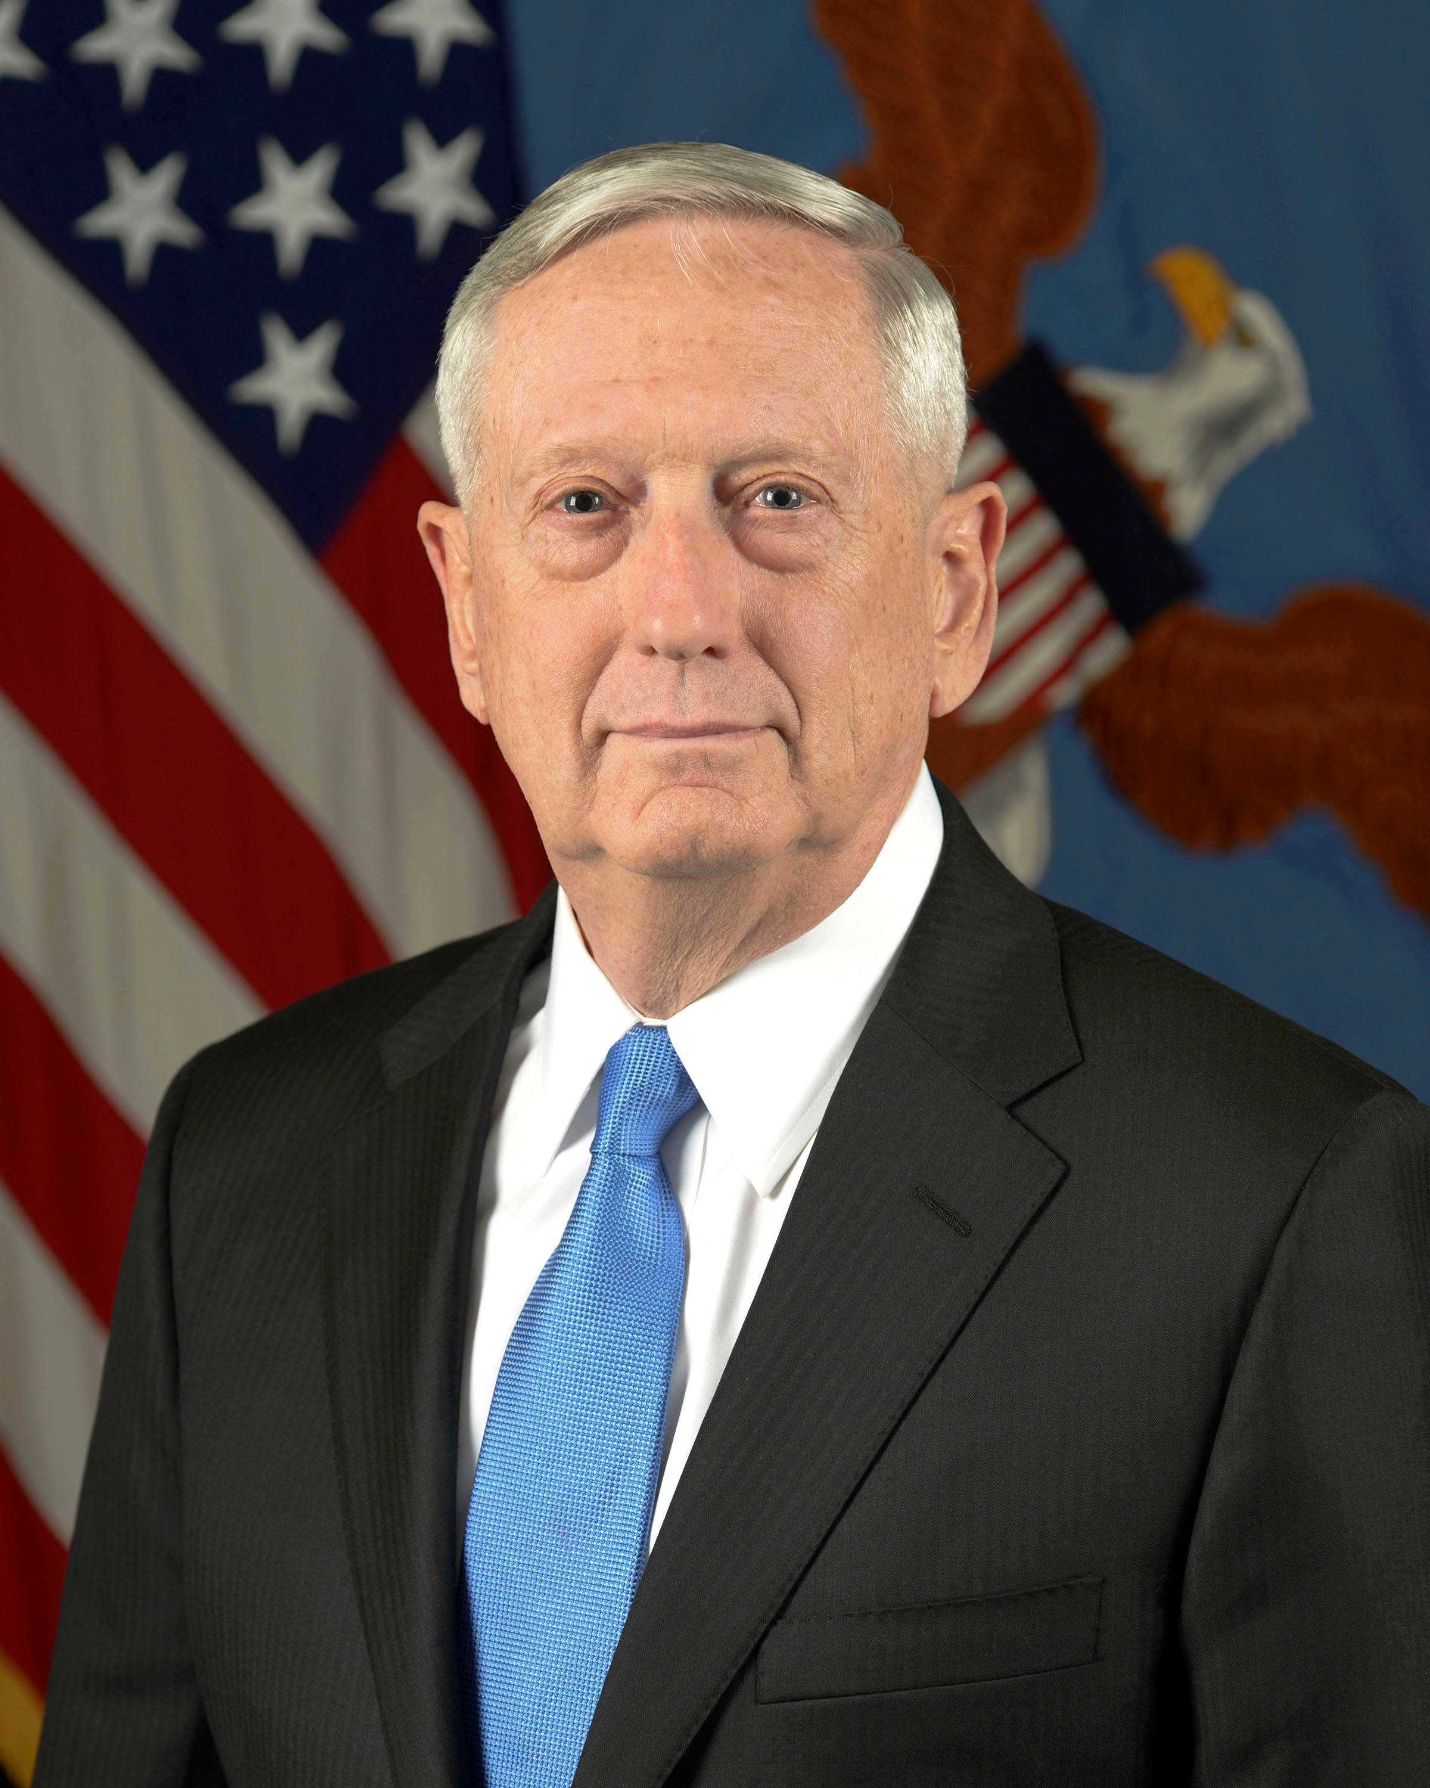
SECDEF Directive (17 FEB 17)
It is my expressed intent to field a larger, more capable, and more lethal Joint force. It is incumbent on each of us to accomplish this task in the most cost-effective, efficient manner possible. If we are to ask the American taxpayers to provide more resources to our Nation’s defense, we must do the same – by making our business operations more efficient and freeing up funds for higher priority programs.
More cost-effective, efficient
Free up funds for higher priority programs
Identify efficiencies across directed core business functions
Form cross-functional teams
2

Slide 3
Current Environment
The current environment poses several challenges to meeting the SECDEF Vision
Lack of Full Cost
Visibility
Difficulty Linking Resource Usage to Readiness Outputs
Incomplete or Unreliable Data in ERPs
Inability to Produce Auditable Financial Statements
No Common Metrics Between Command Levels
We need a roadmap to get where we need to be
3

Slide 4
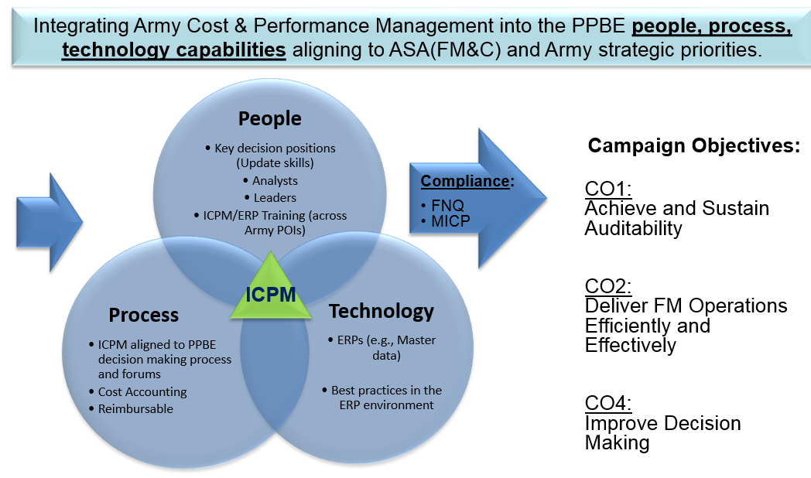
Cost & Performance Management Strategic Effort
The Cost Management Strategic Plan (CMSP) outlines the Army’s high level Cost Management goals
Financial Management Strategic Effort Focused on the cross-functional roadmap for leading change in Process, People and Technology.
4

Slide 5
ICPM Strategic Effort Overview
Integrating Army Cost & Performance Management (ICPM) enables change to people, process, technology capabilities that support FM Campaign Objectives (CO).
Governance:
Cost Management Steering Group (CMSG)
People
Technology
Process
ICPM/ERP Training (across Army POIs)
ERPs (e.g., Master data)
Best practices in the ERP environment
Cost Accounting
Reimbursable
Analysts
Leaders
ICPM aligned to PPBE decision making process and forums
Key decision positions (Update skills)
Campaign Objectives:
CO1:
Achieve and Sustain Auditability
CO2:
Deliver FM Operations Efficiently and Effectively
CO4:
Improve Decision Making
Authoritative Sources:
Title 10
17 FEB 17 SECDEF Memo
GO 1 2017-1
FMR 37-1
AR 1-1
Cost Accounting Federal Standards
Compliance:
FNQ
MICP
ICPM
5

Slide 6
CM Behaviors Link to Army Outcomes
Progress on ICPM Major Objectives Leads to Improved Army Wide Outcomes
Achieve & Sustain Audit-ready CM Process
Establish and Sustain Cost Managed Organizations (CMO)
Fully Leverage Army ERP Systems
Integrate Performance Data into PPBE
Lower Failure Rate for Audit Samples
Reduce Dollar Materiality of Audit Findings
Establish Army Cost Frameworks (ACF)
Decreased Number of Unsupported JV Transactions
Increase Percentage of Workforce Trained for ERP Job Roles
Expand Adoption of Efficiency and Effectiveness Metrics in PPBE Decision Forums
Greater Percentage of Army Costs Linked to Strategic Outcomes
Many outcomes are linked to audit readiness
6

Slide 7
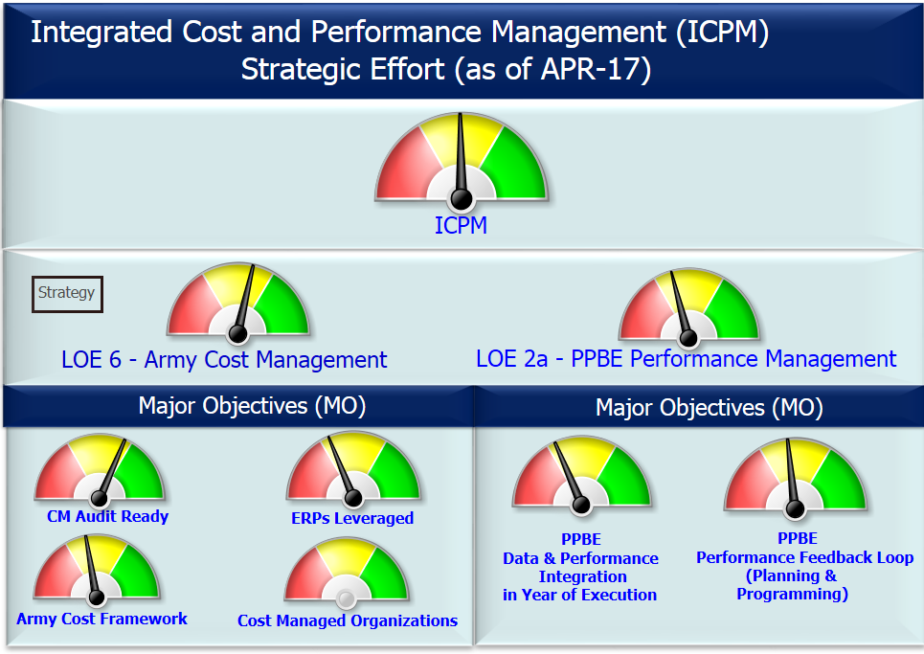
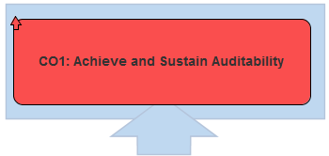
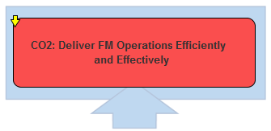
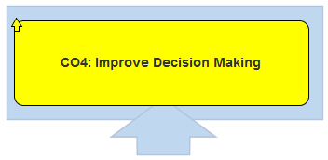
Strategic Effort Status
7

Slide 8
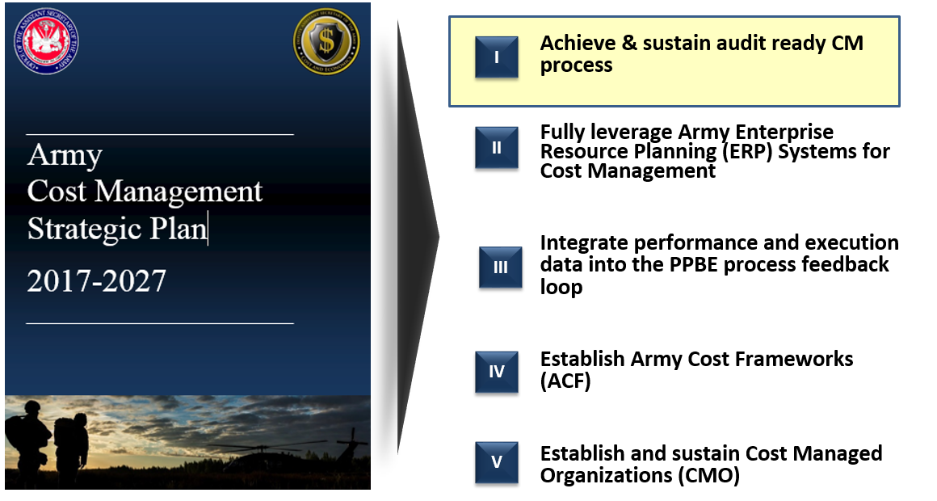
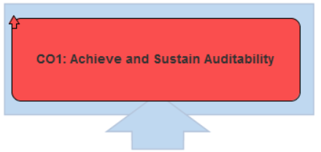
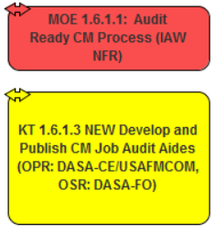
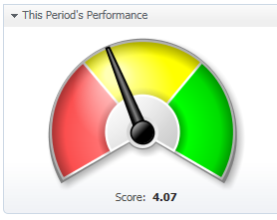
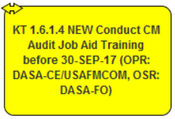
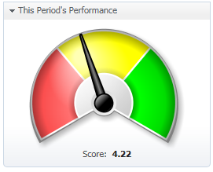
Major Objective- Execute Audit ready CM Process
Develop and Publish CM Audit Job Aides
[4/11 Complete]
CRITICAL PATH
Conduct CM Audit Job Aid Training before 30-SEP-17
8

Slide 9
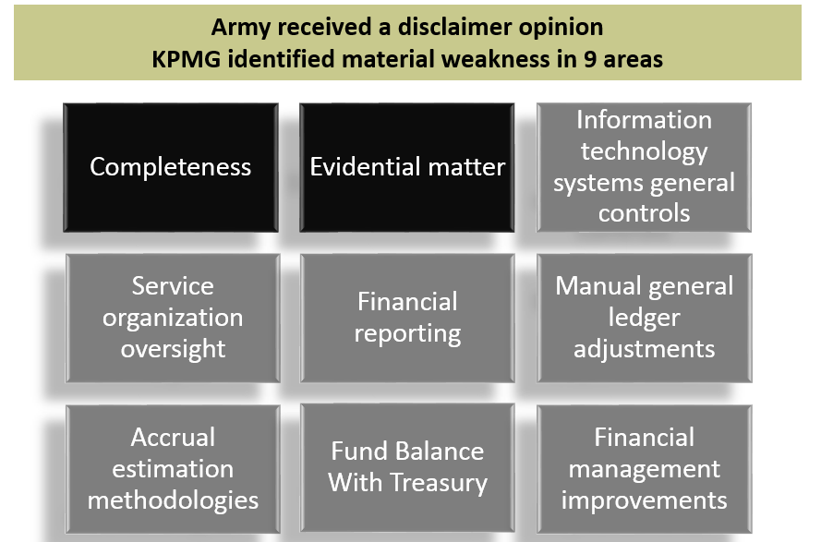
Cost Management and The Audit Process
DASA-CE has three major roles in the Audit Process
1- Building Corrective Action Plans (CAP) for Notice of Findings and Recommendations (NFR) related to Cost Management
2- Providing guidance on how to create and store Key Supporting Documentation (KSD) for auditors
3- Documenting audit-compliant Standard Cost Management Process and training GFEBS operators ICW USAFMCOM and DASA-FO
9

Slide 10
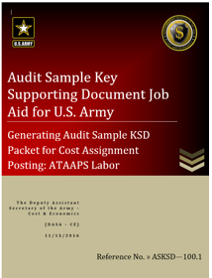
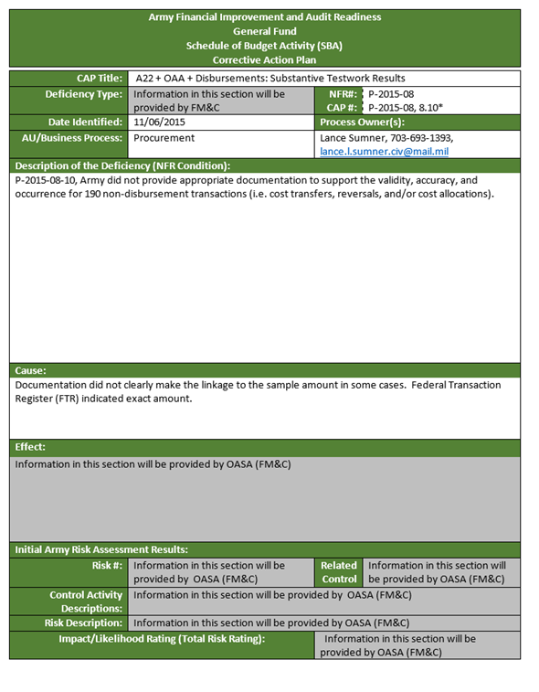
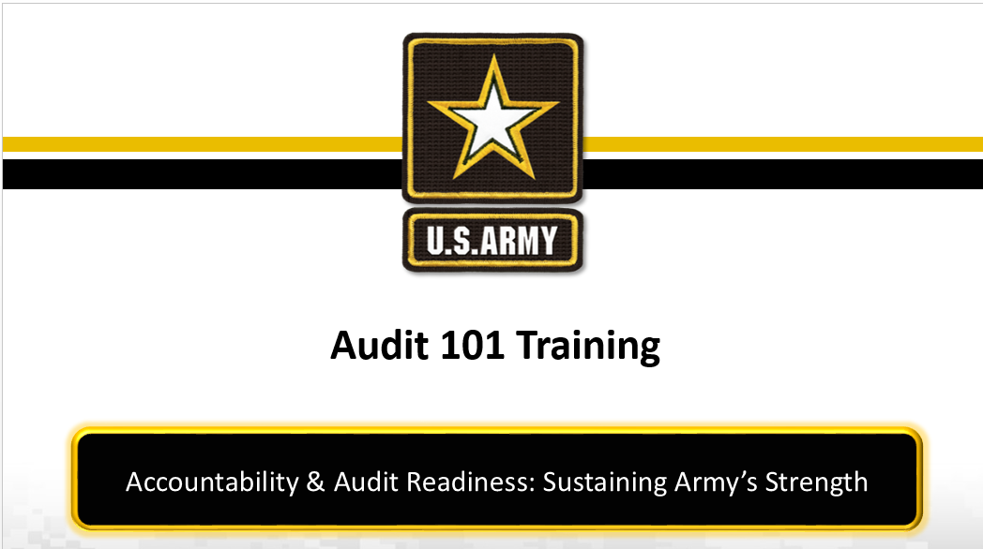
CM Audit Support - Way Ahead
Prepare KSD packets for 11 Cost Management “Use Cases”
Close CAP actions for FY15 NFRs
Perform Audit 101 training ICW USAFMCOM
Analyze FY17 audit NFRs
Implement process change before FY18 Audit
10

Slide 11
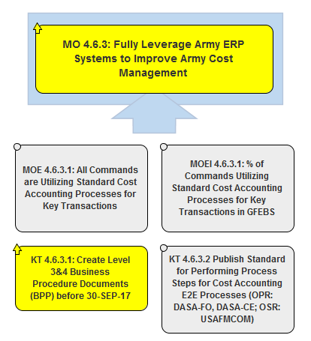
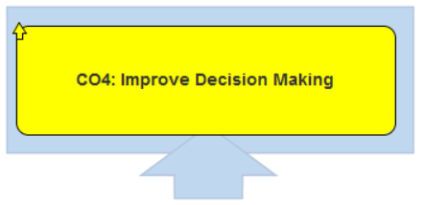
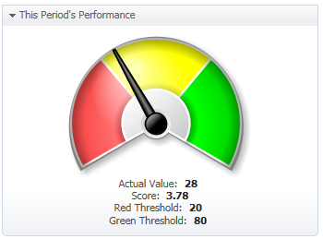
Major Objective - Leverage ERP Systems
Complete Level 3&4 Business Procedure Documents (BPP) for audit- critical Cost Accounting operations before 30-SEP. [19/64 Complete]
CRITICAL PATH
11

Slide 12
Cost Management Technology
Cost management depends significantly on timely and accurate reporting of accounting information resulting from financial transactions recorded in the Army’s Enterprise Resource Planning (ERP) systems.
12

Slide 13
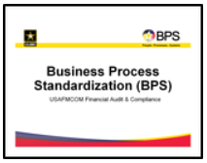
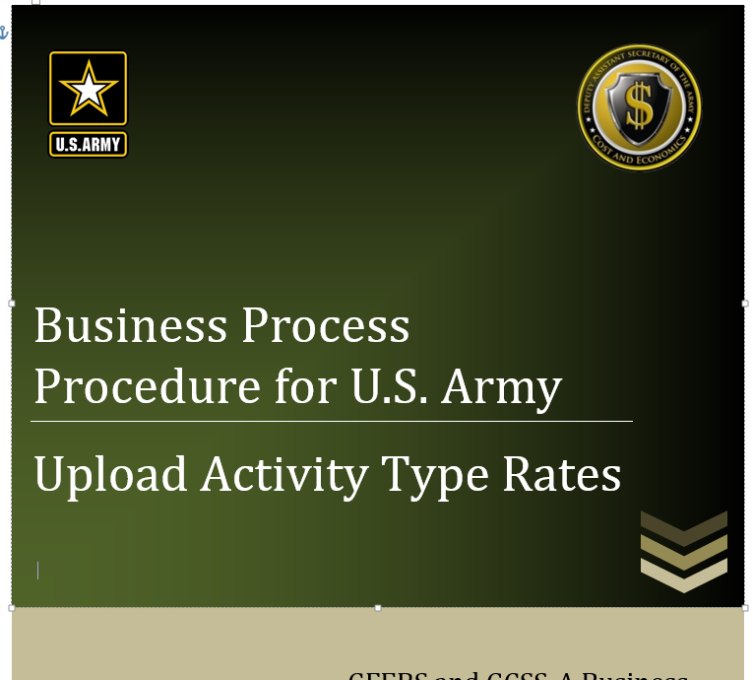
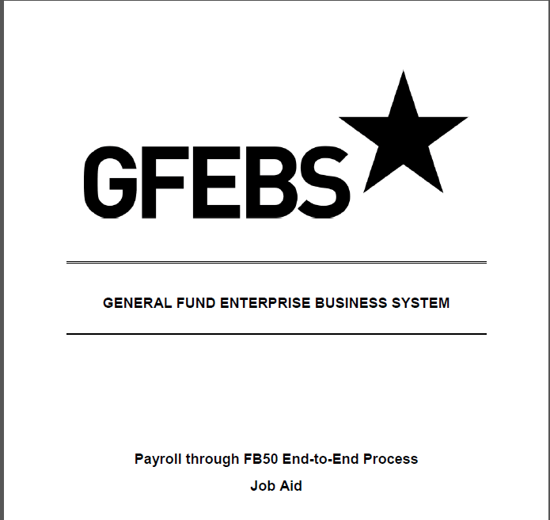
Documenting Standard Process Steps
Three Levels
Required for End to End Process Detail
Business Process Standardization Level
High Level Process View - System Agnostic
[BPS Team/With Org SME’s]
Business Process Procedures/SOP Level
Detailed System Specific Process Steps [USAFMCOM/DASA-CE]
Complete Business Process Documentation
Publish Standard Business Process Steps
Issue Compliance Instructions
Validate Compliance
Training and Process Improvement
Job Aides – Desktop Level
Detailed Transaction-Specific Steps
[USAFMCOM/System Integrator]
Standard Processes Way Ahead
13

Slide 14
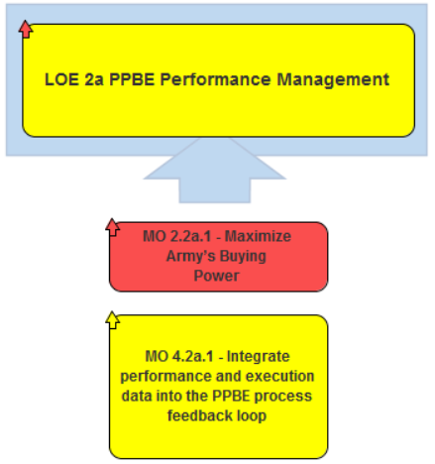
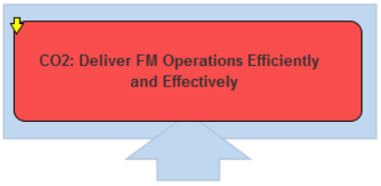
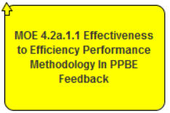
Major Objective- Integrate Performance Data into the PPBE Process
CRITICAL PATH
Develop/Pilot E2E Performance Feedback Loop [50% of Pilots Complete]
14

Slide 15
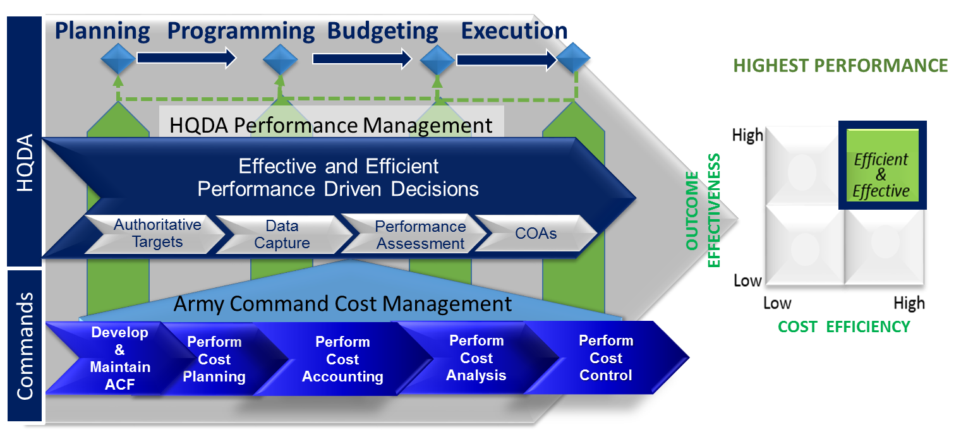
Integrating CM and PPBE Performance Management
15

Slide 16
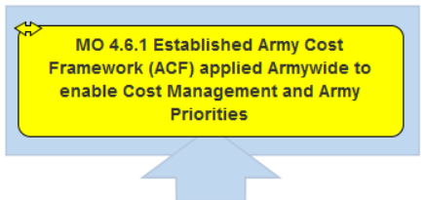
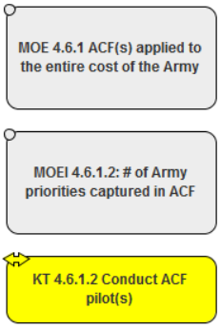
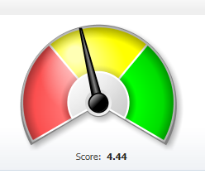
Major Objective- Army Cost Framework
CRITICAL PATH
Perform ACF Pilot Projects [7 Pilots Underway]
16

Slide 17
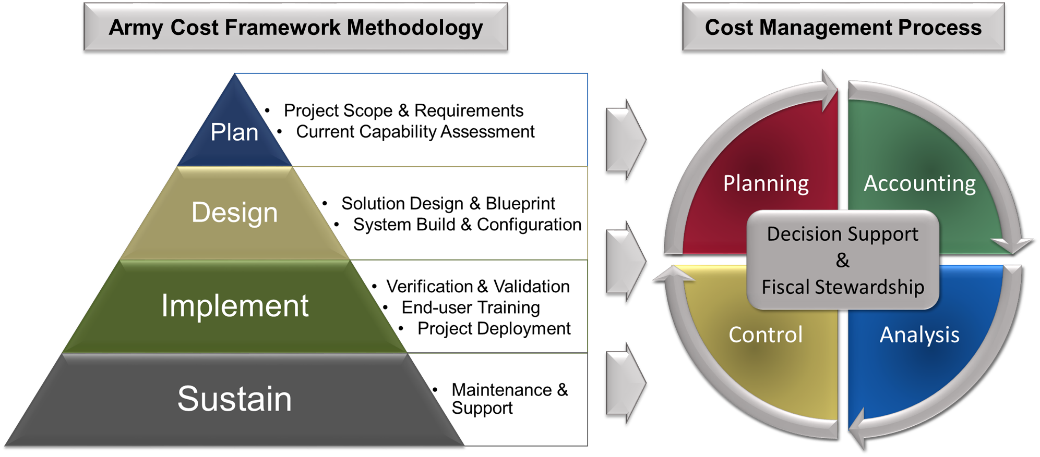
Army Cost Framework (ACF)
Enabling better cost management within ERPs
17

Slide 18
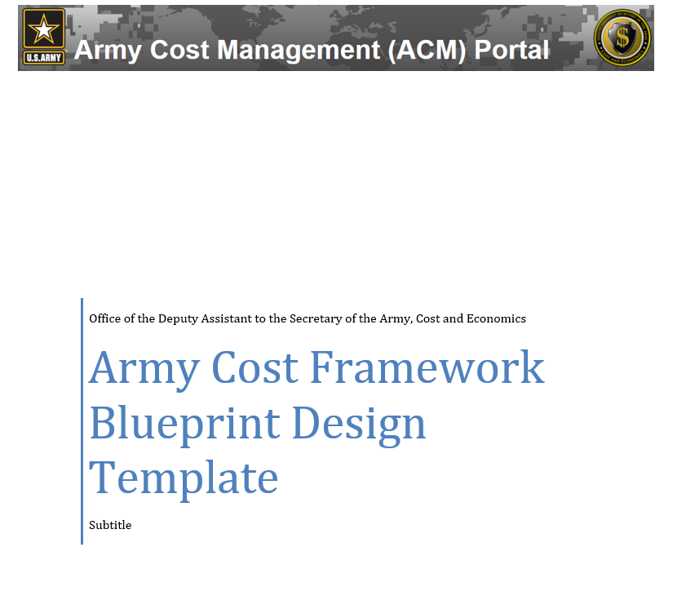
ACF Project Steps
1
PROJECT SCOPE & REQUIREMENTS
2
CURRENT CAPABILITY ASSESSMENT
3
SOLUTION DESIGN & BLUEPRINT
4
SYSTEM BUILD & CONFIGURATION
5
VERIFICATION & VALIDATION
6
END-USER TRAINING
7
DEPLOYMENT & PROJECT CLOSEOUT
8
MAINTENANCE & SUPPORT
18

Slide 19
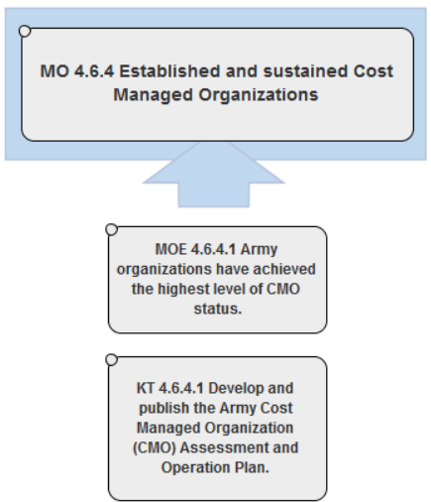
Major Objective- Cost Managed Organizations
CRITICAL PATH
Develop CMO Validation Methodology [Underway]
19

Slide 20
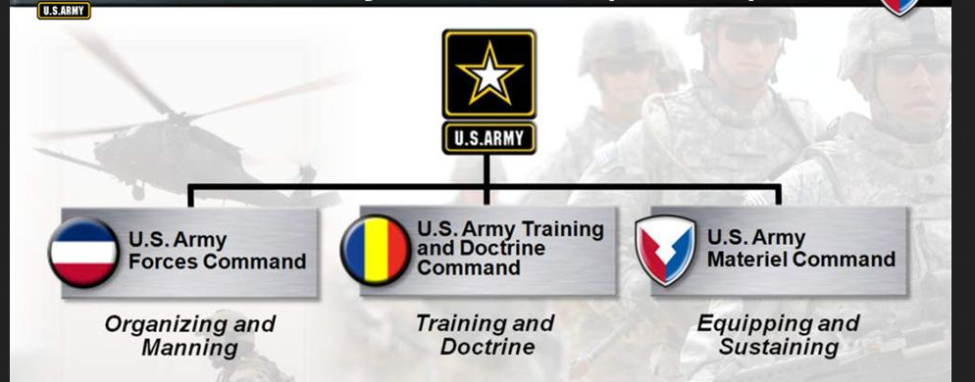
Cost Management Continuous Improvement
PPBE
Request for Cost & Performance Metrics
Reporting
Cost Managed Organizations
Utilizes Cost Management tools in the ERPs
Implements Army Cost Frameworks (ACF)
Uses Standard Cost Accounting Processes for CM transactions
Develops formal Cost Plans in the ERPs
Follows Army Cost Management best practices
Defined and assigned Cost Management roles and responsibilities
Continuous Improvement of Cost and Performance
Management
People
Technology
Workforce Development
Army Cost Framework
Outcome
Cost Management Execution
Process
20

Slide 21
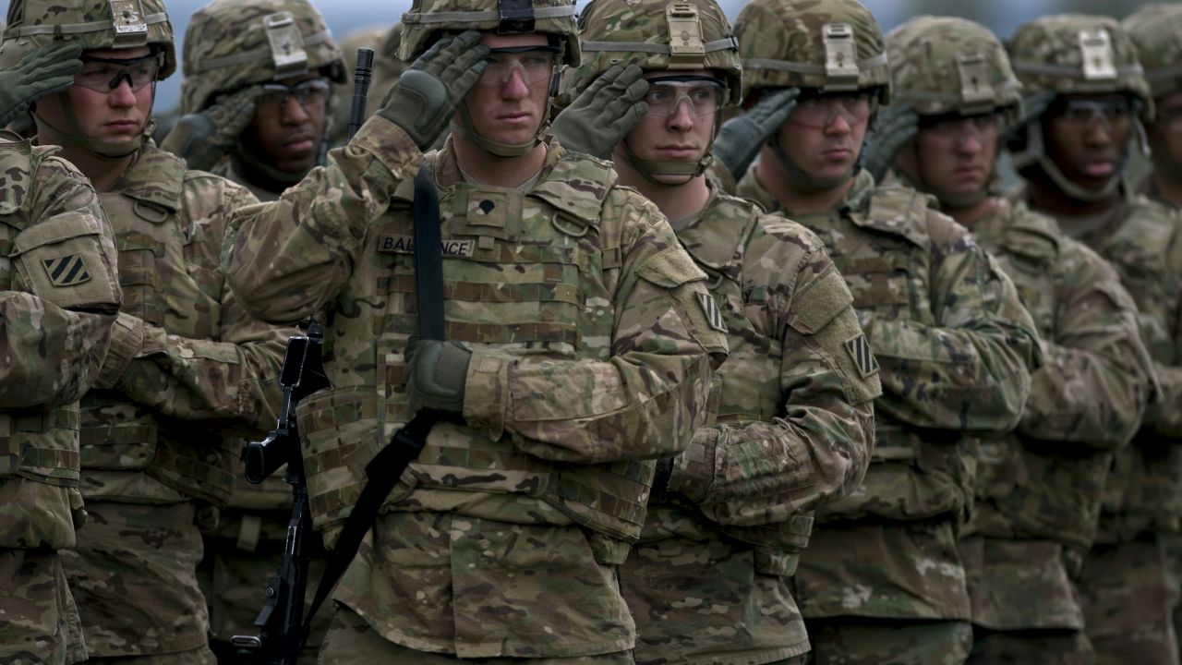
Readiness is the Driver
The “So What” of ICPM is Increased Readiness
Achieve & sustain audit ready CM process
Transforming Our Business Operations to Be More Efficient and Effective
Achieving Clean Audit Opinion
Maximizing Resources Available for Readiness
Fully leverage Army ERP systems for Cost Management
Integrate performance and execution data into the PPBE
Optimized Readiness Outcomes for Soldiers and Families
Establish Army Cost Frameworks (ACF)
Establish and sustain Cost Managed Organizations (CMO)
21

