Slide 1
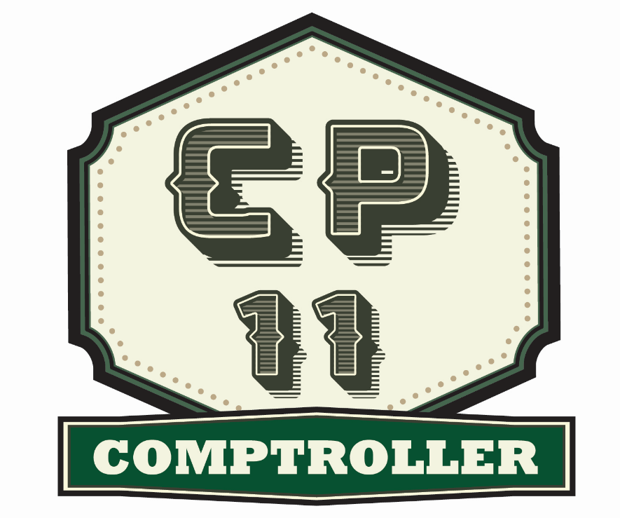
Our Resource Management Communities
Dr. Dennis Davis
Chief, CP11 Proponency Office
Deputy Chief of Staff G-8 HQDA
Ms. Beryl Hancock
Chief, CP26 Proponency Office
Deputy Chief of Staff G-1, HQDA

Slide 2
Army Resources
Money CP11 (Comptroller)
Spaces CP26 (Manpower and Force Management)
Faces CP10 (Civilian Human Resource Management)
CP50 (Military Human Resources Management)
Together, we all manage RESOURCES

Slide 3
Resource Management…
...A Dynamic Environment
In this Era of Constant Engagements, our work includes:
- Balancing Competing Funding Priorities
- Balancing Operating and Generating Forces
- Balancing Manpower (military, civilian and contractor)
- Leveraging Technology
Under Fiscal Realities, we are:
- Reconciling FY18 Budget
- Determining Planning Factors for POM 19-23
- Restructuring Organizations (Delayering; Hire Freeze)
- Actively engaging on Workforce Planning
- Building towards Audit Readiness

Slide 4
Career Program 11

Slide 14
Competencies

Slide 15
Competency Worksheet
The Technical Competencies, related to our resource management work and detailed in the respective career program ACTEDS Plan, are displayed on the worksheets. These worksheets are offered as your scoring sheet. Use the OPM proficiency levels to self-assess your level of proficiency for each competency based on your experiences, knowledge and skills. You should annotate when possible what experiences or training support your self-score.
Once you have completed this self-assessment, review your career program ACTEDS Plan.
What functional training will support and enhance your competencies?
Consider possible rotational assignments to broaden your exposure to a particular competency.
Perhaps some on-line training or professional reading will build your knowledge base.
Look for CP11 or CP26 positions in USA Jobs where you can immerse yourself in a new functional area.
Share your self-assessment with your supervisor as you review and update your Individual Development Plan (IDP).

Slide 16
Comptrollers (CP11)

Slide 17
Manpower and Force Management (CP26)
Analysis
Statistical Analysis
Computer and Software Skills
Efficiency Review and Productivity Programs
Occupational
Cost Benefit Analysis
Manpower Principles and Policies
Requirements Determination
Planning, Programming, Budgeting and Execution
Manpower Integration
Manpower Information Systems
Human Resources / Position Management
Force Development and Documentation
Strategic Sourcing
Organizational Structure
Fiscal Law
Technical Writing
Materiel Acquisition and Analysis
Internal Controls
Functional
* Competencies in BOLD are shared with CP11 and/or CP10 and CP50

Slide 18
Now Here’s the “So What”
For Dr Davis and myself, the questions are:
How do we improve our collective capabilities as resource managers?
How do we ensure we have talent ready, willing and able to step up to new challenges and new positions?
For you, as a CP11 or CP26 careerist, the questions are:
What competencies have I mastered?
What competencies do I need to advance my career?
What experience or training will enable me to close that competency gap?
What breadth of experience do I bring?
What depth of experience do I offer?
What should be the next “event” on my Individual Development Plan (IDP)?

Slide 19
Building Competencies
It is the combination of Experience, Training, Education and Self-Development that support a well-rounded career.
Look for positions that will broaden your experience (functionally, organizationally, geographically); value OJT; movement will give you a different perspective.
Focus on the Return of Value that training and education offer; put your training and education to immediate use when you return to your home station.
Remember, Self-Development is your investment in your career.
EXPERIENCE
On-the-Job Training (OJT)
Different Positions
Different
Functions
Different Organizations
FORMAL TRAINING
Self-Development
Reading,
Writing,
Self-Study
EDUCATION

Slide 20
Consider: Resource Management Training
 | CP11 / CP26
 | Planning, Programming, Budget and Execution (PPBE) Course
 | Army Comptroller Course (ACC
 | Executive Comptroller Course (ECC)
 | Defense Resource Management Course (DRMC)
 | Manager's Internal Control Program (MICP)
 | Resource Management and Budget Course (RMBC)
 | Defense Decision Support Course (DDSC)
 | Senior Resource Management Course (SRMC)
 | ASMC Professional Development Institute
CP11 |  | CP26
Financial Management Certification |  | Manpower and Force Management Course
Defense Financial Management Course (DFMC) |  | Capabilities Development
Certification Defense Financial Management (CDFM) |  | How the Army Runs (HTAR) Course
Defense Comptrollership Program (DCP) |  | ORSA Military Applications Course (ORSA MAC)
 |  | FA50 Qualifications Course
 |  | Defense Resource Management Course (DRMC)
 |  | Force Management Orientation Course (FMCOC)
 |  | Combat Training, Doctrine Developers Integration Course (CTDDIC)
 |  | Risk Management
 |  | FA49 Qualifications Course
 |  | Human Capital Resource Management (HCRM)
 |  | Mulit-Criteria Decision Making Course
 |  | Introduction to Budgeting Concepts
Training we have in common

Slide 21
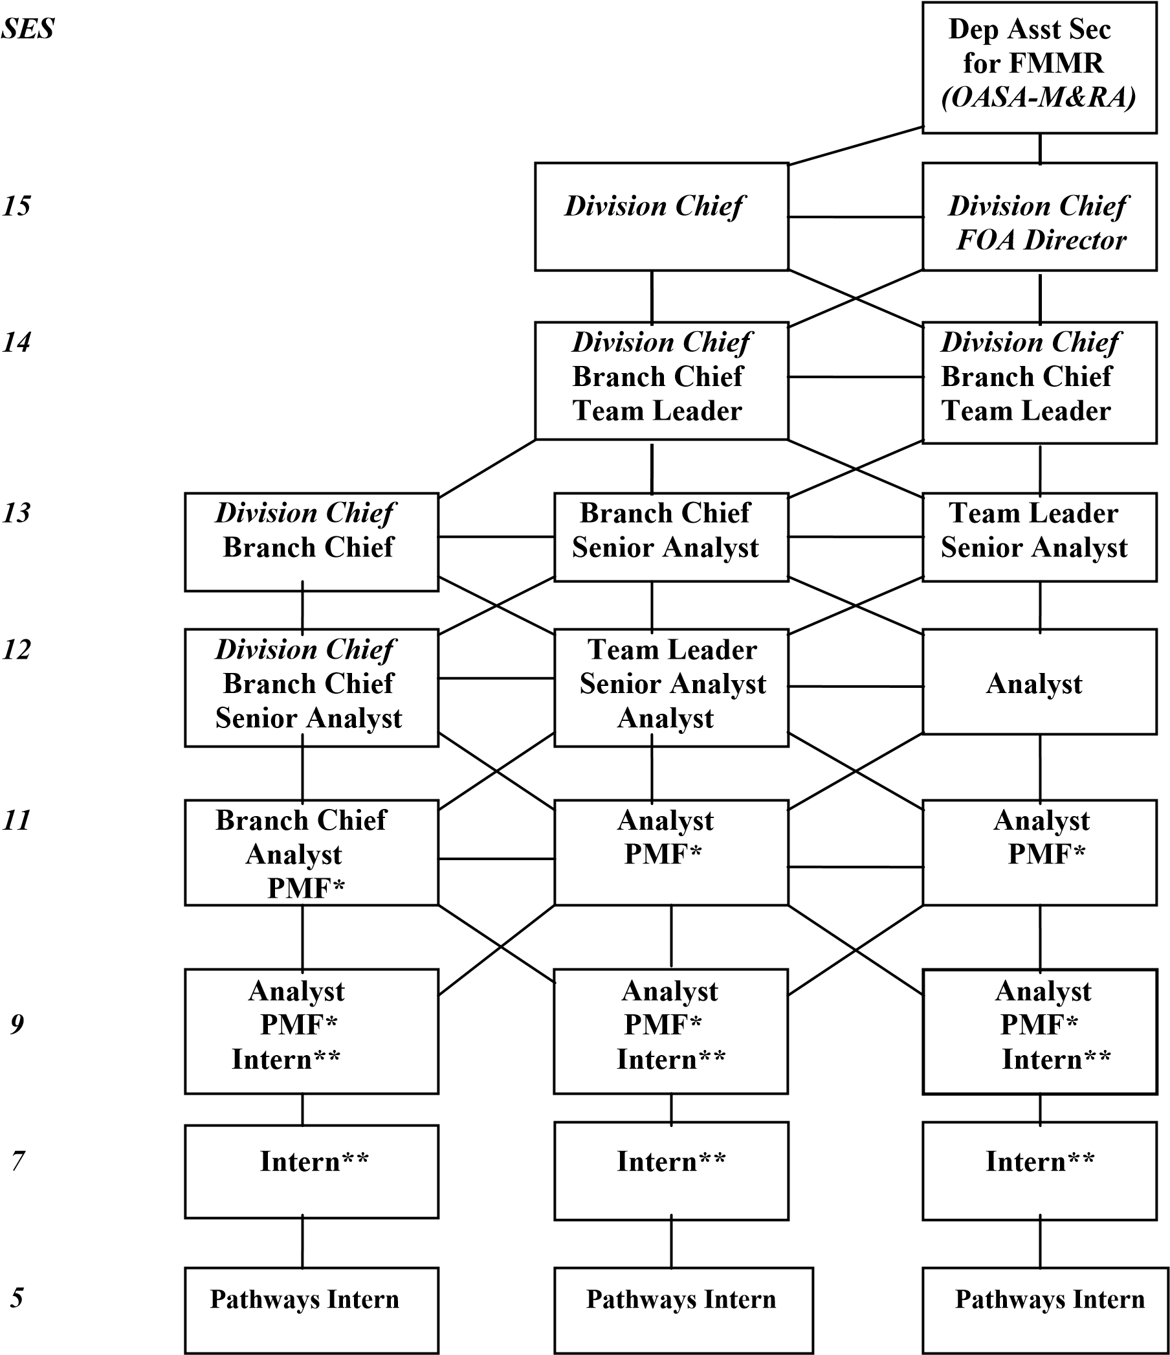
Career Ladder – Mobility is a Factor
Mobility – both organizational and geographic – bring opportunities to build breadth of experience.
Based on personal career goals, mobility – be it up, down, or lateral – and can refresh, renew and reset direction.
Installation ACOM/ASCC/COCOM HQDA/FOA/DRU
Subordinate Command

Slide 22
Mapping Experience: Breadth and Depth
CP26
Function
PPBE
Organizational Documentation
Allocation & Reporting
Capabilities Developments
Requirements Determination
General Manpower Management
Equipment Management
Force Structure
Organization, Mission & Function
Organizational Level
Garrison / Installation
MSC
ACOM
ASCC
ARSTAF
Army Secretariat
Joint/Defense staff
OSD
CP11
Functions
Auditing
Accounting
Budgeting
Acquisition & Contracting
Managerial Services
Position
Intern
Analyst
Team Chief
Senior Analyst
Branch Chief
Division Chief
Command
HQDA / OA22 / FOA ARCYBER
/ DRU / SSA NETCOM
FORSCOM MEDCOM
TRADOC INSCOM
AMC CIDC
USAREUR COE
USARCENT MDW
USARNORTH ATEC
USARSO USMA
USARPAC ARCYBER
USARAF USARC
USASOC ASC
IMCOM NGB
SMDC / ARSTRAT COCOMs
Defense / Joint OSD
Where You Sit, A Different Perspective. Growth.

Slide 23
“Own Your Career”

Slide 24
Civilian Toolkit
Official Personnel Folder (eOPF)
Find and review your eOPF in the CPOL Employee Portal: https://acpol.army.mil
31 Civilian Career Programs with ACTEDS Plans
Review your Career Program ACTEDS Plan: http://cpol.army.mil/library/train/acteds/
Army Career Tracker (ACT)
Log-in to Army Career Tracker: https://actnow.army.mil
Civilian Education System (CES)
Review CES opportunities at: http://www.civiliantraining.army.mil
Enterprise Talent Management (SETM / ETM / EEL)
Access the CSLDO site : https://www.csldo.army.mil
GoArmyEd
Set up your GoArmyEd account for training opportunities: https://www.goarmyed.com/
G. Acculturation
Review TRADOC’s site: http://www.tradoc.army.mil/dcspil/Acculturation/

Slide 25
What’s Next ?
The 4 R’s = RESTART – REFLECT – RESEARCH – REFRESH
Take ownership. It is your career. Determine where you want
to go.
2. This requires thinking about your career. Identify and
understand your preferences, and recognize that your preferences
may likely change over time.
3. Look in the rear view mirror.
Where have you been (breadth)?
What have you learned and accomplished (depth)?
4. Complete a Technical Competency: Self-Assessment.
5. Complete a Professional Competency: Self-Assessment.
6. Set your direction.
7. Build your IDP, identifying professional development.
8. Rewrite your resume.
9. Set filters on USA Jobs for positions or locations that will enable
you to build your competencies.

Slide 27
Set Your Direction: Your Move
Develop your Individual Development Plan (IDP) in Army Career Tracker (ACT).
This is an often over-looked exercise but it is a game plan, your game plan, and one that
you and your supervisor can put into play.
With your competency self-assessments in hand, review the your ACTEDS Plan. Identify
the training that will enhance your skills today and prepare you for tomorrow.
Is there training that you need that is not in you ACTEDS Plan? Remember, training
can be funded by:
- Your organization
- Career Program Competitive Professional Development (CPD) program
- DA centrally managed Programs
You
Prepare yourself for those positions you may want to pursue. Review announcements
to see how the positions and skills are addressed. Identify the competencies and/or
experiences expected for these positions.
Make your IDP a “LIVING” document.

Slide 28
Set Your Direction (continued)
Keep your skills fresh.
While you are working your IDP and waiting for the next functional classroom
training, complete the on-line, no-cost basic training first. Regardless of
your career goals, this training will keep your skills fresh and may prepare you for
other opportunities.
Resource Management and Budget Course (RMBC)
Manager’s Internal Control Program (MICP)
Explore other training options through Army Learning Management System
(ALMS), Skillport, or Khan Academy. You will find courses to advance your
Microsoft skills or writing abilities. Check out “TED Talks” or YouTube videos to
stir up your gray cells. Consider free college courses through sites like Coursera.
Are you uncomfortable giving a speech? Join Toastmasters.
Maintain your “Currency.” Remain knowledgeable of your environment.
Read the Army Posture Statement and The Army Plan (TAP).
Join a professional organization to broaden your skills and network
American Society of Military Comptrollers (ASMC)
US Organizational Managers Association (USOMA)

Slide 29
Set Your Direction (continued)
Focus on your leadership skills through the Civilian Education System (CES).
CES is often a prerequisite for more advanced training opportunities like
Enterprise Talent Management (ETM) and Senior Enterprise Talent Management
(SETM).
Seats in the residential portion are often difficult to secure. At a minimum, complete the distributed learning portion of the course appropriate for your current grade level.
Build experience. There are two factors here: Breadth and Depth.
Changing jobs is an important factor in building experience, competencies and
qualifications.
Staying on one position too long, with no significant increase in duties or responsibilities, limits your breadth of experience.
Conversely, frequent job changes every year or year-and-a-half can compromise your depth of
experience.
If you are geographically immobile, look to organization changes or cross-
functional opportunities.
Visit the USA Jobs website often to see what opportunities exist. Use the filters
available on the site to receive notices of opportunities.

Slide 30
Set Your Direction (continued)
Stretch yourself.
Step out of your comfort zone. Refer to the Professional Development
Pyramids to understand some of chances you have to volunteer and learn.
Take on a “Transformational” tasking or assignment. Put yourself in a learning
situation.
You have much to gain, from networking and coordinating up, down and across
your organization.
Consider the value of Education. While college degrees are not a requirement of Management Analysts, attaining a degree shows commitment to life-long learning and accomplishment.
Review your Suggested Career Development Guide. What in this guide works for you? Build your own career development guide. Be sure to address the four elements that support professional growth: Experience (through OJT), Training, Education and Self-Development.

Slide 31
Questions?
Dr. Dennis Davis dennis.k.davis.civ@mail.mil
Ms. Beryl Hancock beryl.a.hancock.civ@mail.mil

