Slide 1
National PDI Army Service Day 31 May 2017
Audit Readiness and Critical Initiatives in Financial Operations
Office of the Assistant Secretary of the Army (Financial Management & Comptroller) (OASA(FM&C))

Slide 2
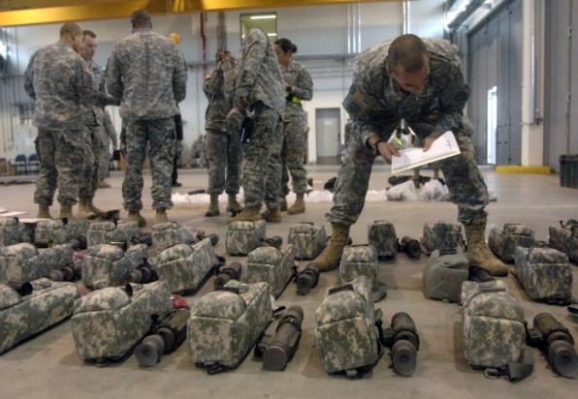
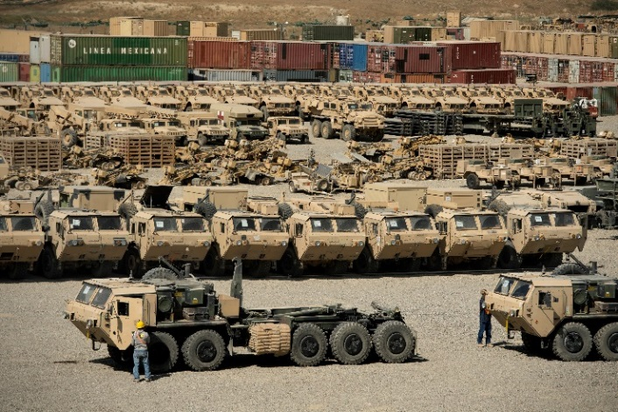
Audit Readiness Is Mission Readiness
Who is responsible?
Everyone has a role, especially leadership
Cross functional and Army wide
What is Audit?
Doing daily functions right
Substantiated transactions
Balanced checkbook with Treasury
Controls: management, systems, access
When:
FY18 - First complete audit
Where:
Across the Army
General Fund & Army Working Capital Fund

Slide 3
Benefits of Audit Readiness
Improves Decision Support
Improves accuracy of fiscal information
Improves forecasting
Improves spending oversight
Improves use of resources
Increases Public Trust
Validates good stewardship
Financial information is accurate, reliable & timely
Enhances Public & Congressional trust
Complies with Laws
CFO Act 1990
NDAA 2010

Slide 4
Audit Beginning Balance Strategy
Property line item | Beginning Balance Strategies
Fund Balance with Treasury (FBwT) | Using post-GFEBS era data (FY 2013 onward), utilize the Army FBwT Tool (AFT) to support each year’s beginning balance with transaction-level detail that reconciles between Army accounting and US Treasury Ensure key supporting documents are made available to support the transaction-level detail for all years that contribute to the beginning balance under audit
General Equipment (GE) | Using budget documentation to estimate full acquisition costs in accordance with SFFAS 50 Budget documentation readily available for major acquisition programs Where key supporting documents are missing, using allowable methodologies to estimate data elements (e.g., Placed-in-service date)
Operating Materials & Supplies (OM&S) | In accordance with SFFAS 3, using Latest Acquisition Cost (LAC) for beginning balances By Oct. 2018, will transition to Weighted Average Cost (WAC) Using allowable estimation methodologies where key supporting documentation missing (e.g., like-kind)
Real Property (RP) | Using Real Property data elements to derive the Plant Replacement Value (PRV) Where key supporting documents are missing, using allowable methodologies to estimate data elements (e.g., Placed-in-service date)
Environmental & Disposal Liabilities (E&DL) | Using Cost-to-Complete packages for each liability to drive beginning balance Relying primarily on similar sites to determine liability Applying more scrutiny to liabilities where professional judgment is used as the primary estimation methodology

Slide 5
FY17 Audit Priorities
Universe of Transactions (UoT) Reconciliation
Posting Logic and Data Categorization
Fund Balance with Treasury (FBwT)
Audit Management and Governance
1
Information Technology General Controls
(ITGC)
2
Journal Vouchers (JVs) and
Financial
Reporting
3
Budget Execution Process Improvement
4
Existence and Completeness
(E&C)
5
Asset Valuation
6
Environmental and Disposal Liabilities
(EDL)
7
8
9

Slide 6
Status and Progress
FY17
Disclaimer
Adverse
Modified
Unmodified**
Status
Progress
Interim Universe of Transactions
Fund Balance with Treasury
Military Pay
FY 17 Statement Budgetary Resources
Single Line Audits
General Equipment
Real Property
Operations, Materials, & Supplies
An Army-wide audit is a massive effort in size and scope;
this is an ongoing requirement that will take time to complete.
6
Notes:
Progress and status
FY17 SBR and balance sheet areas
OM&S

Slide 7
Institutional Challenges for the Army
There are Army-wide challenges that we continue to face:
Inefficient system controls that increase the sample sizes that auditors ask for
Legacy feeder systems and business processes that do not support audit requirements
Synchronization with service providers
Competing priorities
Sustainment challenges
The Army is working across its organization to address these challenges
Notes:
Inefficient system controls
Outdated systems and processes that are not properly configured or mated to audit platforms
Third-party service providers with different practices and standards
Competing priorities: the audit is hardly the Army’s only ongoing activity

Slide 8
The Way Ahead
Complete an audit of the full Statement of Budgetary Resources in FY17
Conduct valuation of property, plant and equipment
Continue to hold ourselves and our teams accountable for corrective actions
Establish and implement strong internal controls for the physical inventories of assets
Enhance governance, outreach and communications
Establish central location for data to support reconciliation of financials with feeder systems
Continue to enhance partnerships with stakeholders
Complete validation and execution of FY15/FY16 corrective actions for Schedule of Budgetary Activity
Continue standardizing business processes across the Army
Expand technical skills for a proficient work force

Slide 9
Next Steps After 30 September
FY18
Beyond
Review and design cost reporting structure with detailed cost component
Perform an analysis of actual financial and operational data
Review and develop data integration approaches
Identify owners for data collection and maintenance
Collect available operational data to build costs drivers
Assign costs to categories, requirements and outputs
Define clear performance metrics and measures
Assign outputs to outcomes
Develop cost relationships and identify cost drivers
Document methodologies and allocations
Design and develop associated cost models
Align cost and performance information with strategic goals and objectives
Link costs to performance metrics and measures, outputs and outcomes
Integrate cost and performance data with Federal Budget/PPBE process to inform programming of future years’ requirements
Analyze costs, outputs and outcomes to measure performance
Compare actuals with budget allotment, programmed amounts and planned outputs
Review and design cost analytics including business process analysis and benchmarking of costs and performance
Define management and executive reports
Monitor costs against performance to meet goals and objectives
Review and develop processes to balance actuals with budget and programmed amounts
Analyze performance and costs against planned goals and objectives
Plan future years’ requirements using integrated cost and performance information

