Slide 1
DOD FM CERTIFICATION
Army Proponency Office
Mailbox: USARMY Pentagon HQDA ASA FM Mailbox DOD Certification
https://fmonline.ousdc.osd.mil/

Slide 2
CP-11 Population Overview
Occupational Series and Description | FY12 3rd Qtr Appropriated Funds US Citizen | FY12 3rd Qtr Foreign National | FY12 3rd Qtr Totals | FY13 4th Qtr Appropriated Funds US Citizen | FY13 4th Qtr Foreign National | FY13 4th Qtr Totals | FY14 4th Qtr Appropriated Funds US Citizen | FY14 4th Qtr Foreign National | FY14 4th Qtr Totals
89 Emergency Management |  |  | 0 | 1 |  | 1 | 1 |  | 1
110 Economist | 21 |  | 21 | 20 |  | 20 | 19 |  | 19
199 Social Science Student Trainee |  |  | 0 | 1 |  | 1 | 2 |  | 2
301 Misc. Administration and Program | 113 | 2 | 115 | 244 | 2 | 246 | 249 | 3 | 252
303 Misc. Clerk and Assistance | 3 | 1 | 4 | 4 |  | 4 | 4 | 3 | 7
318 Secretary |  | 1 | 1
340 Program Management | 8 |  | 8 | 20 |  | 20 | 18 |  | 18
343 Management and Program Analysis | 2,884 | 7 | 2,891 | 2,702 | 9 | 2,711 | 2,556 | 9 | 2,565
344 Management Clerical and Assistance | 10 | 1 | 11 | 14 | 1 | 15 | 14 | 2 | 16
399 Admin & Office Spt. Student Trainee | 9 |  | 9 | 6 |  | 6
501 Financial Administration and Program* | 1,569 | 24 | 1,593 | 1,532 | 27 | 1,559 | 1,506 | 25 | 1,531
503 Financial Clerical and Assistance | 320 | 21 | 341 | 290 | 32 | 322 | 258 | 32 | 290
505 Financial Management | 145 |  | 145 | 138 |  | 138 | 137 |  | 137
510 Accounting* | 1,425 | 42 | 1,467 | 1,394 | 45 | 1,439 | 1,004 | 40 | 1,044
511 Auditing* | 571 | 2 | 573 | 537 | 2 | 539 | 843 | 5 | 848
525 Accounting Technician | 308 | 126 | 434 | 270 | 121 | 391 | 257 | 120 | 377
530 Cash Processing | 52 | 12 | 64 | 49 | 10 | 59 | 50 | 11 | 61
540 Voucher Examining | 21 | 19 | 40 | 15 | 19 | 34 | 14 | 19 | 33
544 Payroll | 100 | 30 | 130 | 93 | 28 | 121 | 93 | 28 | 121
545 Military Pay | 129 | 13 | 142 | 126 | 11 | 137 | 121 | 10 | 131
560 Budget Analysis* | 3,752 | 306 | 4,058 | 3,519 | 298 | 3,817 | 3,470 | 296 | 3,766
561 Budget Clerical and Assistance | 335 | 55 | 390 | 260 | 43 | 303 | 235 | 41 | 276
592 Tax Examining |  |  | 0 | 0 |  | 0
599 Accounting Student Trainee | 90 |  | 90 | 34 |  | 34 | 46 |  | 46
896 Industrial Engineering | 2 |  | 2 | 2 |  | 2
899 Engineering and Arch. Student Trainee | 25 |  | 25 | 5 |  | 5 | 2 |  | 2
1160 Financial Analysis | 5 |  | 5 | 2 |  | 2 | 2 |  | 2
1199 Business and Industry Student Trainee | 9 |  | 9 | 2 |  | 2 | 2 |  | 2
1515 Operational Research Analyst | 395 |  | 395 | 362 |  | 362 | 337 |  | 337
1520 Mathematics | 2 |  | 2 | 2 |  | 2 | 1 |  | 1
1530 Statistician | 11 |  | 11 | 11 |  | 11 | 9 |  | 9
1531 Statistician Assistant | 1 |  | 1 | 1 |  | 1 | 1 |  | 1
Totals | 12,315 | 662 | 12,977 | 11,656 | 648 | 12,304 | 11,250 | 644 | 11,894
* Mission Critical Occupations are considered core to achieving the mission. Such occupations usually reflect the mission-critical work of the organization.

Slide 3
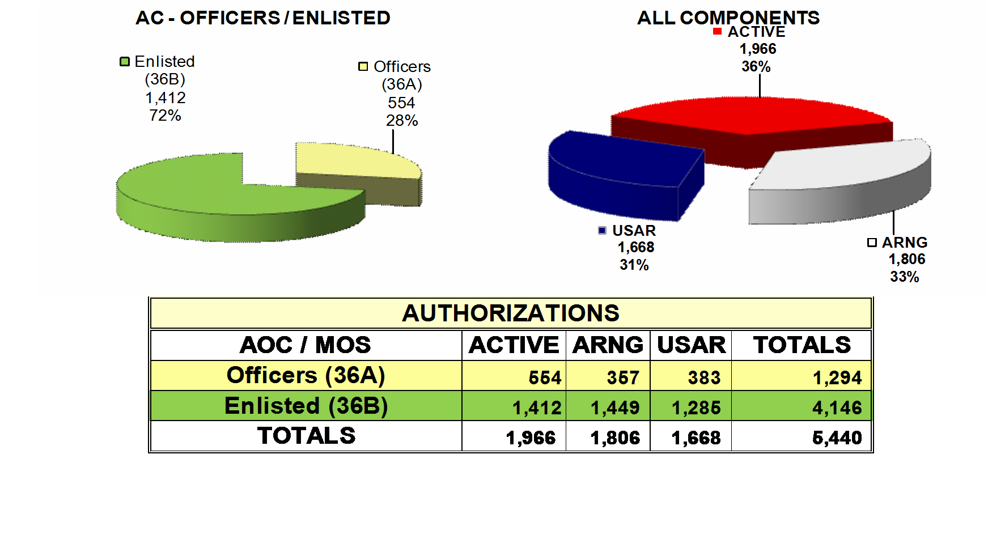
Financial Management (Military)
Officer and Enlisted (36A and 36B) – (A/O JAN 2015)

Slide 4
Agenda
Opening Remarks
DoD FM Certification Program
How to Use FM myLearn to course searches
Learning History Worksheets
Demo of Three Step Process
How to redact PII in Adobe PDF
Review of the 12 common errors for Certification Rejection
How to run User Reports in LMS
Online Resources
Closing Remarks

Slide 5
FM Certification Program Background
The National Defense Authorization Act for Fiscal Year 2012 (Public Law 112-81) provided the Secretary of Defense with the authority to prescribe professional certification and credential standards
To achieve auditable financial statements and provide DoD with a strong, well-trained financial management (FM) workforce
While good training programs existed, DoD did not have a framework to guide FM workforce training and emphasize key types of training such as audit readiness and decision support
In early 2011, senior DoD FM leadership initiated efforts to develop a DoD FM certification program
NDAA authorized the program & DoD FM leaders created the policy.
Notes:
The National Defense Authorization Act (NDAA) for Fiscal Year (FY) 2012 (Public Law 112-81), provided DOD the authority to prescribe certification and credential standards for the financial management community.

Slide 6
Certification Program Purpose and Background
Establish a framework to guide DoD FM professional development
Intent is to make a good FM workforce even better!
  Encourage career broadening and leadership
  Ensure financial management workforce has knowledge, skills, and abilities necessary to achieve auditable financial statements
Organize professional development efforts with relevant FM and leadership competencies
The National Defense Authorization Act for Fiscal Year 2012 (Public Law 112-81) provided the Secretary of Defense with the authority to prescribe professional certification and credential standards.

Slide 7
Program Foundation: Competencies
Goal: To implement standardized financial management competencies that describe the knowledge, skills and abilities needed to perform and achieve desired results.
Competencies defined by FM Senior Working Group:
  Comprised of FM subject matter experts (SMEs) from Military Departments and Defense Agencies
  23 DoD FM enterprise-wide competencies*
    Competencies defined and 5 levels of proficiency identified for each
    Competencies are mapped to the various Occupational Series
  17 of the 23 are applicable to DoD FM certification program*
DoD leadership competencies also emphasized
  5 levels of leadership on the DoD Leadership Continuum
* Listed in the backup slides
Notes:
The foundational framework for the Program is the set of 23 enterprise-wide financial management competencies, associated proficiency levels, and selected leadership competencies. The Program will ensure that the FM workforce has the requisite FM knowledge, skills, and abilities to perform effectively in all FM career series. The Program also provides a mechanism to ensure that the FM community is meeting critical training requirements in areas such as auditable financial statements, fiscal law, and decision analytics. The DOD FM Certification Program is a long-term workforce development initiative. FM workforce members have two years to achieve initial certification and are required to maintain certification for the entire duration of their FM career.

Slide 8
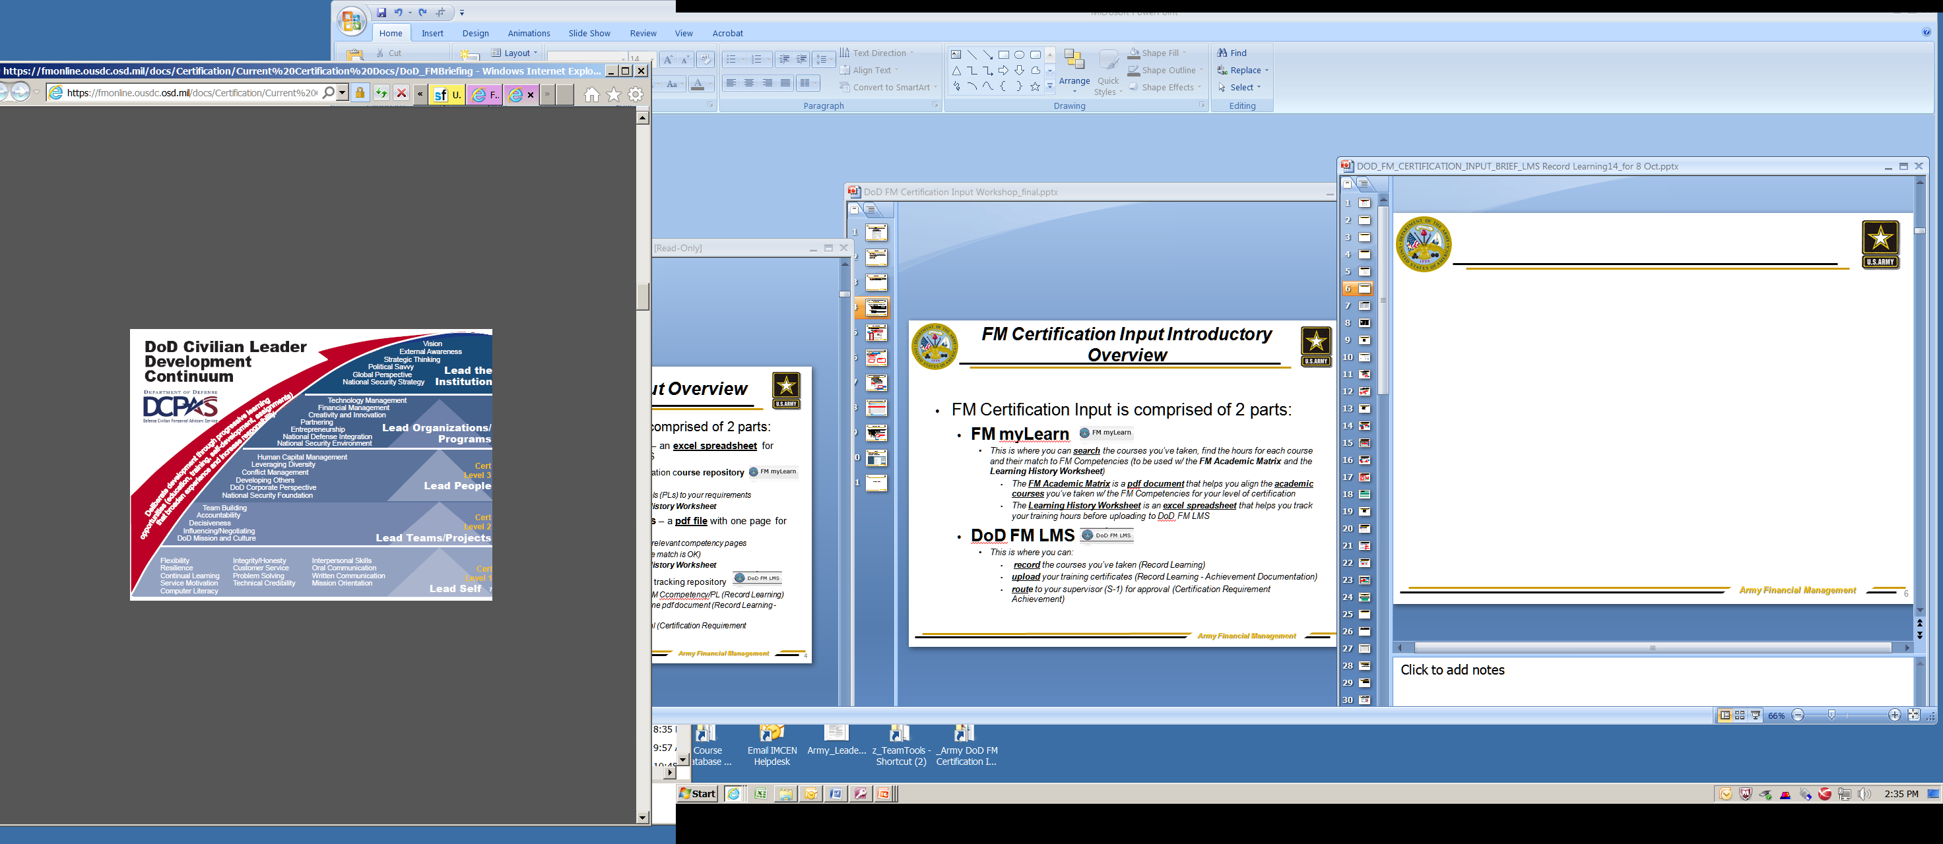
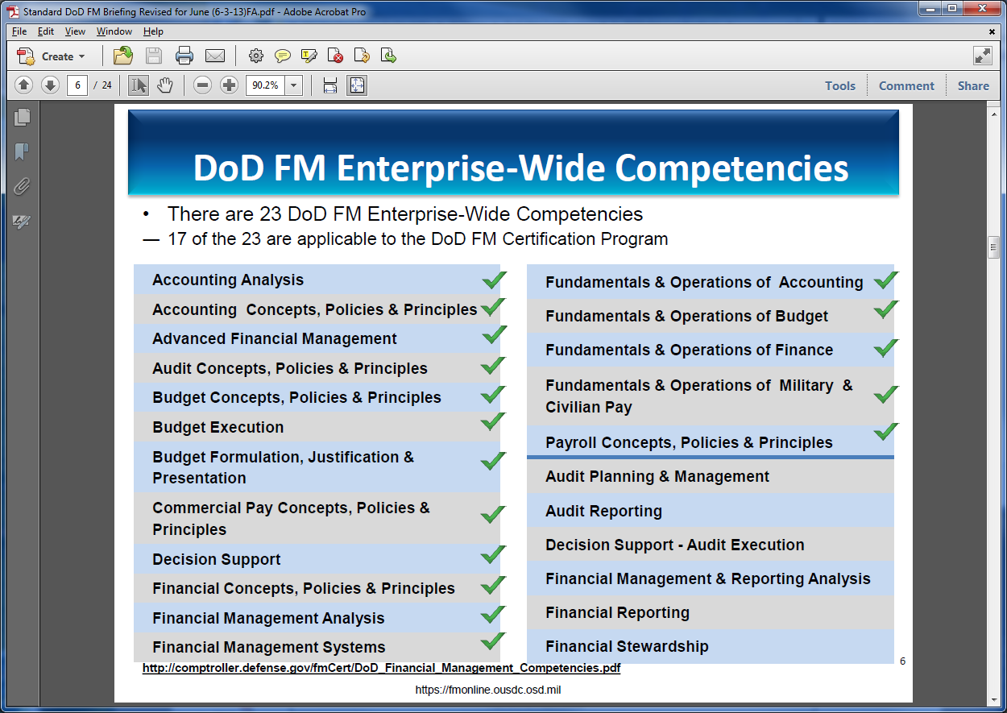
What are DoD FM Certification Program Competencies?
17 of 23 Enterprise-wide FM competencies were mapped to the 05XX Series by the DoD Senior Working Group (SWG)
DoD Leadership competencies
23 FM Enterprise-wide Competencies established by the DoD FM Senior Leadership Group (SWG)
ü
ü
ü
ü Apply to DoD FM Certification Program FM and Leadership competencies.
Notes:
Only checked competencies are used by the Cert program.
How was it determined that the newly established FM Certification Program would include 17 of the 23 enterprise-wide FM competencies?
The Senior Working Group (SWG), which developed the conceptual framework for the DoD FM Certification Program, determined which FM competencies and associated proficiency levels would be required for each certification level. Factors considered in their selection of specific competencies were
the universal or enterprise-wide requirement for the competency;
the emphasis on improved analysis; and
the “broadening” guidance, i.e., to ensure that all employees are trained in other than their respective primary occupational series or specialties.

Slide 9
Army Level Guidelines
DoD FM certification levels link grade with job knowledge and complexity
Program is position based and each participant must be assigned a level
General guideline for designating certification level of positions with leadership discretion as needed
Guidance from DTM
Level | Officer | Enlisted | Civilian *
1 | 01-02 | E1-E4 | GS1-GS8
2 | 03-04 | E5-E6 | GS9-GS13
3 | 05 and above | E7-E9 | GS14 and above
* GS and equivalent pay plans

Slide 10
Know your Proficiency Level
FM CERT LEVELS
FM Competencies
Proficiency Levels (PL)
Leadership Competencies
Level 1
Lead Self
PL1
(lowest)
Level 2
Lead Teams/Projects
PL3
Level 3
PL5
(highest)
Lead People

Slide 11
DoD FM Certification Levels & Requirements
LEVEL 1 | Course Hrs | LEVEL 2 | Course Hrs | LEVEL 3 | Course Hrs
Competencies |  | Competencies |  | Competencies
Financial Management Sys (PL1) | 6 | Financial Management Systems (PL3) | 8 | Financial Management Systems (PL5) | 4
Decision Support (PL1) | 4 | Decision Support (PL3) | 8 | Decision Support (PL5) | 10
Fundamentals and Operations of X Primary Track (Accounting or Budget or Finance or Mil & Civ Pay) (PL1) | 6 | Accounting Analysis OR Financial Mgt Analysis (PL3) | 10 | Accounting Analysis AND Financial Mgt Analysis (PL5) | 12
 |  | Budget Formulation, Justification and Presentation OR Budget Execution (PL3) | 10 | Budget Formulation, Justification and Presentation AND Budget Execution (PL5) | 12
 |  | Concepts, Policies and Principles of Primary Track (Accounting or Budget or Finance or Audit or Commercial Pay or Payroll) (PL3) | 10 | Advanced Financial Management (PL5) | 12
 |  | Fundamentals and Operations of Y Alternate Track (Accounting or Budget or Finance or Mil & Civ Pay ) (PL1) | 6 | Concepts, Policies and Principles of Alternate Track (Accounting or Budget or Finance or Audit or Commercial Pay or Payroll) (PL3) | 10
Course: DoD FM 101 – (Six of the twelve modules may be waived with the exception of Audit Readiness) | 24 | Other Required Courses: Audit Readiness, Fiscal Law, & Ethics | 9 | Other Required Courses: Audit Readiness, Fiscal law, & Ethics | 9
Sub-Total | 40 | Sub-Total | 61 | Sub-Total | 69
Lead Self | 6 | Lead Teams/Projects | 10 | Lead People | 12
Total Hours | 46 | Total Hours | 71 | Total Hours | 81
At least 2 years of DoD FM Experience |  | At least 4 years of FM experience; 2 years must be DoD FM experience |  | At least 8 years of FM experience; 2 years must be DoD FM experience
 |  |  |  | At least one 3-month Developmental assignment
CETs required every 2 years after achieving Certification Level | 40 | CETs every two years after achieving Certification Level | 60 | CETs required every two years after achieving Certification Level | 80

Slide 12
Choosing Primary and Secondary Tracks
    Certification Level 2
      Must identify a Primary Track
        Concepts, Policies and Principles of X ( CHOOSE ONE: Accounting or Budget or Finance or Audit or Commercial Pay or Payroll PL3)
      Must identify an Alternate Track
        Fundamentals and Operations of Alternate Track of Y ( CHOOSE ONE: Accounting or Budget or Finance or Audit or Commercial Pay or Payroll PL1)
    Certification Level 3
        Must identify an Alternate Track of X ( CHOOSE ONE: Accounting or Budget or Finance or Audit or Commercial Pay or Payroll PL3)
Note: Your Alternate Track can be a lower proficiency level
REMINDER: Be sure to follow the job aid when choosing your Tracks in the Learning Management System (LMS)
Notes:
Academic course titles, not courses, are mapped to the FM myLearn academic matrices.
Use the FM matrix for FM courses
Use the Leadership Matrix for Leadership courses
Example: for the Defense Comptroller Program use the academic matrices to gain credit for your coursework taken during the program.
Do the same for MBAs or other degree programs.

Slide 13
Applicability
Applicable to DoD Civilians and Military in the DoD FM Workforce
  DoD FM Workforce includes personnel who are assigned to FM designated positions:
    Civilians in the 05XX Occupational Series;
    Civilians who perform financial management tasks, but are not in the 05XX Occupational Series;
    Military members in FM Occupational Specialties;
    Military members who perform financial management tasks, but are not in FM Occupational Specialties.
All FM positions will be coded Level 1, Level 2 or Level 3
No grandfathering—no incumbent DoD FM members receive certification “automatically;” all must achieve certification
Two years to achieve certification
Course-based rather than test-based

Slide 14
The Learning History Worksheet
Eight Steps to Assess Gaps and Prepare for LMS Input
Download the LHW for Certification level
Assemble FM course documentation*
Search for courses in FM myLearn
Map your FM myLearn courses to the Learning History Worksheet
Assess Certification Gaps
Map OUSD(C) Web Based Courses.
Map Academic Courses
Plan to Fill Gaps
Notes:
Use Learning History Worksheet for your cert level. It is mapped to your required competencies and PLs
Note the required Proficiency Levels are indicated on the worksheet
Input your course information here to determine gaps necessary to fulfill to achieve certification
The worksheet is for you and your supervisor. It is not submitted to the DoD FM LMS.

Slide 15
First Steps for Users
Gather all relevant FM and leadership training and education completed
  Locate external courses in FM myLearn to determine the competencies aligned
  Familiarize yourself with the Academic and Leadership Matrices that guide alignment of academic courses.
  Based on the aligned competencies, list only course names in your Learning History Worksheet to fulfil the required hours. This is not the type of forum to capture all of your training.
  Identify any gaps and complete any training needed.
Once in LMS:
  Record Learning
  Upload Documentation
  Request for Achievement

Slide 16
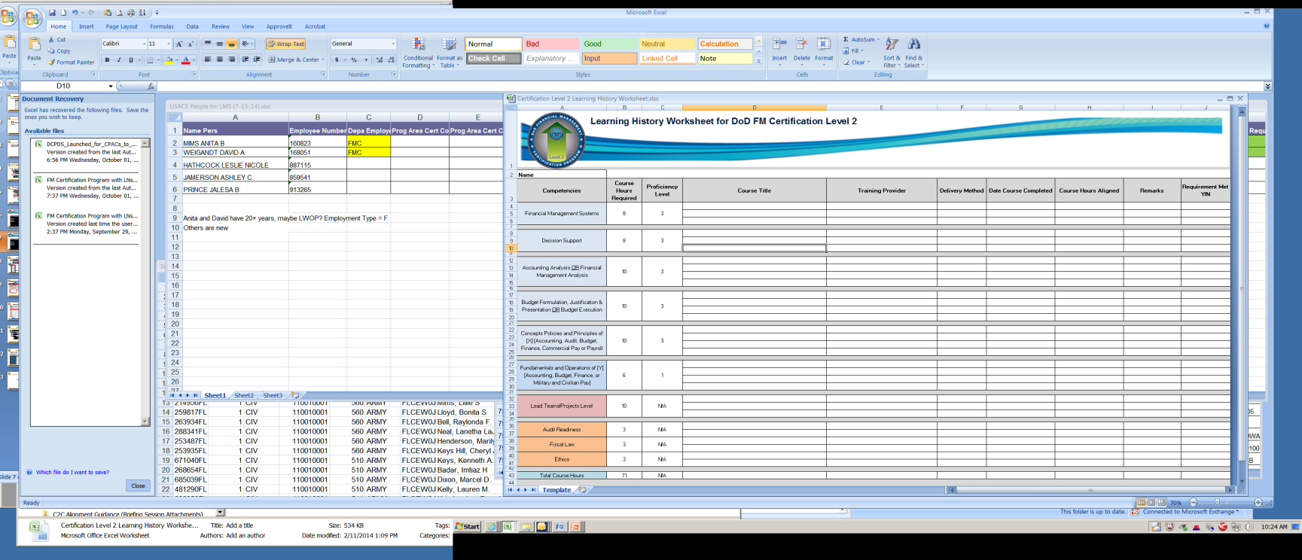
The Learning History Worksheet
The Learning History Worksheet (LHW) for each certification level shows the competency, course hour and PL requirements
Financial Management Systems 8 3
Example: Cert Level 2 requires 8 hours of Financial Management Systems at PL 3
Notes:
Use Learning History Worksheet for your cert level. It is mapped to your required competencies and PLs
Note the required Proficiency Levels are indicated on the worksheet
Input your course information here to determine gaps necessary to fulfill to achieve certification
The worksheet is for you and your supervisor. It is not submitted to the DoD FM LMS.

Slide 17
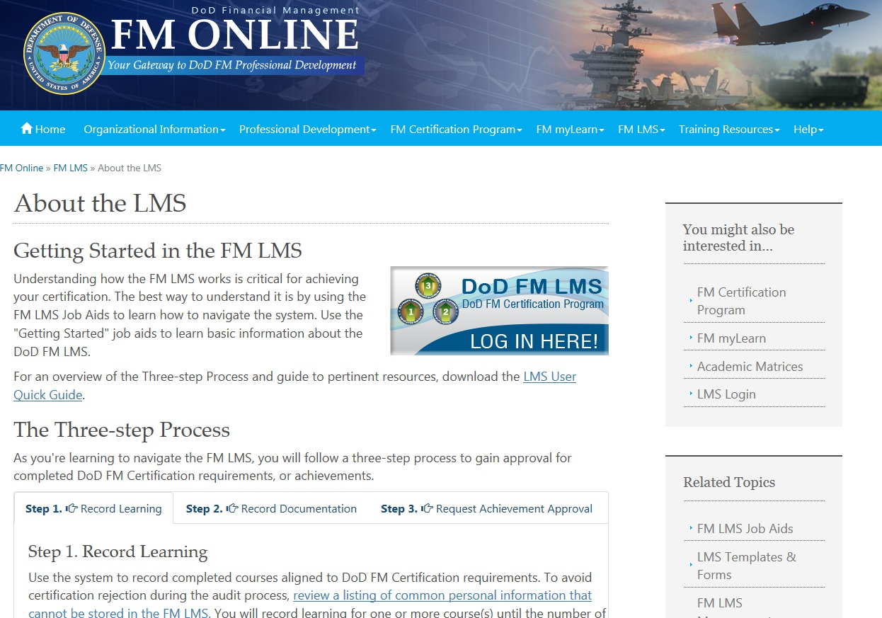
DoD FM Learning Management System
FM LMS is the one stop shop for the DoD FM Certification Program

Slide 18
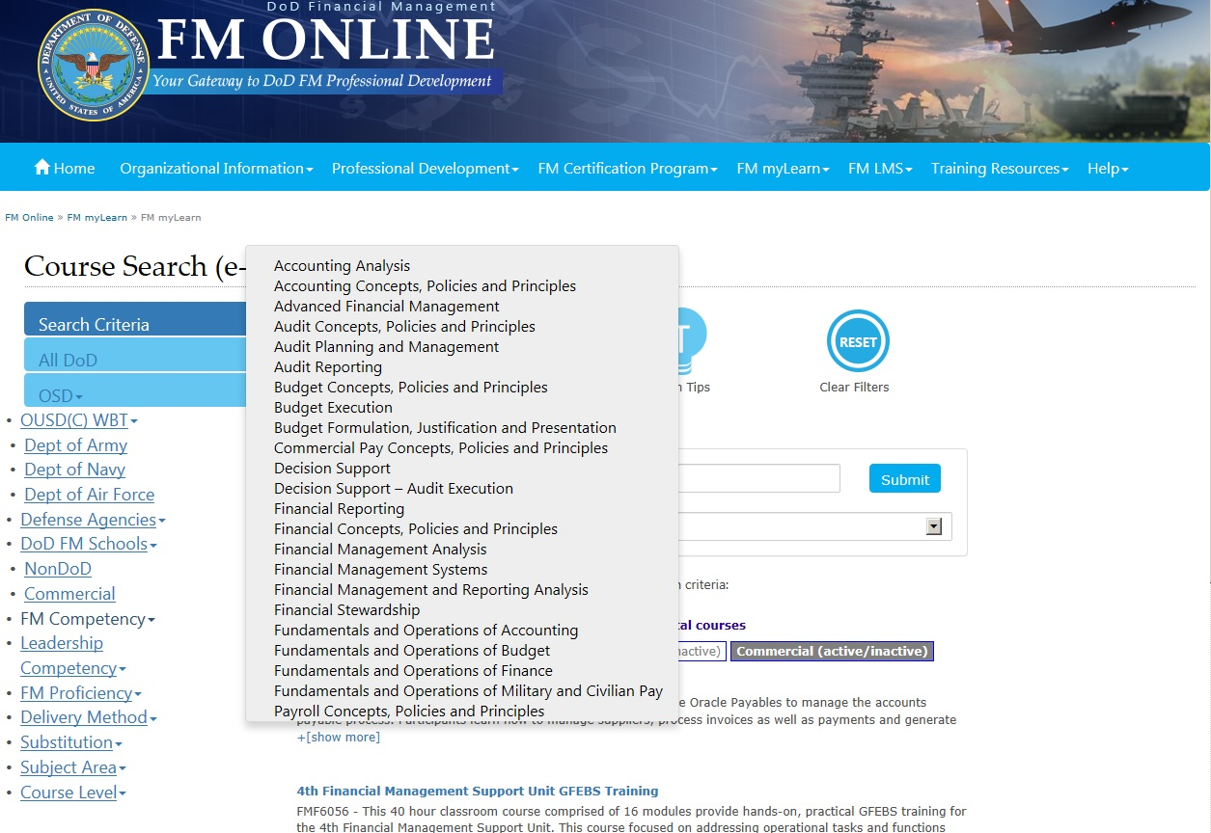
DoD FM Certification
Mapping Courses to Competencies
FM Online is the entry point for critical and essential program information
The FM Competencies tab shows the link between competencies and occupational series
Notes:
Course Based Program – Not Test
Courses completed provide competency achievements

Slide 19
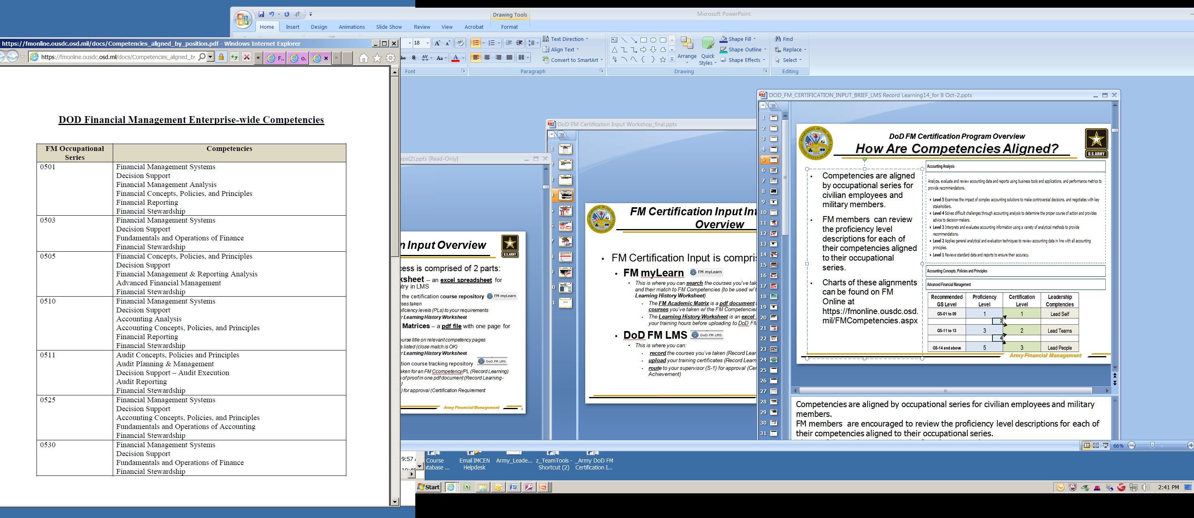
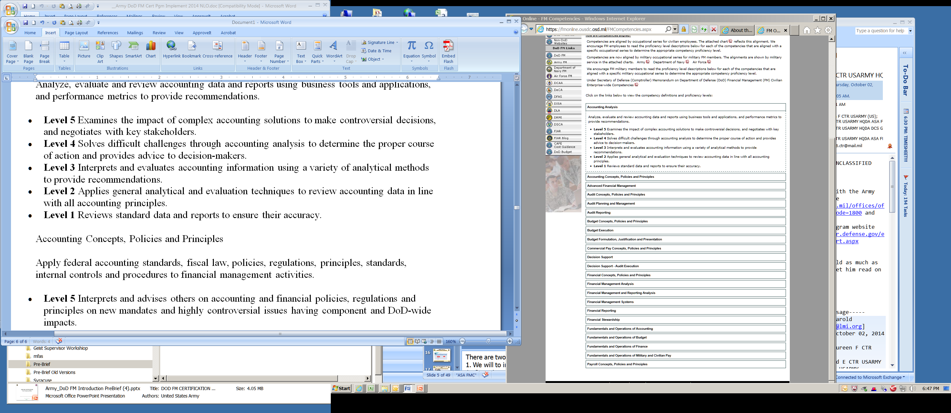
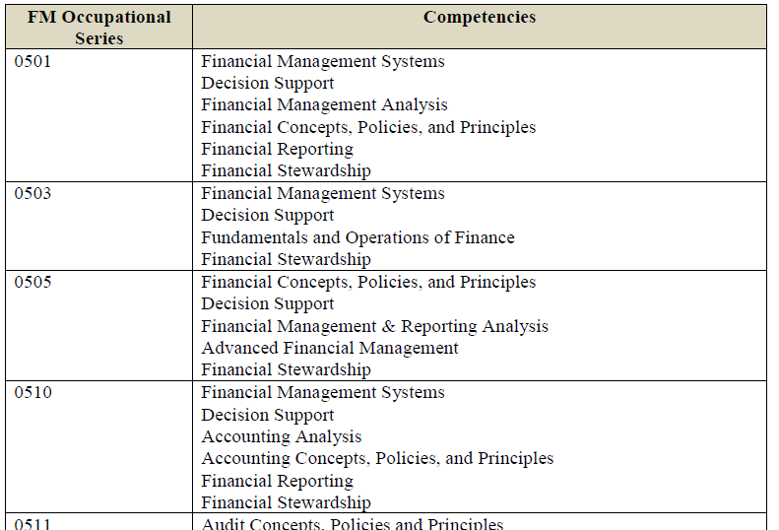
Competencies are Aligned to the FM Occupational Series
Competencies are mapped to the Enterprise-wide FM Occupational Series
Each competency has 5 proficiency levels – Example – Accounting Analysis
Three levels are used in the certification program
Accounting Analysis
Find these Charts on FM Online
https://fmonline.ousdc.osd.mil/docs/Competencies_aligned_by_position.pdf
https://fmonline.ousdc.osd.mil/FMCompetencies.aspx
Notes:
Going from left to right:
- each 05XX occupational series is mapped to a set of competencies, and each of the - competencies has 5 levels of proficiency (mastery)
- defining the knowledge, skill and attributes needed to perform.
FM members are encouraged to review the proficiency level descriptions for each of their competencies aligned to their occupational series.
Charts of these alignments can be found on FM Online Home Page at the FM Competencies tab on the left.
Competencies help to develop an integrated and standardized FM body of knowledge; create an agile, flexible workforce;
develop a high-performing workforce;
increase professionalism;
and provide a clear roadmap for career development.
What does a competency look like – what is the structure?
The competency is identified by a set of key words and is followed by a definition. Each definition begins with an action verb and identifies a process that impacts a related activity. The competencies have five levels of proficiency or mastery. These proficiency levels begin with an action verb, identify a basic level of knowledge and understanding, increase in complexity, and continuously build or grow from level one to level five.
0510
Financial Management Systems
Decision Support
Accounting Analysis
Accounting Concepts, Policies, and Principles
Financial Reporting
Financial Stewardship
0511
Audit Concepts, Policies and Principles
Audit Planning & Management
Decision Support – Audit Execution
Audit Reporting
Financial Stewardship
0525
Financial Management Systems
Decision Support
Accounting Concepts, Policies, and Principles
Fundamentals and Operations of Accounting
Financial Stewardship
0530
Financial Management Systems
Decision Support
Fundamentals and Operations of Finance
Financial Stewardship
0540
Financial Management Systems
Decision Support
Accounting Concepts, Policies, and Principles
Commercial Pay Concepts, Policies, and Principles
Fundamental and Operations of Accounting
Financial Stewardship
0544
Financial Management Systems
Decision Support
Payroll Concepts, Policies, and Principles
Fundamentals and Operations of Military and Civilian Pay
Financial Stewardship
0545
Financial Management Systems
Decision Support
Payroll Concepts, Policies, and Principles
Fundamentals and Operations of Military and Civilian Pay
Financial Stewardship
0560
Financial Management Systems
Decision Support
Financial Management Analysis
Budget Concepts, Policies, and Principles
Budget Execution
Budget Formulation, Justification and Presentation
Financial Stewardship
0561
Financial Management Systems
Decision Support
Budget Concepts, Policies, and Principles
Fundamentals and Operations of Budget
Financial Stewardship
0599
Financial Management Systems
Decision Support
Financial Management Analysis
Financial Concepts, Policies, and Principles
Financial Reporting
Financial Stewardship

Slide 20
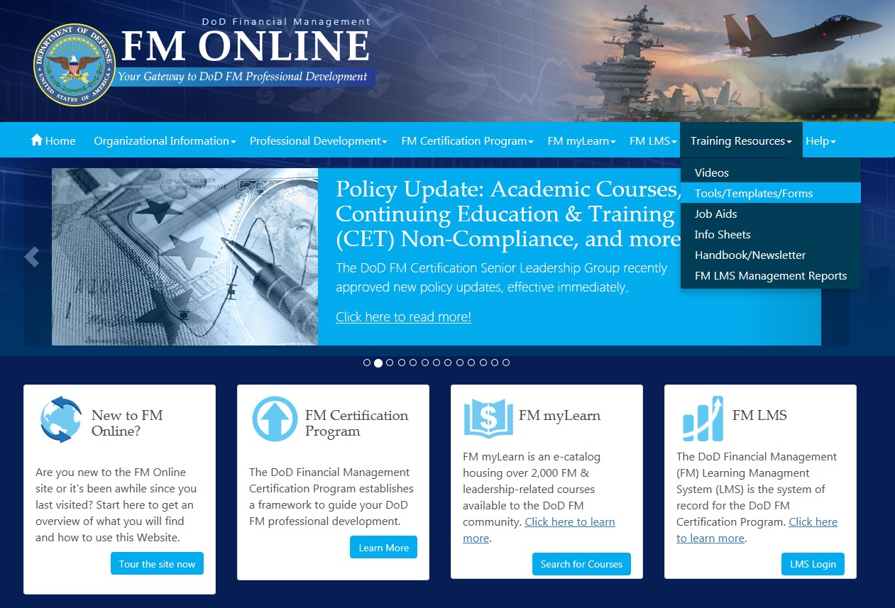
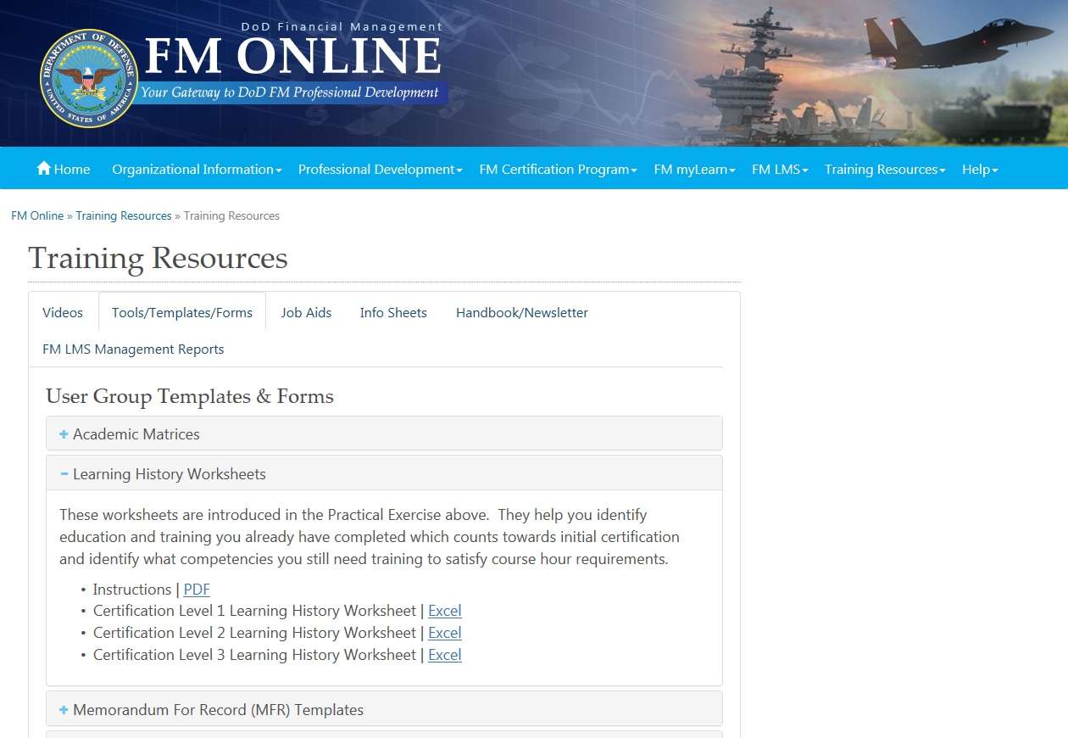
1. Download the LHW from FM Online
Find your certification level Learning History Worksheet
Notes:
Find your Learning History Worksheet
Starting on the FM Online Home Page, click DoD FM Certification Program tab on the left
On the DoD FM Certification Program, click the Templates/Forms tab on the left
On the Templates/Forms page find your certification
Click to open
Save to your system

Slide 21
    2. Assemble Documentation
Examples of common courses FMers have completed:
  Defense Resources Management Course (DRMC)
  Enhanced Defense Financial Management Training Course (EDFMT)
  Financial Manager Captain's Career Course (FMCCC)
  Advanced Comptroller Course (ACC)
  Executive Comptroller Course (ECC)
  Defense Comptroller Program (DCP)
  GFEBS courses, PPBE, ICAM, PCAM
Notes:
Sample list of courses found in FM myLearn commonly taken by Fmers

Slide 22
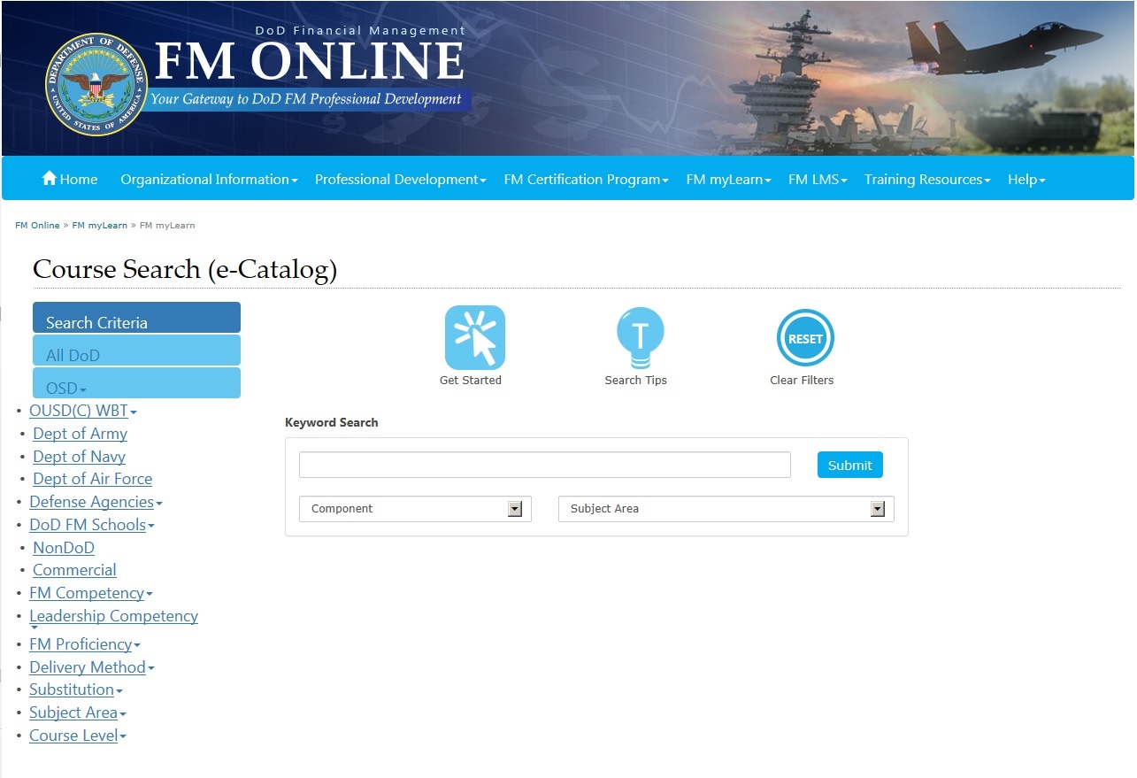
3. Search for Courses in FM myLearn
Search Using Keywords
Search Using the Filter Tabs

Slide 23
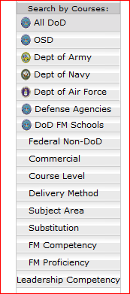
3. Search for Courses by Competency
Search Using the Competency Tab
Notes:
Find your courses in FM myLearn
Find the Aligned competencies at the bottom of the page
Record relevant course competencies
Note: Academic courses are not mapped in FM myLearn. Use the Academic Matrix to gain credit for these (later slides)
Note: Gain credit for a “program” such as the Defense Comptrollership Program, MBA, CPA, etc., course by course.

Slide 24
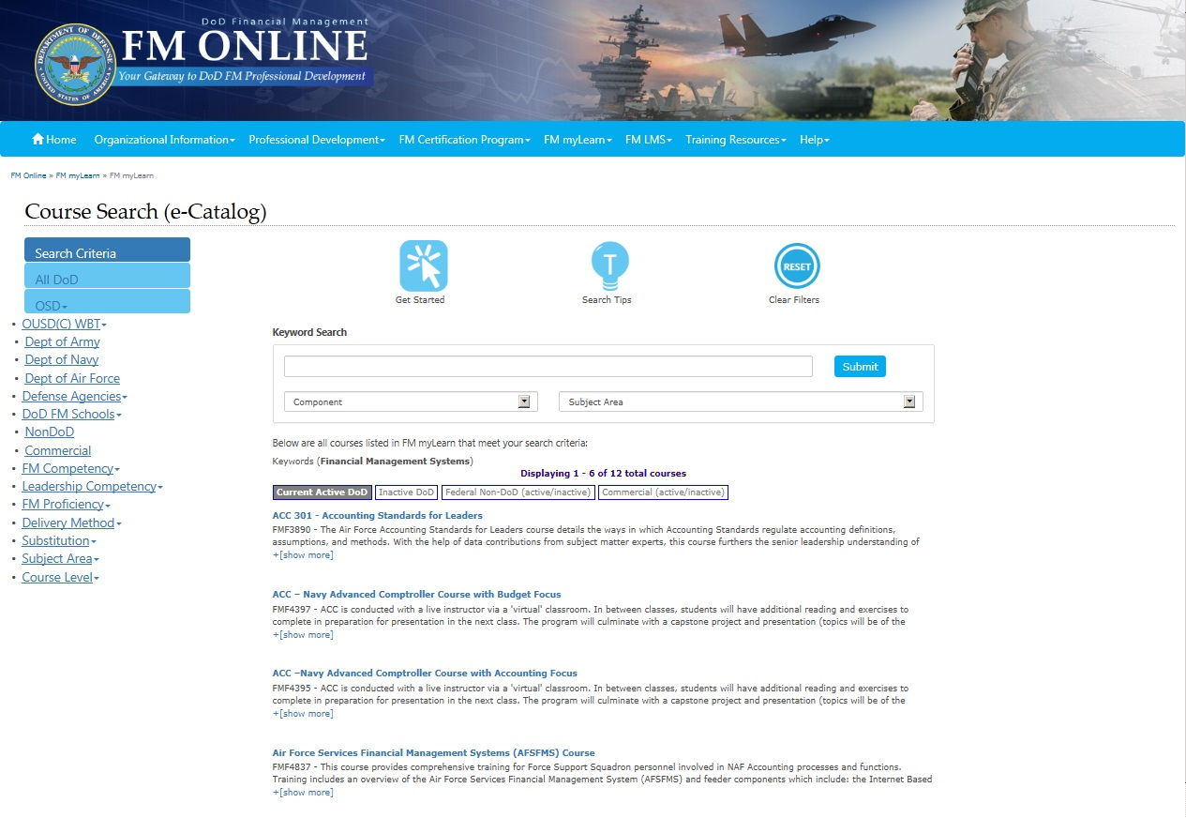
3. Results of Competency Search
“Active” courses found for Competency “Financial Management Systems”

Slide 25
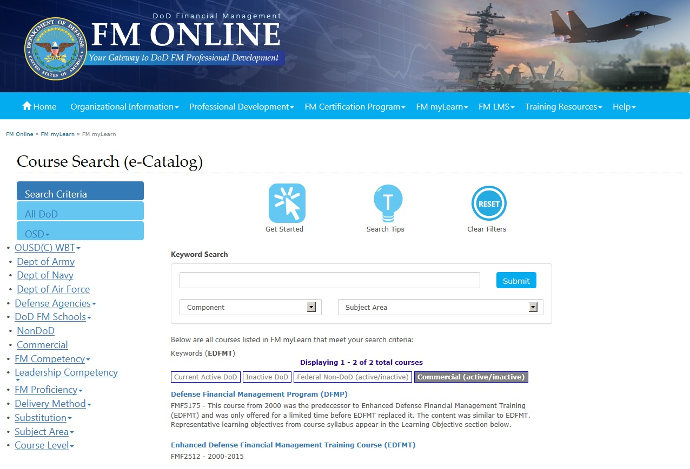
3. Search for Courses Using Keywords
Search using Keywords
Use these tabs to find all matching courses; Some may be inactive, commercial
*
Notes:
This is a sample selection on Civilian Education System (CES) courses
The system shows active DoD courses first
Click other tabs to find more courses
Examples
- Older courses are often under the Inactive DoD tab;
- EDFMT is under the commercial tab
Hint - Sort by name

Slide 26
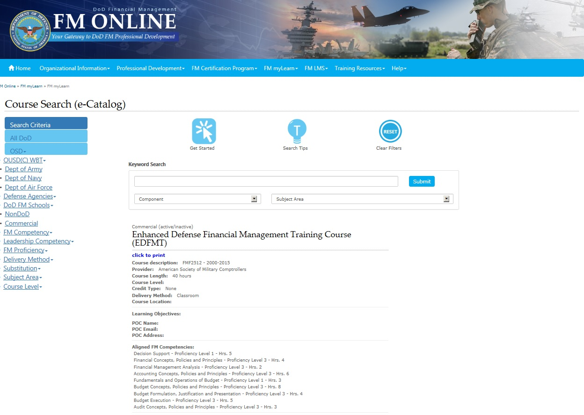
4. Map FM myLearn courses on LHW
Verify it’s the right course
Record Cert Level 2 matches on the LHW:
→ Financial Management Analysis
→ Budget Formulation, Justification
→ Budget Execution
Notes:
Example here is Changing World of the CFO
Selected on course title
Verified the title is the course wanted
Reviewed Provider, Course Length, and other course attributes
Identified relevant FM and Leadership Competencies/PLs - match to the Learning History Worksheet (example: Financial Management Systems – Proficiency Level 3 – Hrs 15)

Slide 27
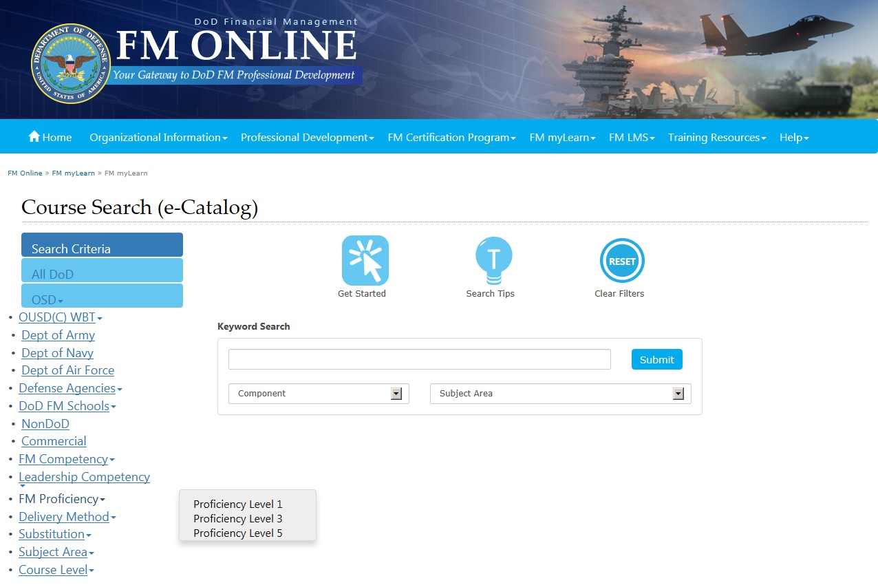
3. Search for Courses in FM myLearn
Search Using the FM Proficiency Tab
Notes:
Search in 2 ways:
Enter a keyword or course number (if you know it), or
Filter on items such as DoD Department/School, Competency, Proficiency Level, Substitution for Other Required Courses, etc.

Slide 28
The Learning History Worksheet
Eight Steps to Assess Gaps and Prepare for LMS Input
ü
Download the LHW for Certification level
Assemble FM course documentation*
Search for courses in FM myLearn
Map your FM myLearn courses to the Learning History Worksheet
Assess Certification Gaps
Map OUSD(C) Web Based Courses.
Map Academic Courses
Plan to Fill Gaps
ü
ü
Notes:
Use Learning History Worksheet for your cert level. It is mapped to your required competencies and PLs
Note the required Proficiency Levels are indicated on the worksheet
Input your course information here to determine gaps necessary to fulfill to achieve certification
The worksheet is for you and your supervisor. It is not submitted to the DoD FM LMS.

Slide 29
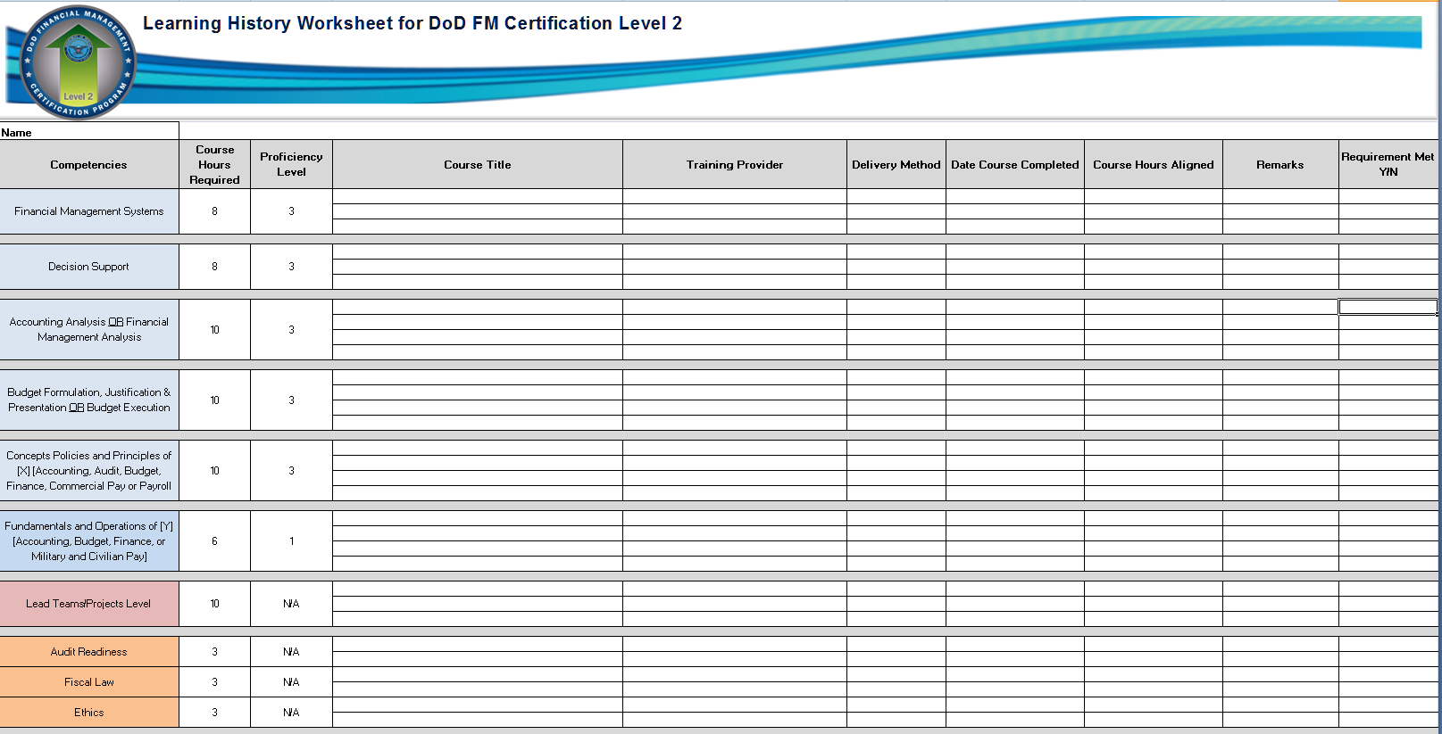
5. Assess Certification Gaps
Record course Competency/PL hours on the LHW
→ Financial Management Analysis PL 3 - Hrs. 2
→ Budget Formulation, Justification and Presentation – PL3 – Hrs. 4
→ Budget Execution – PL 3 – Hrs 5
EDFMT – Financial Management Analysis
2
EDFMT – Budget Formulation
EDFMT – Budget Execution
4
5
Notes:
How do you know which Proficiency Level to choose? See the Proficiency Level column
This is an Excel spreadsheet. You can modify it to suit yourself.
Note:
When there is an OR for a competency (OR) you need hours from EITHER, so you could have all hours from one competency.
When there is an AND for a competency, you need hours from BOTH, 1/3 for each competency.

Slide 30
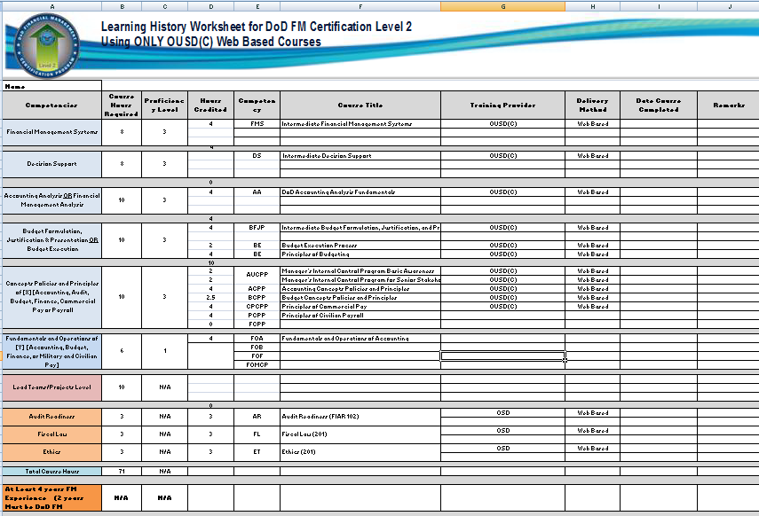
6. Map OUSD(C) WEB Based Courses to the LHW
Cert Level 2 OUSD(C) Courses Available Online

Slide 31

7. Map Academic Courses to the LHW
    Search the FM myLearn academic FM and Leadership matrices relevant courses
    Match course title to title listed in the matrix (close match is OK) and course level to certification level
    Record course and hours on the Learning History Worksheet
Notes:
Academic course titles, not courses, are mapped to the FM myLearn academic matrices.
Use the FM matrix for FM courses
Use the Leadership Matrix for Leadership courses
Example: for the Defense Comptroller Program use the academic matrices to gain credit for your coursework taken during the program.
Do the same for MBAs or other degree programs.

Slide 32
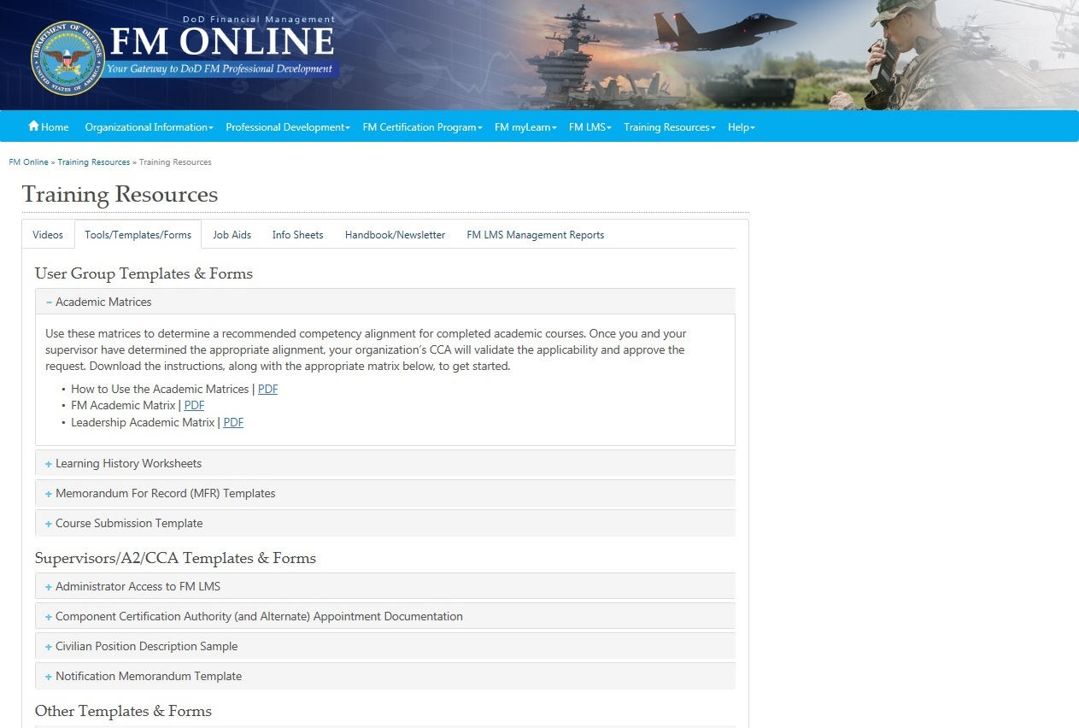
7. Map Academic Courses to the LHW
Use Academic Matrices in FM myLearn to get credit for your academic courses:
FM academic matrix and Leadership academic matrix
Select FM Academic Matrix under Training Resources

Slide 33
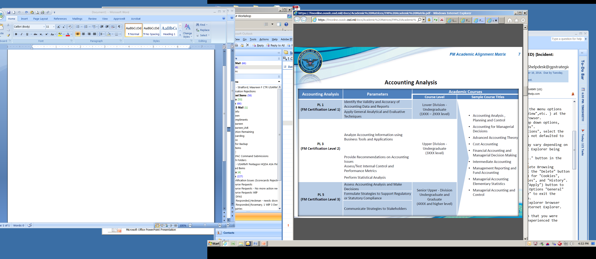
Accounting Analysis Competency
7. Map Academic Courses to the LHW
*
Notes:
For example:
A course named Managerial Accounting and Control at the course level matching your certification level provides credit toward the Accounting Analysis competency.
A course named Accounting for Managers would likely provide credit toward Accounting Analysis, matching it to the Managerial Accounting and Control title.
Look at the syllabus or college course description which will most likely mention “control.”
At certification Level 2, only count 3xx/3xxx level courses. There is NO upward or downward compatibility.
At Certification Level 3, count course numbers 4xx/4xxx or higher.

Slide 34
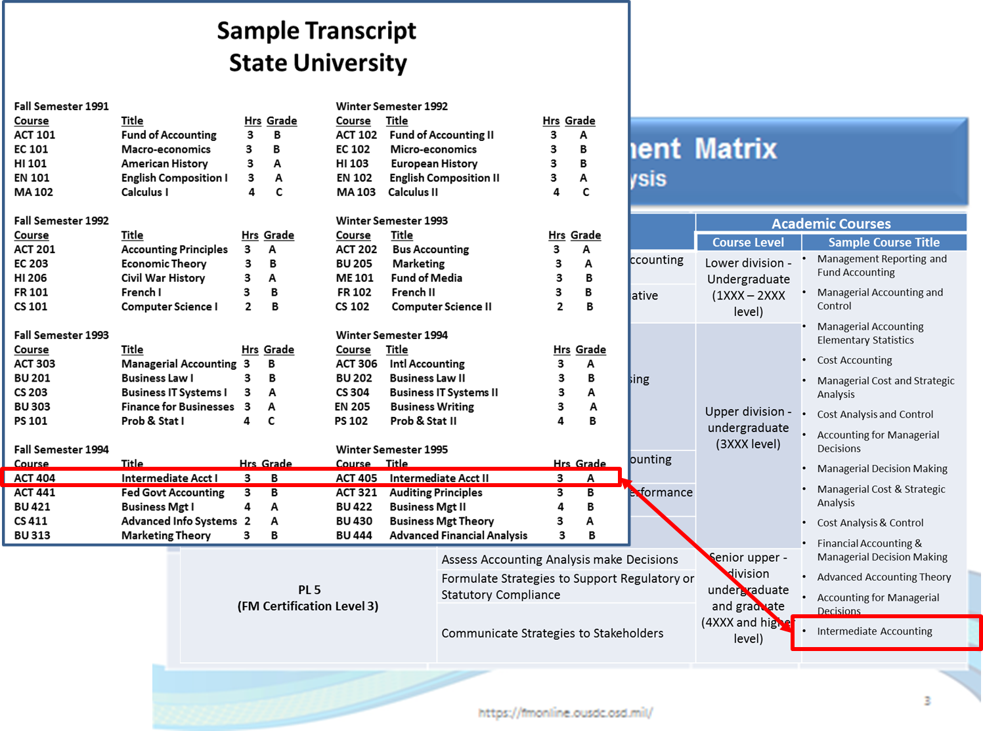
7. Map Academic Courses to the LHW
*
*There is a an individual matrix for each FM competency on your worksheet
Notes:
For example:
A course named Managerial Accounting and Control at the course level matching your certification level provides credit toward the Accounting Analysis competency.
A course named Accounting for Managers closely matches Managerial Accounting and Control would credit Accounting Analysis, title.
Look at the syllabus or college course description which will most likely mention “control.”
At certification Level 2, only count 3xx/3xxx level courses. No upward or downward compatibility.
At Certification Level 3, count course numbers 4xx/4xxx or higher.

Slide 35
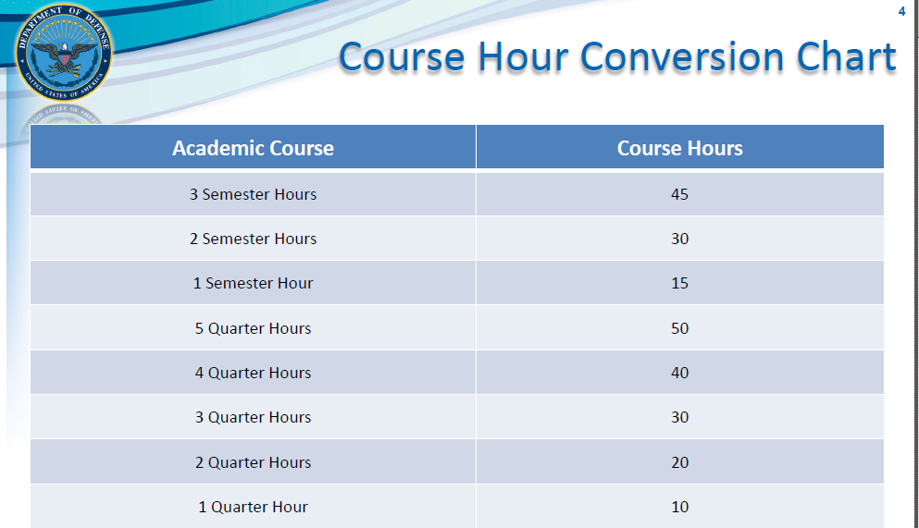
7. Map Academic Courses to the LHW
Notes:
For example:
A course named Cost Accounting definitely provides credit toward the Accounting Analysis competency. You may count it if you are Certification Level 2 and your course number was 3xx or 3xxx only (see *). You may count it if you are Certification Level 3 and your course number was 4xx/4xxx or higher.
A course name Managerial Accounting would likely provide credit toward Accounting Analysis. Look at the syllabus or college course description which will most likely mention “control.”

Slide 36
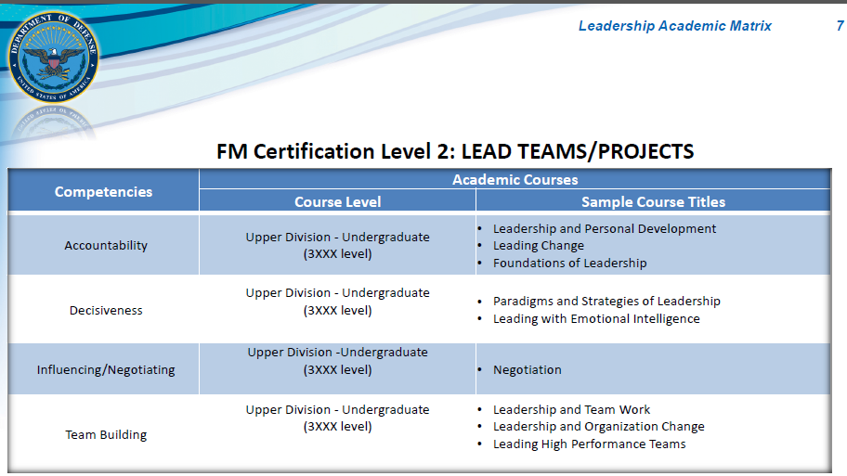
Leadership Academic Matrix
Notes:
Sample of the Leadership Academic Matrix

Slide 37
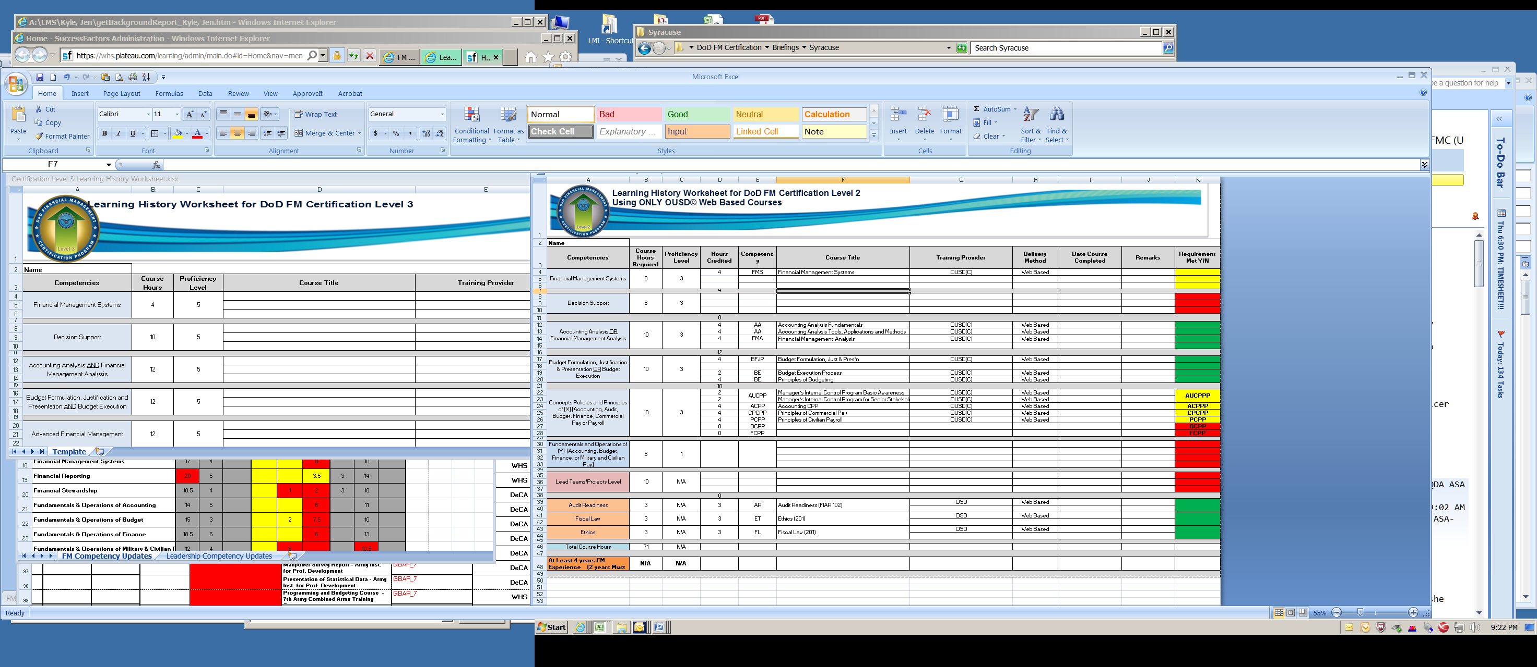
8. LMS Achievement Documentation
Create only One PDF for each achievement (required competency)
  PDF must include all documentation pertaining to the achievement of the competency
Example:
PDF File #1 “Financial Management Analysis”
Includes Proof of Completion for: Accounting Analysis Fundamentals
Accounting Analysis Tools, Applications and Methods
Financial Management Analysis
PDF File #2 “Budget Formulation, Justification, & Presentation”
Includes Proof of Completion for: Budget Formulation, Justification, and Presentation
Budget Execution Process
Principles of Budget
37
Notes:
One PDF per competency

Slide 38
8. LMS Achievement Documentation
Acceptable Documentation, in order of preference:
  Certificate of Completion
  Transcripts
  Academic Evaluation Report (DA Form 1059)
  Army Training Requirements and Resources System (ATRRS) Record
  Officer/Enlisted Record Brief (ORB/ERB)
  Army Civilian Record Brief (ACRB)
  Screen snapshot from officially-updated Army or DoD training database showing your name, the name of the course, and your date of completion
  Memorandum for Record (MFR).
  *The user MUST redact PII such as SSN prior to uploading into LMS, or it WILL be rejected by OSD.

Slide 39
Personal Information
Common personal information that cannot be stored in the FM LMS
FM LMS Documentation | Personal Information
Certificates of Completion | SSN (to include last 4) Email address, mailing/home address
Academic Transcript | SSN (to include last 4), id numbers Place & DOB Personal email address, mailing/home address
ORB, ERB, DD-214 | SSN (to include last 4), id numbers Citizenship, legal status Gender, race/ethnicity Place & DOB Home, cell phone numbers Personal email address, mailing/home address Religious preference Security clearance Spouse and family information Financial information Disability information
SF-50s, resume | SSN (to include last 4), id numbers Citizenship, legal status Place & DOB Home, cell phone numbers Personal email address, mailing/home address Financial information Disability information

Slide 40
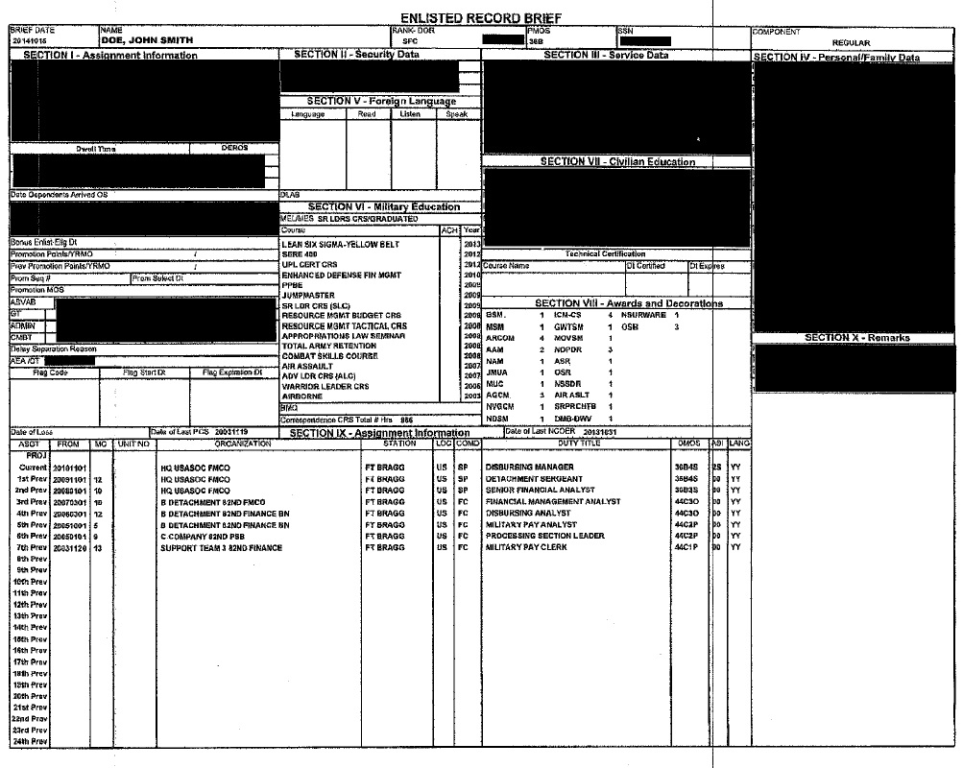
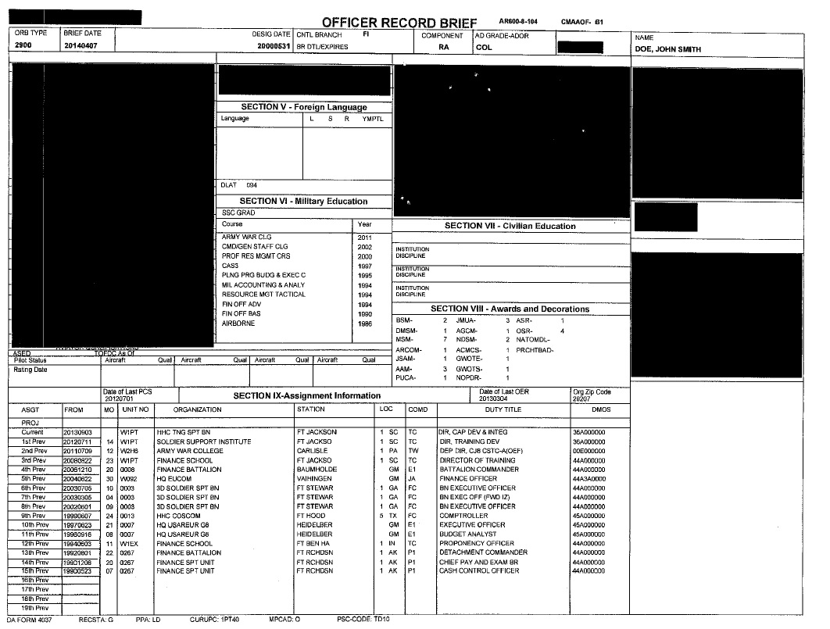
LMS Achievement Documentation
Examples of Redaction
How to Redact PII in Adobe: Tools> Protection> Mark for Redaction> Apply Redactions> Save
Notes:
The “Three Step Process” is a term often referenced on FM Online regarding data entry into LMS

Slide 41
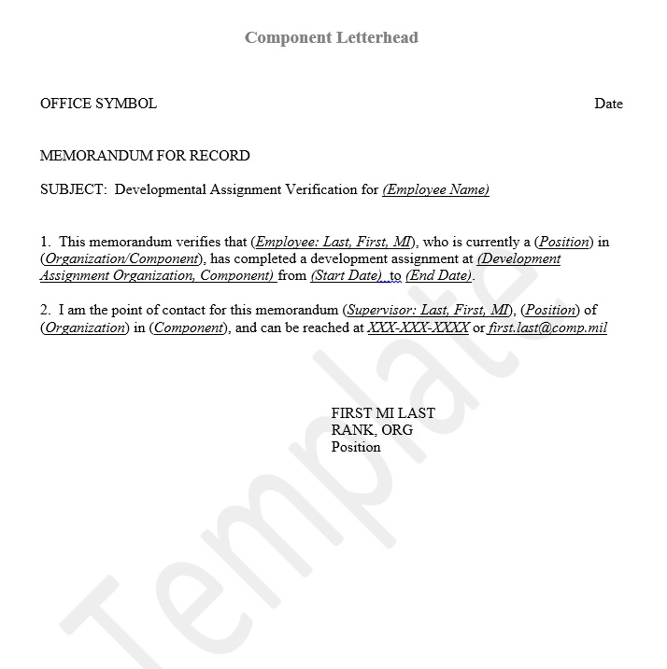
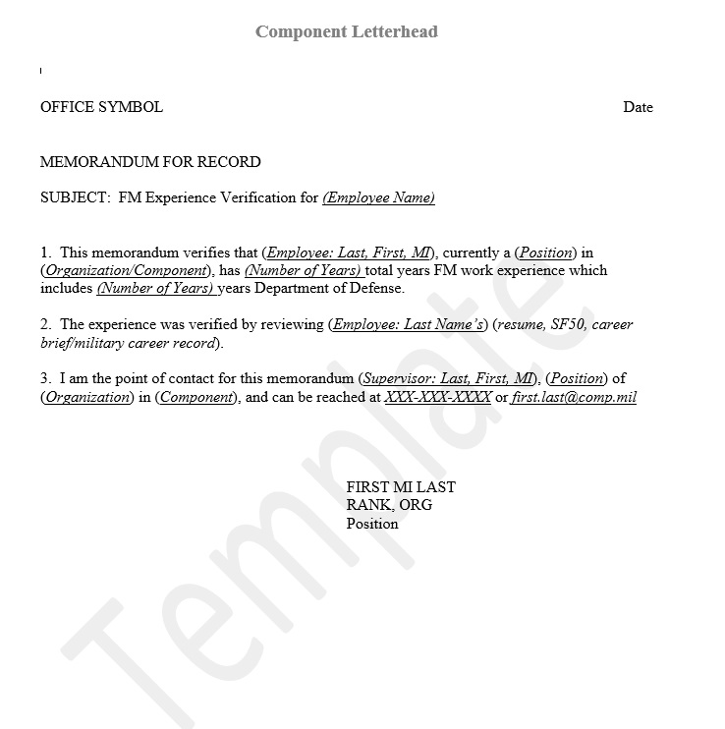
Memorandum for Record (MFR) for Experience
A verified (MFR) signed by a supervisor may be uploaded to prevent recording PII into the system for experience requirements (recommended). Templates are found on FM Online.
3-Month Development Assignment
(only for Cert Level 3)
Total FM Experience
Total Years DoD Experience
Notes:
The “Three Step Process” is a term often referenced on FM Online regarding data entry into LMS

Slide 42

Introduction to LMS Input
Three Step Process for LMS* Input:
      Record Learning of Course(s) - Using your Learning History Worksheet record learning for all courses needed to satisfy each competency requirement
      Record Competency Documentation - Record learning achievement documentation for each competency – upload one PDF file per competency with all certificates of proof (Record Learning - Achievement Documentation)
      Request Achievement Approval - Route request for approval to your supervisor (LMS S1) (Certification Requirement Achievement)
      *The DoD FM LMS is the certification course tracking repository
Notes:
The “Three Step Process” is a term often referenced on FM Online regarding data entry into LMS

Slide 43
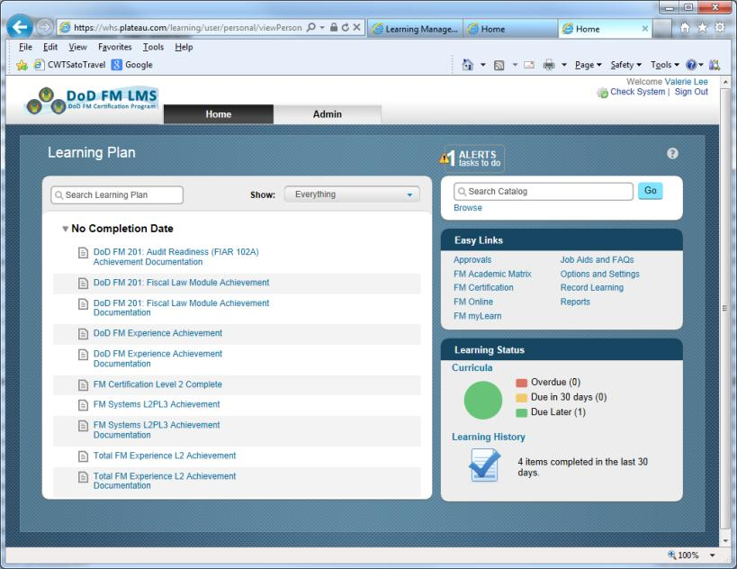
Introduction to LMS Input
LMS Home Page
Add Primary/Alternate Track
Take
User Training
LMS Home Page: take User Training (Curricula), enter course achievement data (Record Learning), select Primary/Alternate track (Catalog), run Scorecard report.
Notes:
The Learning Plan is shown on the Home page upon entering LMS
1. Take User Training: click Curricula in the Learning Status box
2. Record Learning events: click the Record Learning button in the Easy Links box
3. Choose a Primary or Alternate track: click Search Catalog.
Primary and Alternate tracks become a new Curricula and their hours will NOT add to the scorecard.

Slide 44
DoD FM Learning Management System
LMS is a web-based application where users will track certification progress
  Administration
  Oversight
  Validation
  Auditability
LMS documents/tracks work experience, developmental assignments, individual course requirements, achievement of certification standards, and continuing education and training hours (CETs)
Distributes/launches select courses online
Documents waivers
Course alignments available at FM myLearn (from FM Online site)

Slide 45
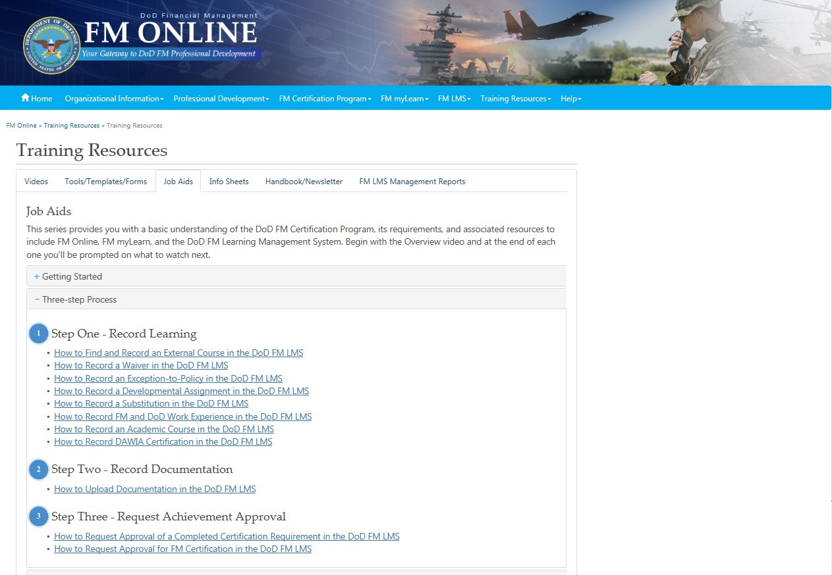
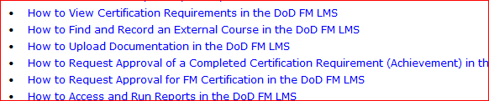
Introduction to LMS Input- Job Aids
For assistance, Job Aids are available via FM LMS
Once all information is recorded, don’t forget to send your overall certification request using this job aid.

Slide 46
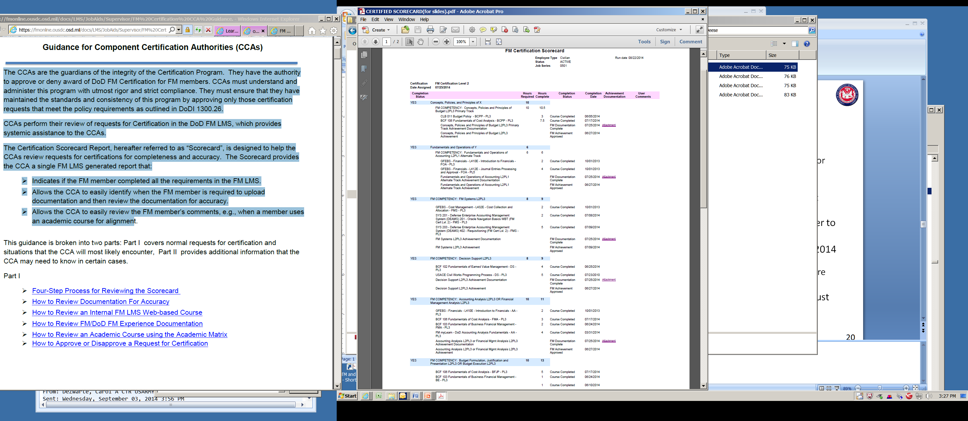
Introduction to LMS Input –
Approved Scorecard – Cert Level 2
Notes:
Scorecard that passed certification

Slide 47
LMS Roles
CCA
A2
(optional)
Participants
Approve/deny certification requests
Ensure requests for certification have all necessary information
Approve/deny achievement requests
S1
Pursue certification
Provide documentation to prove course completion
Review & forward certification requests
Review & forward certification requests
Work with CA to ensure LMS has correct organizational hierarchy
Monitor and track member progress
Submit achievements for approval (competencies or full certification)
Coordinate with supervisor of record to grant time waivers
CA
Manage org. hierarchy in LMS
Provide LMS support (password resets, login issues, etc.)
Comfortable learning new software!
Notional Ratios | S1 | A2 | CCA | CA
 | 1:25 | 1:50 | 2-5 | 1:100
Notes:
CA = Component Administrator
CCA = Component Certification Authority
A2 = Approver Level 2
S1 = Supervisor

Slide 48
Common Errors of Certification Rejection
Have your certification approved! Avoid the most common mistakes which cause the auditors to cancel FM certifications! Below you will find the text of the most common errors, any one of which will cause your FM Certification to be denied/canceled. S1s/CCAs must Deny certification if any scorecard contains any one of these errors. CCAs won't see these errors if the FMers and S1s do their job.
No. | Errors Causing Certification Denial/Cancellation | Cause/Explanation of Denial/Cancelation of FM Certification
1 | "PII on Transcript" | You may not have any part of your social security number, your birth date (month/day), birth place, student ID, home address, home phone number, etc. Redact any personal information from the ORB, CRB, transcript or any other items included in your documentation. Hint: In Adobe Acrobat --> Tools --> Protection --> Mark for Redaction
2 | "PII in SF50 Single SF50 does not show years. Recommend using MFR" | You should submit an MFR. Neither a single SF50, nor two SF50s, will show the years.
3 | "Documentation does not go on courses" | Course Completed Learning Events may not have attachments. Documentation has its own completion Status and must be a separate learning event.
4 | "Documentation not in single pdf" "Both certificates go into 1 file" "Just have 1 attachment with the certificate for the [course name]" | You may upload only ONE pdf file for each competency (blue line on your scorecard). You must "combine" all documentation for a competency (not course) into one PDF when you have more than one course. You must upload documentation in an Achievement Documentation learning event, separate from the course learning event(s).
5 | "Delete" | You must remove (or not enter) courses in excess of those necessary to meet the requirement. You must delete extra courses if you have extra courses that exceed the requirement. Multiple attachments and duplicate course entries must be deleted
Notes:
The nine most common mistakes are:
Documentation not in single pdf
Extra documentation/courses
Course not identified on transcript
Used 400/4000+ level academic courses for Level 2 Certification
Certificate does not match the course
Documentation is uploaded to the course learning event
Course titles are not close to ones in the Academic Matrix
PII on Academic transcripts
Documentation missing

Slide 49
Common Errors of Certification Rejection
(continued)
No. | Errors Causing Certification Denial/Cancellation | Cause/Explanation of Denial/Cancelation of FM Certification
6 | "Course title not in Academic Matrix" | You may not use any academic course title that does not match closely to the Sample Course Titles in the Academic Matrix for your competency without prior Course Manager approval
7 | "Course not identified on transcript or on transcript" | You must identify your academic course title on the transcript in the Comments box
8 | "Wrong level, needs to be 3xx" | You must only use courses for your certification level: Cert Level 1 --> 1xx/2xx, Cert Level 2 --> 3xx, Cert Level 3 --> 4xx+
9 | "Certificate does not match course recorded" | The course title on the certificate must match the course cited
10 | "Documentation not done" | You must have documentation for all courses cited. All documentation for one competency must be in 1 attachment.
Notes:
The nine most common mistakes are:
Documentation not in single pdf
Extra documentation/courses
Course not identified on transcript
Used 400/4000+ level academic courses for Level 2 Certification
Certificate does not match the course
Documentation is uploaded to the course learning event
Course titles are not close to ones in the Academic Matrix
PII on Academic transcripts
Documentation missing

Slide 50
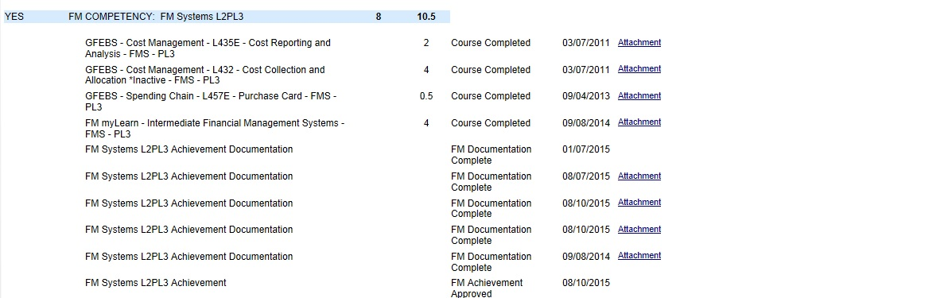
Can you find the errors?
Notes:
The nine most common mistakes are:
Documentation not in single pdf
Extra documentation/courses
Course not identified on transcript
Used 400/4000+ level academic courses for Level 2 Certification
Certificate does not match the course
Documentation is uploaded to the course learning event
Course titles are not close to ones in the Academic Matrix
PII on Academic transcripts
Documentation missing

Slide 51
Here’s the mistakes
No attachment on courses
Notes:
The nine most common mistakes are:
Documentation not in single pdf
Extra documentation/courses
Course not identified on transcript
Used 400/4000+ level academic courses for Level 2 Certification
Certificate does not match the course
Documentation is uploaded to the course learning event
Course titles are not close to ones in the Academic Matrix
PII on Academic transcripts
Documentation missing

Slide 52
Here’s the mistakes
No attachment on courses
Missing attachment on documentation
Notes:
The nine most common mistakes are:
Documentation not in single pdf
Extra documentation/courses
Course not identified on transcript
Used 400/4000+ level academic courses for Level 2 Certification
Certificate does not match the course
Documentation is uploaded to the course learning event
Course titles are not close to ones in the Academic Matrix
PII on Academic transcripts
Documentation missing

Slide 53
Here’s the mistakes
No attachment on courses
Missing attachment on documentation
Duplicate documentation entries
Notes:
The nine most common mistakes are:
Documentation not in single pdf
Extra documentation/courses
Course not identified on transcript
Used 400/4000+ level academic courses for Level 2 Certification
Certificate does not match the course
Documentation is uploaded to the course learning event
Course titles are not close to ones in the Academic Matrix
PII on Academic transcripts
Documentation missing

Slide 54
Here’s the mistakes
Extra hours documented
No attachment on courses
Missing attachment on documentation
Duplicate documentation entries
Notes:
The nine most common mistakes are:
Documentation not in single pdf
Extra documentation/courses
Course not identified on transcript
Used 400/4000+ level academic courses for Level 2 Certification
Certificate does not match the course
Documentation is uploaded to the course learning event
Course titles are not close to ones in the Academic Matrix
PII on Academic transcripts
Documentation missing

Slide 55
Active Users vs. Inactive Users
Please note: If a user is promoted or changes organizations during the DoD FM Certification Process, their account will go inactive and must be activated with new level and/or organization ID. This is an automated function with the DCPDS record controlled by HR.
If you cannot log into LMS or if you have gone inactive, please contact your Lead CA to be activated.

Slide 56
FAQs
LMS Supervisor does not have to be supervisor of record
  It’s the person who is assigned the duties of reviewing requests for achievements in LMS (to avoid circular reference)
Requirements aren’t cumulative
  Need to fill ONLY the requirements of your certification level, not yours and the ones below it
There is no time limit on how recently a class was taken in order to get credit
Deadline for certification for all users going live prior to 1 July 2014 will be 30 June 2016
People can’t choose what certification level they pursue – it is position based and must be the level they are assigned
https://fmonline.ousdc.osd.mil/FMCertProgram/FAQ.aspx#certificationrequirements20

Slide 57
Continuing Education and Training (CETs)
Certification Level 1
  40 CETs required every two years after achieving Certification Level
Certification Level 2
  60 CETs required every two years after achieving Certification Level
Certification Level 3
  80 CETs required every two years after achieving Certification Level
  CETs can be earned by completing any course listed in FM myLearn e-catalog. Each course hour credit is equal to one CET hour.

Slide 58
Point of Contact
After Initial Launch
  Treat your local CAs as your primary POCs
  Local CAs will reach out to HQDA Lead CAs if they need further assistance
    USARMY Pentagon HQDA ASA FM Mailbox DOD Certification
Please treat Army as your primary point of contact for any FM certification-related issues
  Reaching out to OSD instead of our CAs removes our visibility and it’s harder for us to understand and assist
ARMY FMC TEAM Mailbox: usarmy.pentagon.hqda-asa-fm.mbx.dod-certification@mail.mil
Mr. Anson Smith, anson.d.smith.civ@mail.mil, 703-697-6898
Mr. Richard Corns, richard.e.corns.ctr@mail.mil, 703-692-7414
Ms. Carly Beato, carly.m.beato.ctr@mail.mil, 703-571-0900
Notes:
Please contact our team first, not the OSD team, if you need any assistance or have questions. If you go to OSD first instead of us, we lose visibility of your concerns and are less able to make sure they are addressed.
The main email contact is the mailbox listed here. Every participant of the team has access to it, so using that guarantees you have access to the whole team. The launch specialists are Brandon Robinson, Carol DeZwarte, and Jill Cahill. Army’s course manager is Maureen Stratford. All their contact information is listed here.

Slide 59
For any additional questions during your certification process, you contact the Army FM Certification Mailbox at: usarmy.pentagon.hqda-asa-fm.mbx.dod-certification@mail.mil
Questions?

Slide 60
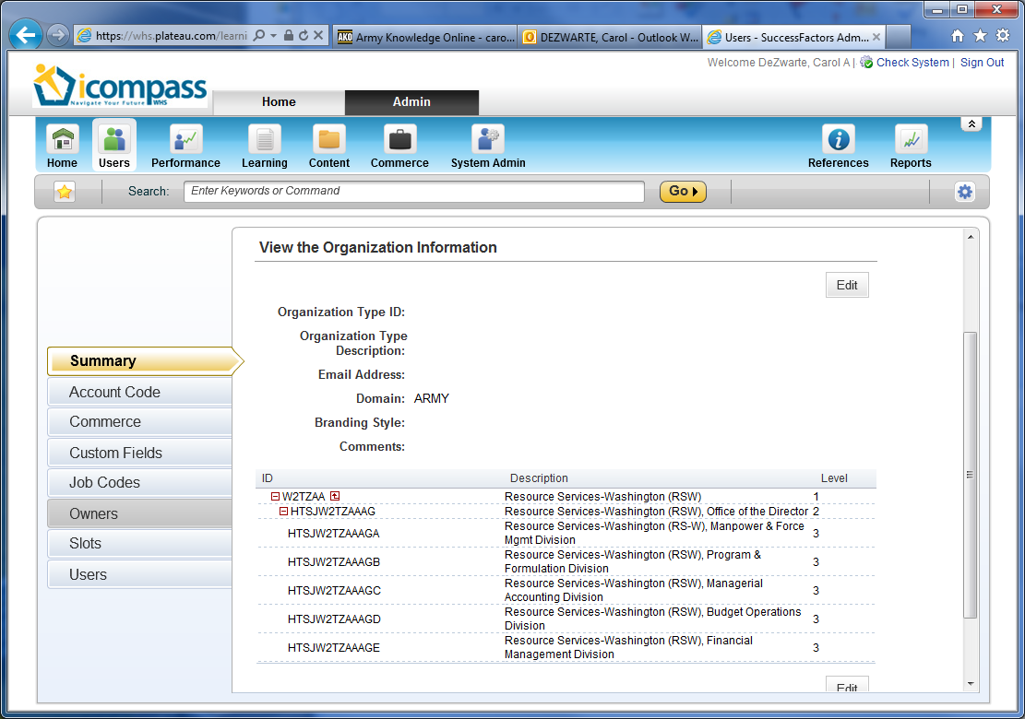
Definitions
DCPDS: Defense Civilian Personnel Data System
MILPDS: Military Personnel Data System (they are numerous)
LMS: Learning Management System
LMS leadership roles:
  CCA: Component Certification Authority in LMS
  CA: Component Administrator in LMS
  S1: Supervisor Level 1 in LMS
  A2: Approver Level 2 in LMS
RSW’s Structure in LMS
Command Macro Structure: organizational hierarchy of a command within LMS (as implied by the org components personnel are assigned to in DCPDS)

Slide 61
Helpful Links
FM Online:
https://fmonline.ousdc.osd.mil/Default.aspx
FM myLearn:
https://fmonline.ousdc.osd.mil/FMmyLearn/Default.aspx
Learning Management System (LMS):
https://whs.plateau.com/learning/admin/nativelogin.do#nav=search
LMS Job Aids:
https://fmonline.ousdc.osd.mil/FMCertProgram/JobAids.aspx
DoD FM Certification Frequency Asked Questions:
https://fmonline.ousdc.osd.mil/FMCertProgram/FAQ.aspx#certificationrequirements20
DoD FM Certification Academic Matrix:
https://fmonline.ousdc.osd.mil/fmmylearn/AcademicMatrix.aspx

