Slide 1

AMERICA’S ARMY:
THE STRENGTH OF THE NATION
AMERICA’S ARMY:
THE STRENGTH OF THE NATION
Senior Enterprise Talent Management / Enterprise Talent Management
A Talent Management Policy and Program for Career Army Civilians
Civilian Leader Development Office
Assistant Secretary of the Army for Manpower and Reserve Affairs

Slide 2


Agenda
AMERICA’S ARMY:
THE STRENGTH OF THE NATION
AMERICA’S ARMY:
THE STRENGTH OF THE NATION
Senior Enterprise Talent Management (SETM)
Enterprise Talent Management (ETM)
Emerging Enterprise Leaders (EEL)
SETM / ETM Applications Timelines
Application Process
HQDA Boards Recommendations
Points of Contacts
2

Slide 3
SETM/ETM Programs
AMERICA’S ARMY:
THE STRENGTH OF THE NATION
AD 2017-13 PURPOSE: SETM/ETM are the means by which the Army prepares Senior Civilians (GS-12/15 or equivalent) to assume positions of greater responsibility across the department.
POLICY:
Army Directive 2017-13, “Department of the Army Senior Enterprise Talent Management (SETM) / Enterprise Talent Management (ETM) Program.
Complete copy located on SETM system under SETM/ETM Policy and can be assessed by clicking http://www.apd.army.mil/epubs/DR_pubs/DR_a/pdf/web/ARN4644_AD2017-13_Final.pdf.
Enhances the current SETM program and establishes the new ETM program.
SELECTION PROCESS:
Army Civilians must volunteer and apply via SETM automated system
Commands/organizations conduct selection board and submit their Order-of-Merit-List (OML) to CLDO.
HQDA Board Members (SESs/GOs/GS-15s/COLs) individually assess and assign utilization ratings to each applications.
Board Phase I – Board determines final utilization ratings and selects Phase II candidates.
Board Phase II – Board conducts individual interviews and establish an OML by modules.
Board Phase III – Board decides placements of DSLDP/SSC/ASCF/CGSOC graduating students based on commands/organizations’ input, needs of the Army and candidates’ requests.
3
Notes:
The new Army Directive 2017-13 expanded the current SETM program to include the ETM program. This directive was signed by the Secretary of the Army on 1 Aug 17. The new policy applies the same structured and rigorous selection process designed to ensure the Army is selecting the best of the best to participate in these enterprise level training opportunities. The selection process consists of input from raters, endorsers, FCRs, and Command Boards to be considered at HQDA. The HQDA SETM Board consists of SESs and GOs from across the Army. The HQDA ETM board consists of GS-15s and COLs from across the Army. Both of these boards consists of 3 phases.

Slide 4

SETM Program Modules
AMERICA’S ARMY:
THE STRENGTH OF THE NATION
Defense Senior Leader Development Program (DSLDP)
Open to Army senior Civilians GS-14/15 (or equivalent) with 3+ years of Army service.
2-year program: Attend Senior Service College (SSC) at Air, Navy, National War College or Eisenhower School plus 4 to 6 month developmental assignment.
Baccalaureate Degree required.
Can earn a Masters’ Degree.
Reassigned to HQDA CPTA.
Mobility and Continued Service Agreements required.
TDY funded at 55% Flat Rate per JTR.
Graduate Placement/Reassignment Worldwide.
Army Senior Civilian Fellowship (ASCF)
Open to Army senior Civilians GS-14/15 (or equivalent) with 3+ years of Army service.
Part I - 12-month study at different types of organizations/agencies.
Part II - 12-month fellowship (i.e. Chief of Staff of the Army Strategic Study Group in Crystal City, VA).
Phase III – Graduate Placement/ Reassignment Worldwide.
Baccalaureate Degree required.
Reassigned to HQDA CPTA.
Mobility and Continued Service Agreements required.
PCS or TDY funded at 55% Flat Rate per JTR.
Senior Civilian Army Talent Management – Army Strong!
4
Notes:
DSLDP: Students will remain on command roles for the entire 24 months while enrolled in DSLDP to include the 10 months at a SSC. Army DSLDP students will not attend the AWC. They will attend another services war college (Air War College, Naval War College or National Defense University). SSC Resident: 10 month Army War College or Dwight D. Eisenhower strategic learning educational experience. Participants are reassigned to a Civilian Personnel Training Account (CPTA) upon reporting to school. This allows Commands to backfill behind students. Graduates will be placed by the HQDA SETM Graduate Placement Board. SSC-DE: Participants remain on Command roles during this 24 month learning experience. Students will attend some seminars and workshops at the AWC. Graduates remain at Command not included in the graduate placement process. No mobility agreement required. SETM-TDY: Centrally funded 179 day career broadening experience. SETM-TDY assignments can be submitted by Commands to CLDO to received board vetted participants to complete projects with specific outcomes.

Slide 5
SETM Program Modules
AMERICA’S ARMY:
THE STRENGTH OF THE NATION
Senior Service College (SSC) Resident
Open to Army senior Civilians GS-14/15 (or equivalent) with 3+ years of Army service by the start date of the program.
1-year program (July to June): Attend Army War College (Carlisle, PA) or Eisenhower School at National Defense University (Fort McNair, DC).
Reassigned to HQDA CPTA.
Mobility and Continued Service Agreements required.
PCS or TDY funded at 55% Flat Rate per JTR.
Graduate Placement/Reassignment Worldwide.
Senior Service College (SSC) Distance Education
Open to Army senior Civilians GS-14/15 (or equivalent) with 3+ years of Army service by the start date of the program.
2-year program: Attend Orientation (May),
2 week TDY at the end of first year (June) and 2 week TDY at the end of program that includes CAPSTONE/Graduation at AWC (June).
Mobility optional, if so Graduate Placement/ Reassignment Worldwide.
Stay assigned to parent organization.
Continued Service Agreement required.
TDY funded at 100% Flat Rate per JTR.
Senior Civilian Army Talent Management – Army Strong!
5
Notes:
SSC Resident: 10 month Army War College or Dwight D. Eisenhower strategic learning educational experience. Participants are reassigned to a Civilian Personnel Training Account (CPTA) upon reporting to school. This allows Commands to backfill behind students. Graduates will be placed by the HQDA SETM Graduate Placement Board. SSC-DE: Participants remain on Command roles during this 24 month learning experience. Students will attend some seminars and workshops at the AWC. Graduates remain at Command not included in the graduate placement process. No mobility agreement required. SETM-TDY: Centrally funded 179 day career broadening experience. SETM-TDY assignments can be submitted by Commands to CLDO to received board vetted participants to complete projects with specific outcomes.

Slide 6
SETM Program Modules
AMERICA’S ARMY:
THE STRENGTH OF THE NATION
Naval War College
Senior Level Course
Open to Army senior Civilians GS-14/15 (or equivalent) with 3+ years of Army service by the start date of the program.
1-year program (July to June) at Newport, RI.
Have experience in DA National Security policy and Defense agencies interaction Have a minimum Secret level clearance.
College of Naval Warfare graduates are awarded a Master’s degree in Defense and Strategic Studies (most agree to curriculum attendance and completion).
Reassigned to HQDA CPTA.
Mobility and Continued Service Agreements required.
PCS or TDY funded at 55% Flat Rate per JTR.
Graduate Placement/Reassignment Worldwide.
SETM – Temporary Duty (SETM – TDY)
Open to Army senior Civilians GS-14/15
(or equivalent).
Detail not to exceed 179 days.
TDY Worldwide.
Commands submit projects using Encl 10.
CLDO validates projects.
FCRs match selectees to projects.
Stay assigned to parent organization.
Continued Service Agreement required.
CLDO pays TDY costs.
TDY funded at 75% Flat Rate per JTR.
Senior Civilian Army Talent Management – Army Strong!
6
Notes:
ASCF: A 12-month study followed by a 12-month utilization assignment ending with a permanent reassignment that leverages experiences gain and lessons learned.

Slide 7
SETM Execution Timeline
AMERICA’S ARMY:
THE STRENGTH OF THE NATION
February 2020, HQDA SETM Phase III (Graduate Placement)
July 2019 – June 2021, SETM-ASCF
July 2019 – June 2020 SETM-SSC (Resident)
May 2019 – July 2021, SETM SSC (Distance Education)
January 2019 – April 2021 SETM-DSLDP
February – September, 2019 SETM-TDY
January 2019, SETM Results Published
20 – 24 August 2018, HQDA SETM Phase II Board (Interviews)
31 July 2018 – 3 August 2018, HQDA SETM Phase I Board (Pre-Selection)
29 June 2018, SETM OMLs due to CLDO
1 – 29 June 2018, Command Boards SETM
16 – 31 May 2018, FCR Assess and Rank Applications
15 May 2018, SETM Application Closes
2018
Application Period 1 Mar 18 – 15 May 18
1 March – 15 May 2018, SETM Application Period
7
Notes:
This is our current SETM Timeline.

Slide 8
ETM Program Modules
AMERICA’S ARMY:
THE STRENGTH OF THE NATION
Command and General Staff Officer College (CGSOC)
Open to senior DACs GS-13 (GS-12 by exception) with 3+ years of Army service.
Expands participants’ knowledge of the operational and tactical Army.
Completion of CES Advanced Course or equivalent/constructive credit required.
Baccalaureate degree required.
Can earn a Master’s degree.
TDY funded at 55% Flat Rate per JTR.
Attendance at CAC-Fort Leavenworth.
CSA & Mobility Agreements required.
Reassignment under GPP for PCS option (Utilization Plan required for TDY option).
Executive Leader Development Program (ELDP) DoD Level Program
Open to senior Army DACs GS-12/13 (equiv) serving in a permanent position for at least 1 year before nomination is due to DoD.
10-month program of intense learning and training experiences across DoD Enterprise.
Able to participate in rigorous physical activities at DoD Components’ locations.
Have completed the CES Intermediate Course.
Have a Secret clearance as a minimum.
Possess a valid Gov’t Travel card & passport.
TDY funded at 100% per JTR.
Must use 2018 ELDP application forms.
Senior Civilian Army Talent Management – Army Strong!
8
Notes:
ETM-Command and General Staff Officer Course (CGSOC) (in-residence attendance): The ETM-CGSOC resident attendance module is open to select Army Civilians in grade GS-13 and equivalent, and by exception, to Army Civilians in grade GS-12 and equivalent, that have completed or been granted credit for the Civilian Education System (CES) Advance Course and meet all other requirements. Following one month in the Preparation Course (P900), an ETM-CGSOC participant will attend CGSOC Developmental School, a 10-month graduate-level program at Fort Leavenworth, Kansas. The benefits of participating in ETM-CGSOC are an increased knowledge of the operational and tactical Army and preparation for the challenges faced in a dynamic and complex global environment. ETM-Executive Leadership Development Program (ELDP): The ETM-ELDP module is a DoD program open to select Army Civilians in grade GS-12/13 and equivalent. An ETM-ELDP participant will attend a 10-month series of learning and training experiences that blend experiential and academic learning with hands-on exercises focused on the role of the war-fighter. The benefits of participating in ETM-ELDP include joint, interagency, and enterprise-wide experience, a greater understanding of the DoD mission and culture, and leadership training that parallels selected military training and ensures cross-component exposure.

Slide 9

ETM Program Modules
AMERICA’S ARMY:
THE STRENGTH OF THE NATION
Naval War College Intermediate Level Course
College of Naval Command & Staff (CNC&S) Program
Open to Army DACs GS-13/equiv only.
Considered for placement into positions of greater responsibilities Army-wide.
Have served 3 years in permanent Army position before reporting to Newport, RI.
Have completed CES Advanced Course or granted equiv/constructive credit.
Possess a baccalaureate degree.
Have experience in DA Nat’l Security policy and Defense agencies interaction.
Selection based on past performance, demonstrated potential and seniority.
Have a minimum Secret level clearance.
TDY funded at 55% Flat Rate per JTR.
ETM
CNC&S graduates are awarded a Master’s degree in Defense & Strategic Studies (most agree to curriculum attendance & completion).
Selectee will be placed in CPTA and then PCS under the Mobility Agreement after graduation from the course.
Senior Civilian Army Talent Management – Army Strong!
9

Slide 10
ETM Program Modules
AMERICA’S ARMY:
THE STRENGTH OF THE NATION
Enterprise Talent Management - Temporary Duty (ETM – TDY)
Open to Army senior Civilians GS-13 (or equivalent).
Leadership Shadowing Experience
Open to Army senior Civilians GS-13 (or equivalent).
Applicant must currently be serving in a permanent DAC GS-13 or equivalent position.
Applicant must currently be serving in a permanent DAC GS-13 or equivalent position.
Selection for participation does not guarantee a leadership shadowing experience.
TDY assignment not to exceed 90 days.
TDY funded at 75% Flat Rate per JTR.
20 working days structured leadership shadowing experience with FCR/SES.
Broadens experience through participation on a special project or filling a different position to build enterprise level experience.
TDY funded at 100% per JTR.
Participation depends on the resources available to fund shadowing experiences.
Army Civilians must apply annually to participate in or continue participation in the ETM-TDY module.
Senior Civilian Army Talent Management – Army Strong!
10
Notes:
ETM-Shadowing Assignments: The ETM-Shadowing Assignments module is open to select Army Civilians in grade GS-13 and equivalent. An ETM-Shadowing participant has the opportunity to accompany and observe a senior leader in action in his/her daily work environment for up to 20 working days. The senior leader may involve the ETM participant in the task at hand. The benefits of shadowing include experiencing what it is like to work as a senior Civilian at the Army enterprise level; the ability to ask questions while the senior leader goes about his/her daily activities; and validation of perceptions about a particular field of work. ETM-Temporary Duty (TDY) Assignments: The ETM-TDY module is open to select Army Civilians in grade GS-13 and equivalent. An ETM-TDY participant will fill a short-term developmental assignment on a special project, serve as a member of a working group or a member of a tiger team for a period not to exceed 90 days. The benefits of an ETM-TDY assignment include new and challenging work in a different work environment and a broadening experience at the enterprise level.

Slide 11
ETM Execution Timeline
AMERICA’S ARMY:
THE STRENGTH OF THE NATION
February 2020, HQDA ETM Phase III (Graduate Placement)
August 2019, ETM-ELDP Begins
July 2019 - June 2020, ETM-CGSOC Residence Begins
April 2019, ETM-CGSOC Distance Education Begins
February 2019, ETM-TDY and ETM-Shadowing Begins
December 2019, ETM Results Published
12 – 16 November 2018, HQDA ETM Phase II Board (Interviews)
16 – 19 October 2018, HQDA ETM Phase I Board (Pre-Selection)
29 June 2018, ETM OMLs due to CLDO
1 – 29 June 2018, Command Boards ETM
16 – 31 May 2018, FCR Assess and Rank Applications
2018
Application Period 1 Mar 18 – 15 May 18
15 May 2018, ETM Application Closes
March 1 – 15 May 2018, ETM Application Period
Senior Civilian Army Talent Management – Army Strong!
11
Notes:
This is our current ETM Timeline.

Slide 12

EEL Program Modules
AMERICA’S ARMY:
THE STRENGTH OF THE NATION
AD 2017-13 PURPOSE: The EEL Program targets leadership potential earlier than SETM/ETM, engaging aspiring mid-grade GS-11 and GS-12 (or equivalent) Civilian employees who are competitively selected and developed locally in leadership competencies.
Team-Based Problem Solving
EEL participants work within a results-driven team to address a complex task.
Members get to practice the leader’s role in problem solving and broaden their experience and perspective.
Problem solving should practice how to attack problems, gather data, weigh alternatives and derive solutions.
Commands should leverage virtual collaboration tools to facilitate project teams.
Mentoring
Establishes a formal mentoring relationship between the participant and a more experienced senior Civilian employee, early in the EEL program.
Provides guidance focused on professional or personal growth for the duration of the EEL program.
Mentor must be at least two grades above the protégé’s grade and outside the protégé’s
immediate chain of command.
EEL
Self-Development
Teaches participants how to learn indepen-dently using available tools and resources effectively to accomplish goal-oriented learning.
Incorporates required, recommended and/or encouraged self-development learning activities to enable outcomes in each of the other components.
Developmental Assignment
Gives participants an opportunity to perform duties in other occupational, functional or organizational elements.
Optimal assignment period is 60-90 days and no longer than 179 days.
Participants should be assigned within the command, to minimize TDY costs, but outside of the immediate assigned organization.
Senior Civilian Army Talent Management – Army Strong!
12

Slide 13
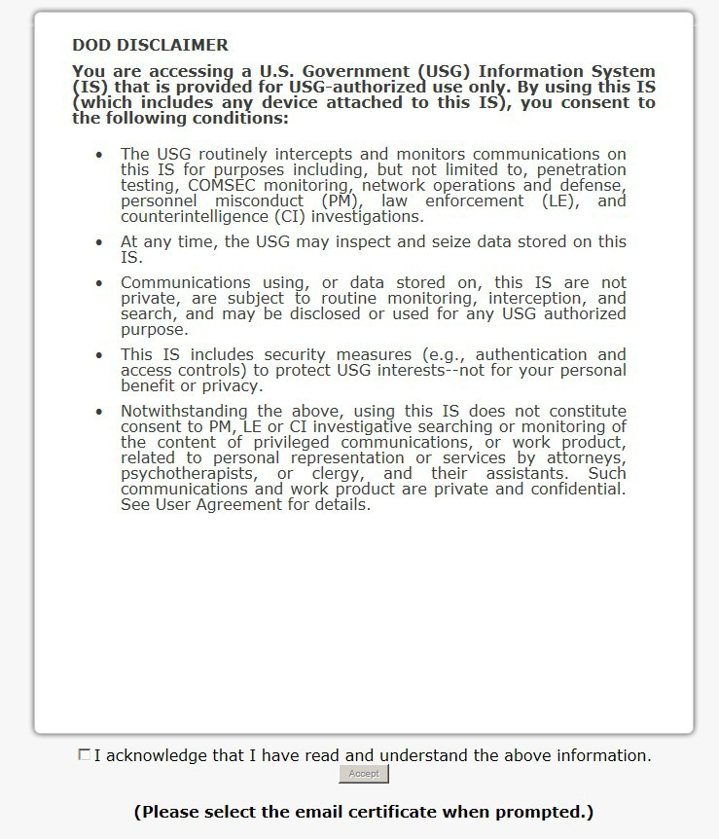

SETM Website Login
AMERICA’S ARMY:
THE STRENGTH OF THE NATION
Senior Civilian Army Talent Management – Army Strong!
13

Slide 14

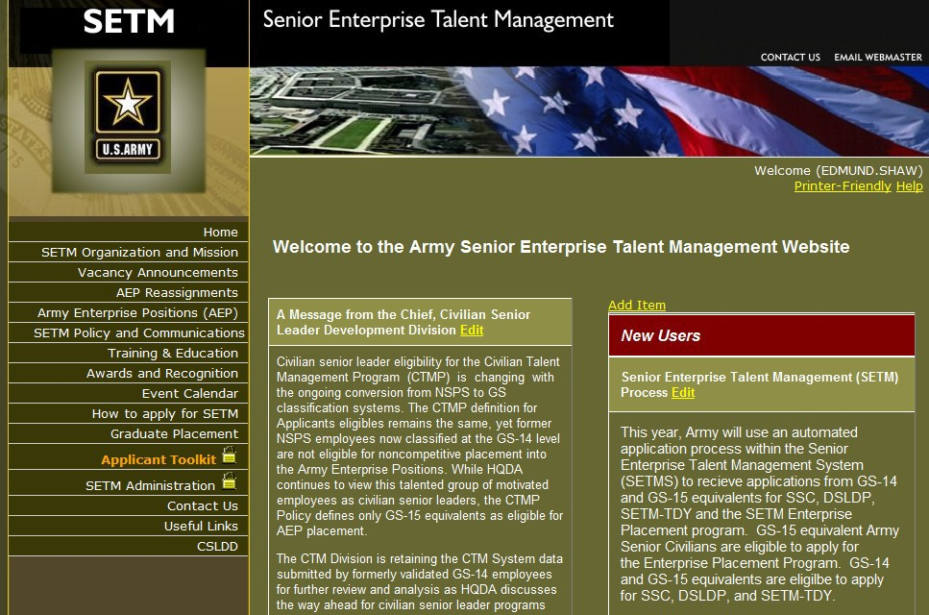

Application Process II
’S ARMY:
A^{A}MEMER^{RI}ICA^{CA}’S ARMY:
THE STRENGTH OF THE NATION THE STRENGTH OF THE NATION
AMERICA’S ARMY:
THE STRENGTH OF THE NATION
Do you see your name or Guest?
Do you see the Applicant Toolkit link?
If you are a GS-12 through GS-15 or equivalent and cannot answer yes to both questions please close your browser and ensure to select your “email” certificate.
If does not work, please contact the appropriate CLDO POCs.
14

Slide 15
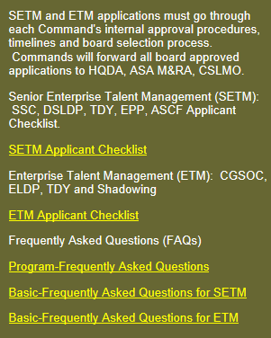


Application Process III
’S ARMY:
A^{A}MEMER^{RI}ICA^{CA}’S ARMY:
THE STRENGTH OF THE NATION THE STRENGTH OF THE NATION
AMERICA’S ARMY:
THE STRENGTH OF THE NATION
15

Slide 16
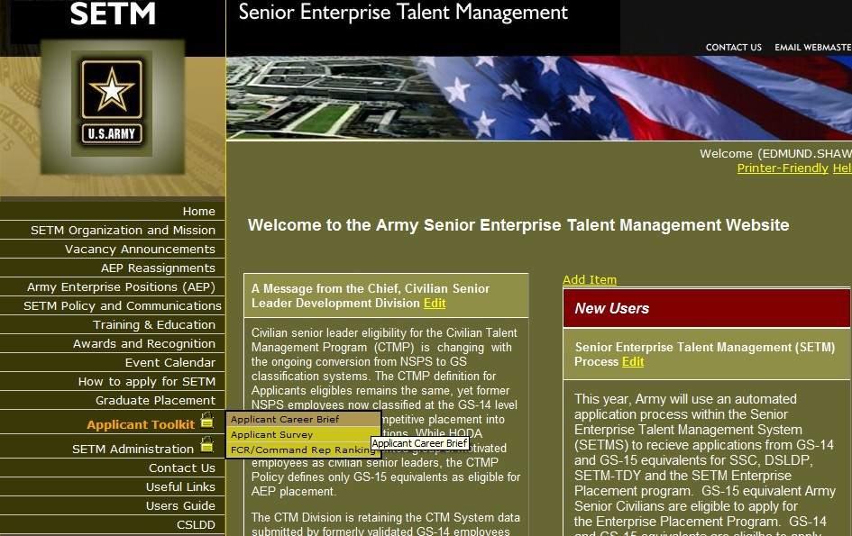
Career Brief
’S ARMY:
A^{A}MEMER^{RI}ICA^{CA}’S ARMY:
THE STRENGTH OF THE NATION THE STRENGTH OF THE NATION
AMERICA’S ARMY:
THE STRENGTH OF THE NATION
16

Slide 17
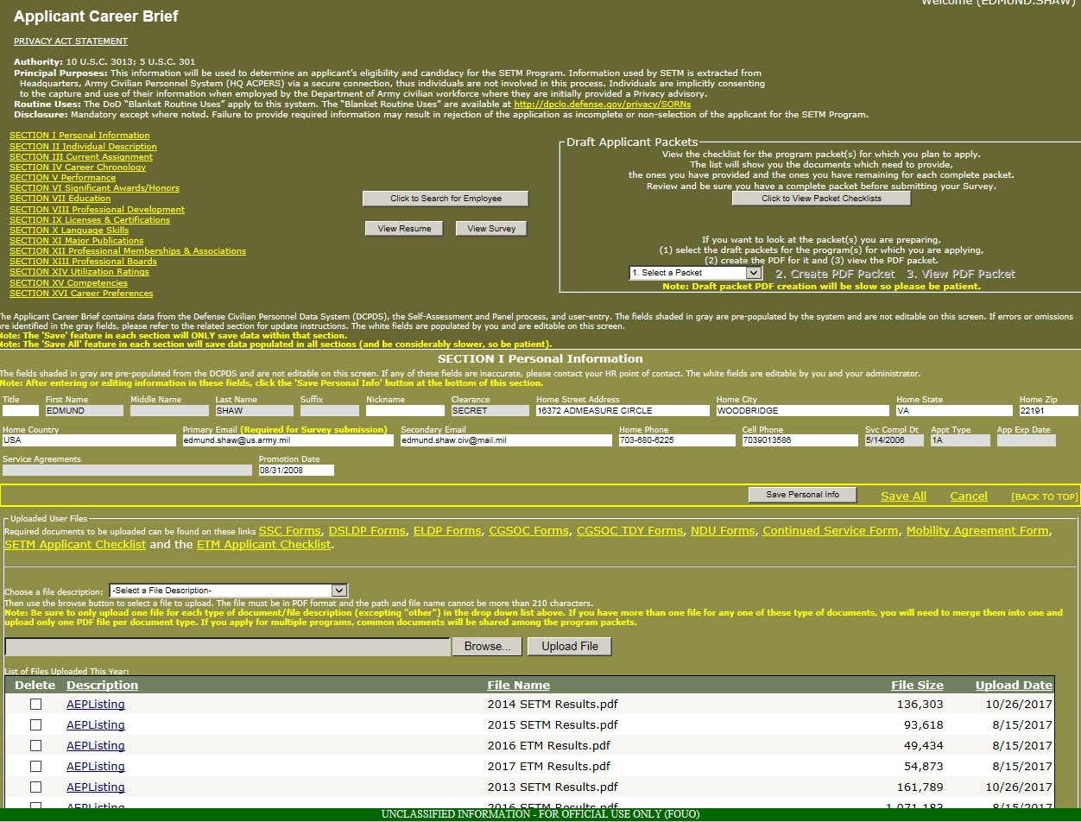

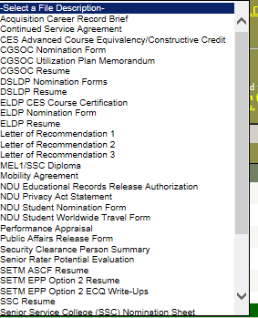
Career Brief Section I
AMERICA’S ARMY:
THE STRENGTH OF THE NATION
17

Slide 18
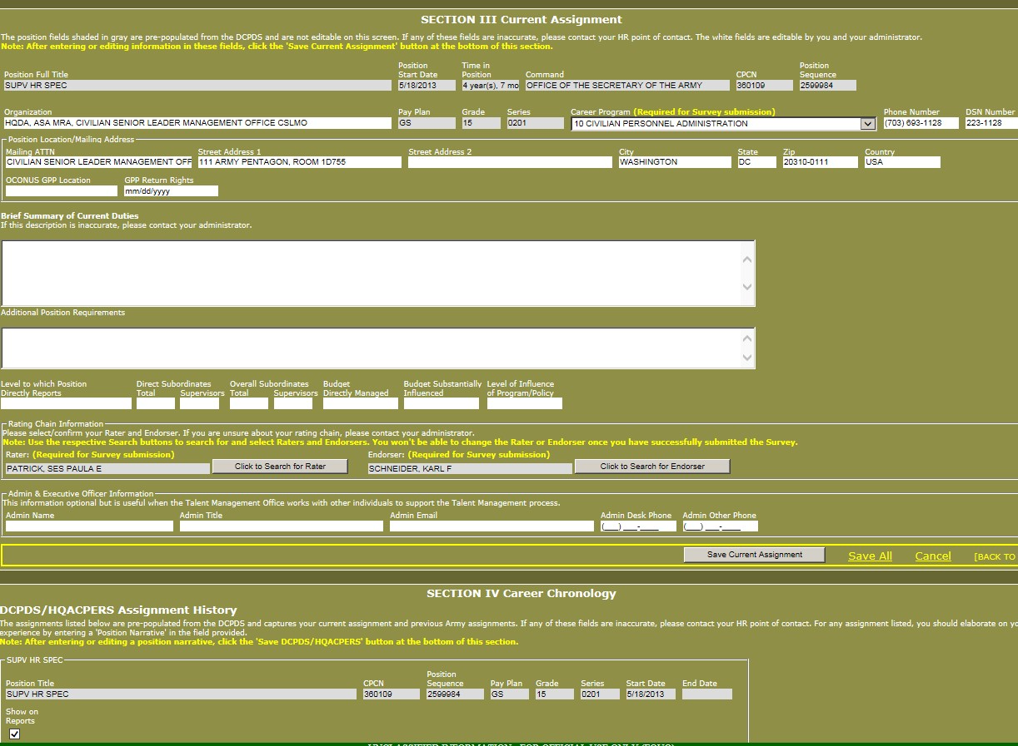
Career Brief Section III / IV
AMERICA’S ARMY:
THE STRENGTH OF THE NATION
18

Slide 19
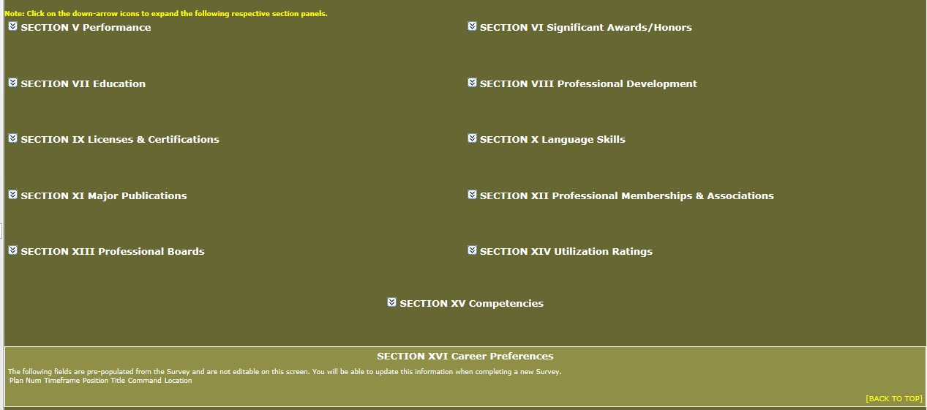
Career Brief Section V - XVI
AMERICA’S ARMY:
THE STRENGTH OF THE NATION
19

Slide 20
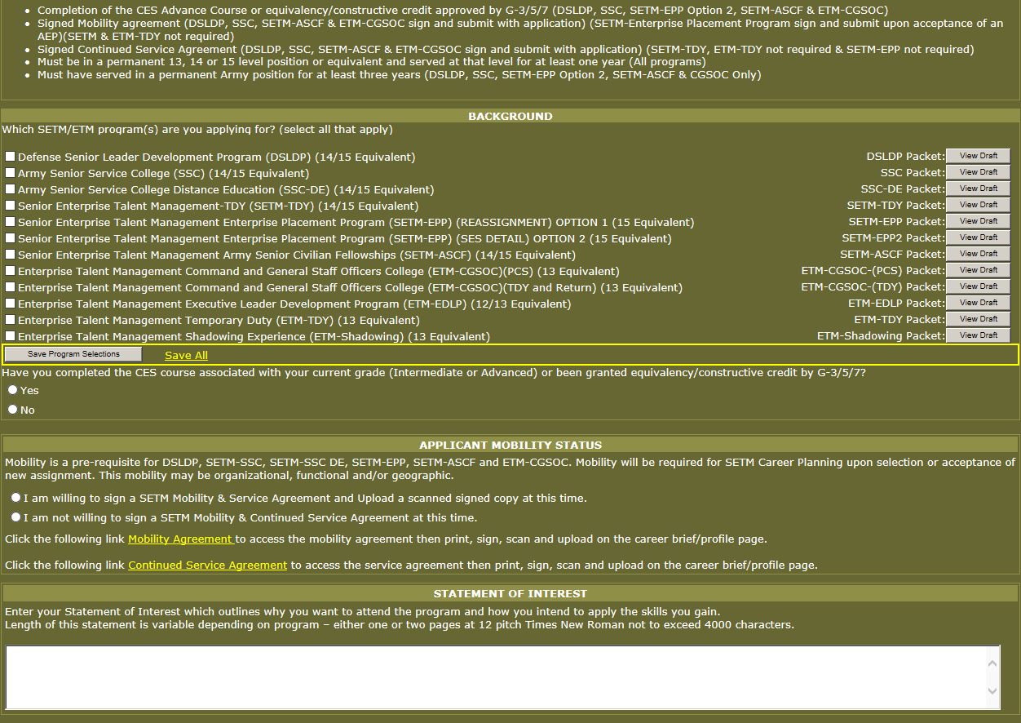

Applicant Survey
AMERICA’S ARMY:
THE STRENGTH OF THE NATION
20

Slide 21
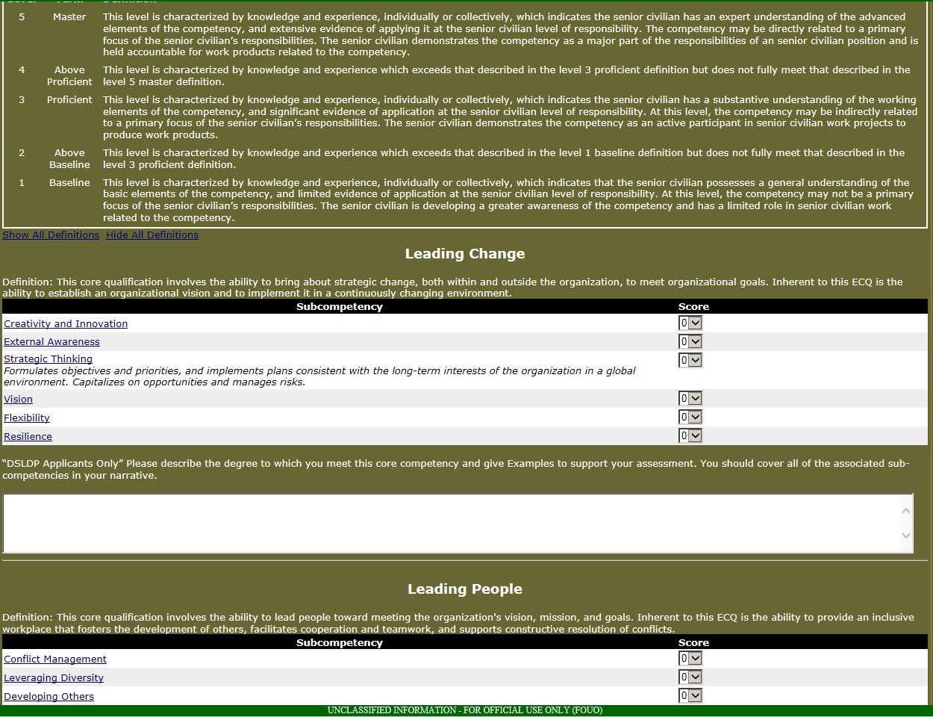

Applicant Survey (ECQs)
AMERICA’S ARMY:
THE STRENGTH OF THE NATION
21

Slide 22
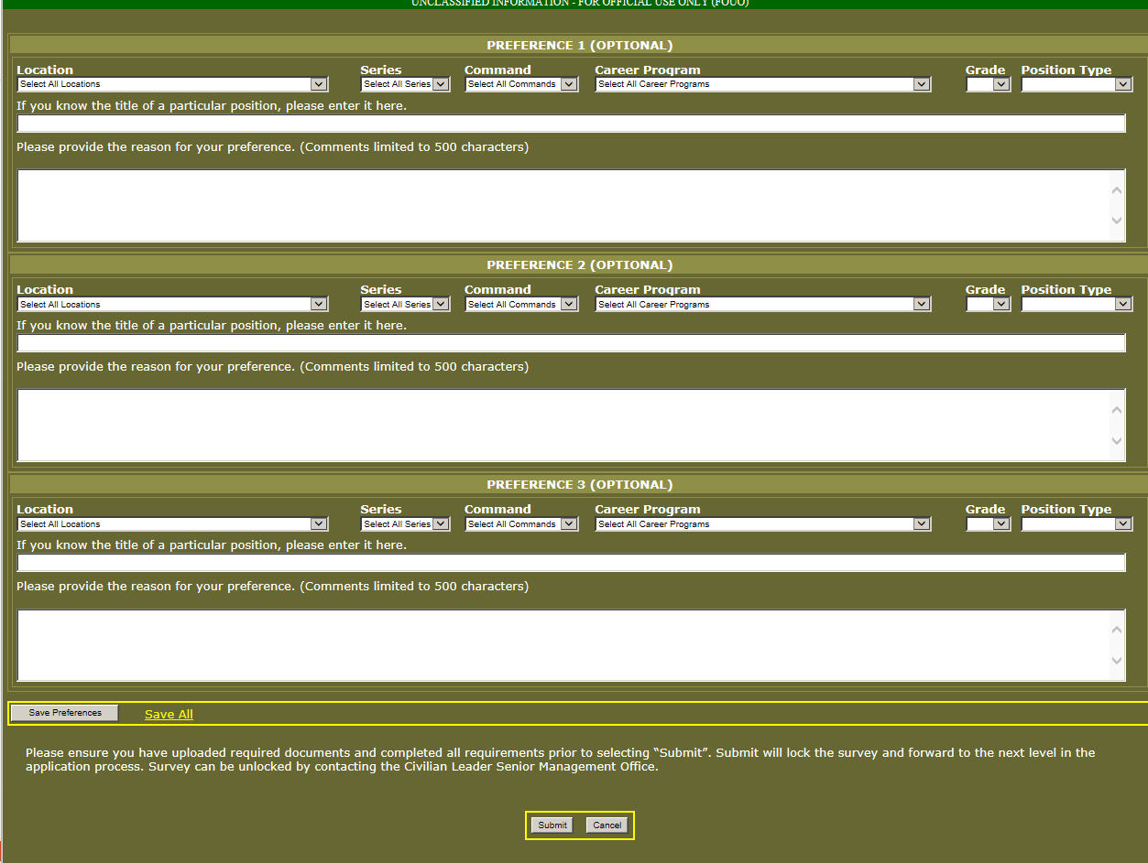

Applicant Survey
AMERICA’S ARMY:
THE STRENGTH OF THE NATION
22

Slide 23
Application Process Flow Chart
AMERICA’S ARMY:
THE STRENGTH OF THE NATION
Applicants apply for Senior Enterprise Talent Management and Enterprise Talent Management Programs using the Senior Enterprise Talent Management (SETM) portal.
Applicant begins the process by completing the Career Brief and Survey in the SETM portal.
Applicant completes the Survey assessing him/herself on the ECQ Competencies, prepares a statement of Interest, selects programs and submits their applications.
Rating Official/Supervisor submits application. Endorser (1st GO or SES equivalent in chain of command) is notified via email there is a pending application.
Endorser assesses applicants and provide comments as to why the applicant should be selected for this program.
Rating Official/Supervisor is notified via email there is a pending application.
Rating Official/Supervisor assesses applicants and provide comments as to why the applicant should be selected for this program.
Recommend Disapproval All
No
Programs
Yes
Rating Official/Supervisor provides justification for disapproval.
STOP
Endorser submits
application. FCR is notified via email there is a pending application.
No
Recommend Disapproval All
Programs
Yes
Rating Official/Supervisor
provides justification for disapproval.
STOP
23

Slide 24
FCR Process Flow Chart
AMERICA’S ARMY:
THE STRENGTH OF THE NATION
CP
Careerist
Yes
Career Program Management Team (CPMT) assemble package the FCR’s review.
FCR assess applicants within their CP and establishes the OML.
CPMT uploads OML Listing into SETM portal.
Applicant is considered by their respective Command Board and builds an OML.
Command OMLs uploaded into to SETM portal.
CLDO SETM/ETM Boards
Roles
Rater = Supervisor
Endorser = GO or SES in Chain of Command
FCR = SES level in CP
24

Slide 25
SETM Board Recommendations
AMERICA’S ARMY:
THE STRENGTH OF THE NATION
Recommendations located on the SETM system under “How to apply for SETM/Application Helpful Hints”
Time Invested in Completing Application
Statement of Interest
Appraisals (Employee Potential)
Rater/Endorser/FCR Comments
Resume Accomplishments (Measurable and Quantifiable)
Competency Scoring
25

Slide 26
SETM/ETM Programs POCs
AMERICA’S ARMY:
THE STRENGTH OF THE NATION
AMERICA’S ARMY:
THE STRENGTH OF THE NATION
Chief, Civilian Leader Development Office
edmund.shaw.civ@mail.mil or 703-693-1128
SSC and ASCF Program Manager
timothy.l.mclean2.civ@mail.mil or 703-695-7987
DSLDP, CGSOC, ETM-TDY, Shadowing and GPP
Program Manager
angel.l.maldonadoramirez.civ@mail.mil or 703-695-4834
ELDP and SETM-TDY Program Manager
lori.a.rhoades.civ@mail.mil or 703-692-1275
CLDO Group Email
usarmy.pentagon.hqda-asa-mra.list.samr-cslmo-edd@mail.mil
SETMS Homepage https://www.csldo.army.mil//Index.aspx
26

Slide 27
AMERICA’S ARMY:
THE STRENGTH OF THE NATION
AMERICA’S ARMY:
THE STRENGTH OF THE NATION
Back-up Slides for SETM/ETM Application and
Board Preparation
27

Slide 28
Additional Briefing Slides
AMERICA’S ARMY:
THE STRENGTH OF THE NATION
SETM Board Review and Analysis
Competence Assessment of Candidates
  Performance and Potential
  Statement of Interest
  Rater’s Assessment
  Endorser’s Assessment
  Functional Chief Representative
  Executive Core Qualifications
  Candidates’ Resumes
Training Education
Utilization and Assignments
SETM Packets
28

Slide 29
Board Review and Analysis
AMERICA’S ARMY:
THE STRENGTH OF THE NATION
Competence Assessment of Candidates (1 of 7)
Performance and Potential:
  Comments that clearly articulated a candidate’s performance and future potential viewed as a plus.
  Weak comments sent a clear message to the board and pondered rating chain’s support of candidate.
  Length of time candidates spent in the assignments coupled with Executive Core Qualifications (ECQs) that represent the critical leadership skills were positives.
  The five documents that helped produce the most accurate snapshot of the candidates were the Statement of Interest, Raters’ Assessment, Endorsers’ Assessment, ECQs submitted by the candidates and candidates’ resumes.
29

Slide 30
Board Review and Analysis
AMERICA’S ARMY:
THE STRENGTH OF THE NATION
Competence Assessment of Candidates (2 of 7)
Statement of Interest:
  That clearly articulated a goal and path using the SETM programs as developmental vehicles to achieve the goal set the stage for the board member.
  The statement of interest was the first look at the candidates’ ability to construct a vision and develop this vision into a tangible end state through written communication.
  Error free, well- constructed statements of interest with a logical flow were a plus.

Slide 31
Board Review and Analysis
AMERICA’S ARMY:
THE STRENGTH OF THE NATION
Competence Assessment of Candidates (3 of 7)
Rater’s Assessment:
  Raters did not routinely send clear and consistent messages reflecting performance and potential.
  Raters should be educated on the impact of inconsistent messaging.
  Raters that distinguished excellence in the performance of their employee painted a picture of potential and confidence in the employee’s ability to perform at higher levels.
• High ratings must be justified and measurable.

Slide 32
Board Review and Analysis
AMERICA’S ARMY:
THE STRENGTH OF THE NATION
Competence Assessment of Candidates (4 of 7)
Endorser’s Assessment:
  Carried a lot of weight when the verbiage correlated with the score assigned to each competency.
  Endorsers were most effective when their rating reflected the competency demonstrated by the applicants as major parts of their responsibility.
  The Board weighs heavily on endorsers’ inputs.
  Endorsers are encouraged to help manage their highly performing employees’ careers.

Slide 33
Board Review and Analysis
AMERICA’S ARMY:
THE STRENGTH OF THE NATION
Competence Assessment of Candidates (5 of 7)
Functional Chief Representative (FCR):
  FCR endorsements are an asset to the board.
  FCR endorsements that expressed the applicant’s accomplishments, developmental needs and rating within the career program was informative to the board.

Slide 34
Board Review and Analysis
AMERICA’S ARMY:
THE STRENGTH OF THE NATION
Competence Assessment of Candidates (6 of 7)
Executive Core Qualifications (ECQs):
  The ECQs define the competencies needed to build a federal corporate culture that drives for results, serves customers and builds successful teams and coalitions within and outside the organization.
  Each core qualification has sub-components. Each sub- component of the ECQs should be addressed as completely as possible.
  In many cases, candidates’ ECQs were not complete and did not correlate with their individual accomplishments verses accomplishments of a team or group. CLDO recommends candidate and rating chain seek SES involvement to properly prepare ECQs.

Slide 35
Board Review and Analysis
AMERICA’S ARMY:
THE STRENGTH OF THE NATION
Competence Assessment of Candidates (7 of 7)
Candidates’ Resumes:
  Having a solid and effective resume greatly improved applicant chances for selection.
  Putting the most important information first; previous work experience, generally was the most effective resumes.
  Back up qualities and strengths, instead of listing responsibilities, list and describe professional achievements with quantifiable and tangible examples that demonstrate results and outcomes.
  Incomplete documentation sent a negative message to the Board.
35

Slide 36
Board Review and Analysis
AMERICA’S ARMY:
THE STRENGTH OF THE NATION
Training and Education
Although Civilian education is a prerequisite and Bachelor's Degree is a requirement for Professional Military Education (PME) programs, higher degrees did not impact candidates negatively or positively.
The Board tended to view developmental courses completed, like the Civilian Education System Advanced Course, positively, showing that individuals were lifelong learners and concerned with their professional development.
36

Slide 37
Board Review and Analysis
AMERICA’S ARMY:
THE STRENGTH OF THE NATION
Utilization and Assignments
The Board viewed applicants’ records that displayed outstanding service in a range of diverse assignments, which showed normal progression, to include special assignments.
It is essential that leaders in the field place high performing subordinates in career enhancing and professional growth assignments.
The board considered the length of time the applicant has been in their current assignment to see if they had enough time to make contributions and accomplish organizational goals.
• Accomplishments should have been quantifiable and measurable.
37

Slide 38
Board Review and Analysis
AMERICA’S ARMY:
THE STRENGTH OF THE NATION
SETM Packets
The overall quality and content of a packet is the first representation of a candidate view by the Board.
Packets missing documents were considered incomplete and not considered by the board. We strongly recommend candidates to request their transcripts immediately. Transcripts received after CLDO’s deadline are viewed as an incomplete packet.
It was imperative that candidates, leaders, and Command representatives started the packets early and paid close attention to detail to the general content of each packet.
Applicants are highly encouraged to compete for multiple programs.
38

