Slide 1
Supplier Self-Services (SUS) Vendor Training
for Value Based Contracts
Last Updated 31 January 2017
ASA (FM&C)

Slide 2
Vendor Training Table of Contents
What is Supplier Self-Service (SUS)………………………..{Slide # 3}
Vendor System Requirements…………….………….……..{Slide # 4}
WAWF/SUS Log On Instructions…………………….……...{Slide # 5}
SUS Screen Shot Instructions…………..………………….{Slide # 14}
Acknowledge Award or
Modification Create Confirmation
Create E-Invoice
Verify Documents Posted …….……………………............{Slide # 27}
Check Payment Status………………………………………{Slide # 29}
Printing or Saving SUS Documents ….……………………{Slide # 30}
Create Credit Memo to Cancel Invoice…..………………...{Slide # 32}
SUS Support Contact Information…………...………..........{Slide # 33}
WAWF Vendor History Folder & Notifications ……….........{Slide # 34}

Slide 3
What is Supplier Self-Services (SUS)?
SUS is a Vendor Portal
Maintains WAWF as the single face to industry for DoD invoicing
User ID management and secure provisioning by CAGE remains in WAWF
Seamlessly logs vendor into SUS based on assigned Pay Office
“One-Stop” interface developed by WAWF
Summary data updated in WAWF for a consolidated view for all of DoD
Utilizes standard GFEBS functionality
Improves Army end-to-end visibility and auditability
Defaults GFEBS PO obligation data to the vendor
Pre-populates vendor invoice data with pre-validated GFEBS data
Allows for identification of errors early in the process
Vendors to validate PO accurately reflects contract terms immediately after award
Vendor input restricted to prevent conflict with contract
i.e., can input Quantity, but cannot change fields like Unit of Measure or Unit Price
Provides vendor integrated visibility of open amount and real-time invoice processing status
Prevents delay in acceptance posting in GFEBS
Eliminates manual intervention to improve auditability
Reduces interest penalties

Slide 4
Vendor System Requirements
Internet Access
Must use Internet Explorer
– Under
or Tools, select Compatibility View Settings
Add “Army.mil”
Close all sessions of Internet Explorer and re-open to re-initialize
WAWF user id
Ensure id used is assigned to CAGE code for SUS contract award
If you are a new user, please navigate to the following website to establish a new vendor account
https://wawf.eb.mil/ or call 1-866-618-5988
Pay Office on contract is assigned HQ0678 for Army GFEBS SUS
Will route user from WAWF to GFEBS SUS vendor portal
4
12/8/2015

Slide 5
WAWF/SUS Log On Instructions
5

Slide 6
Steps 1-11 are same for normal WAWF login to complete invoice entry
Log into WAWF as normal by clicking the “Accept” button
NOTE: WAWF is the official DoD system point of entry to industry for submitting invoices. WAWF will direct user to SUS in step 12.
1

Slide 7
Enter WAWF user ID and password and click “Login”
Management of allowed WAWF users remains with WAWF administrator
If you are a new user and need a User ID and password, see slide #4 for instructions.
2

Slide 8
Select “iRAPT”
3

Slide 9
Once in iRAPT, select “Vendor“ and “Create Document”
4

Slide 10
xxxxxxxxxxxx
DoD Contract (FAR)
xxxxxxxxxxxx
W9124712P0091
Vendor CAGE / DUNS number defaults from logon, verify matches award
Auto-populated after contract # entered , enter contract number and delivery order (if applicable for A or D contracts) . Select “Next”
5
6
7
8
9

Slide 11
XXXXXXXXX XXX XXXXXX
DoD Contract (FAR)
If CLINs are listed, do not double click to go into CLIN details, select “Next”
Validate Pay Official field = HQ0678 ; if not – contact your Contracting Office POC.
When "HQ0678“, system will direct to GFEBSP2P for SUS invoice entry instead of WAWF.
Select “Next”.
10
11

Slide 12
**NEW SCREEN**
XXXXXXXXX XXX XXXXXX
Red Messages above are displayed to identify pilot
NOTE: SUS is a component of the Army Procure-to-Pay (P2P) pilot
Select “Open GFEBSP2P in new window”
12

Slide 13
13
Read notice and select “OK” to be directed to SUS
13

Slide 14
SUS Screen Shot Instructions

Slide 15
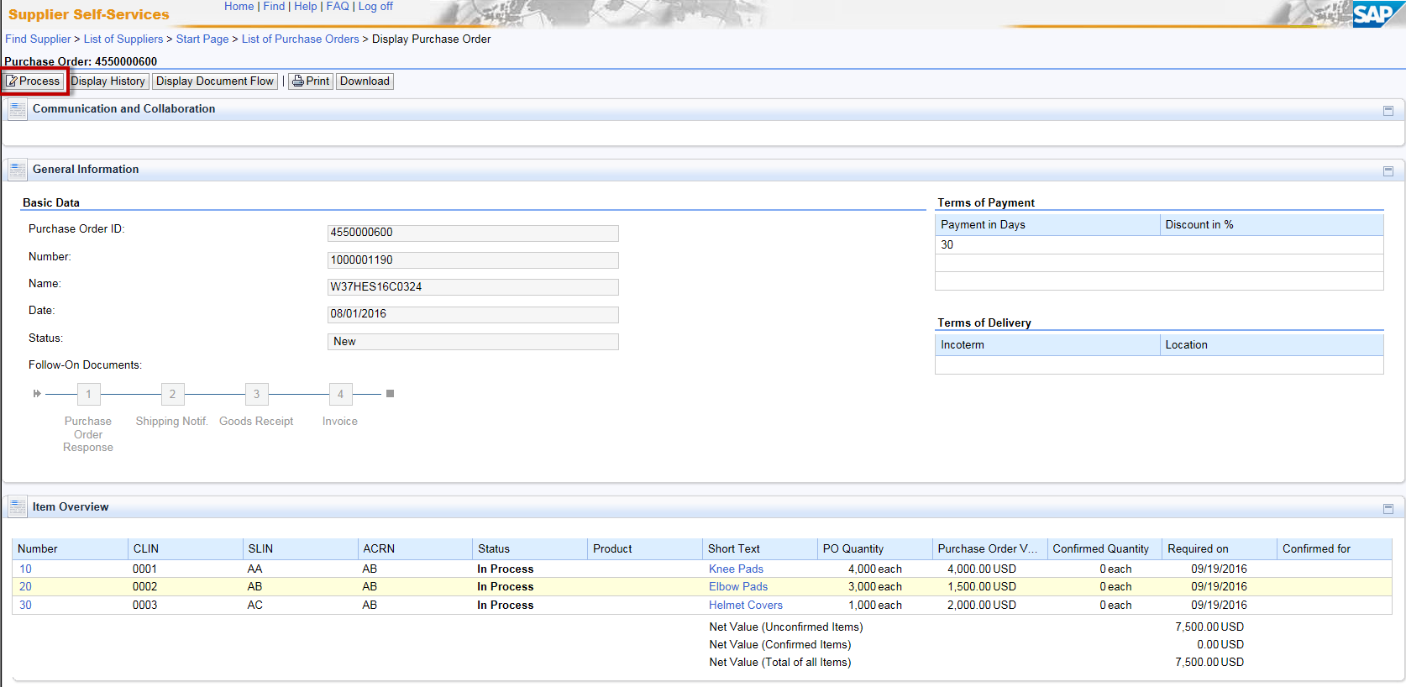
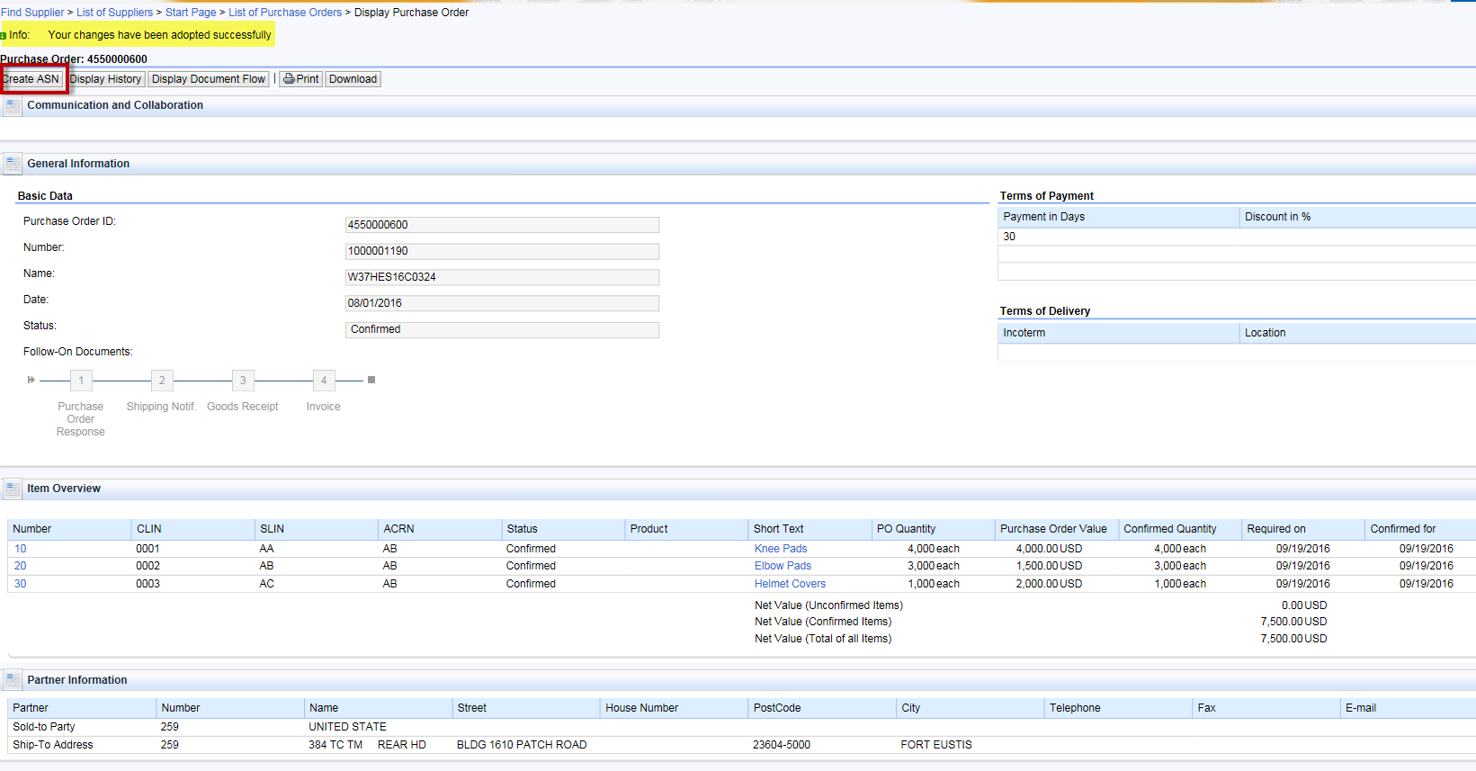
3 Steps to Submit Invoice in SUS for Value Based
“Process” to acknowledge SUS system matches contract
Only required for initial award or if award modified
Goal is to ensure system correctly captures contract award or modification
“Create Confirmation” of value or service provided
Notifies government what you delivered
3. “Create/Send E-Invoice” to match Confirmation
Sends invoice to DFAS Accounts Payable (A/P) for payment
SUS Pilot prepopulates contract information enabling faster payment to vendor

Slide 16
Step 1a. PO Acknowledgment
Contract number entered in WAWF (step #7, slide 8) will auto-direct user to the associated SUS Purchase Order (PO) document.
PO data is replicated from Army GFEBS (accounting and entitlement system) to SUS for vendor to confirm goods delivered or services performed & create invoice.
1a. Compare SUS PO to PDF of contract award.
If no discrepancies, select “Process” to prepare Acknowledgment.
If a discrepancy, call the Contracting Officer listed on the contract award.
NOTE: “Process” button appears for a new or changed contract/PO.
Must acknowledge (or reject) prior to creating follow-on documents.
Basic (or header) data shown above comes from awarded contract

Slide 17
Step 1b. PO Acknowledgment
Review PO CLIN data to make sure amount matches award
 | 1b. If any lines show on PO that were fully invoiced in WAWF, see slide #38 for further instructions on how to first reject those lines by CLIN. If all lines are correct, select “Confirm all items” to see GREEN CHECKs.

Slide 18
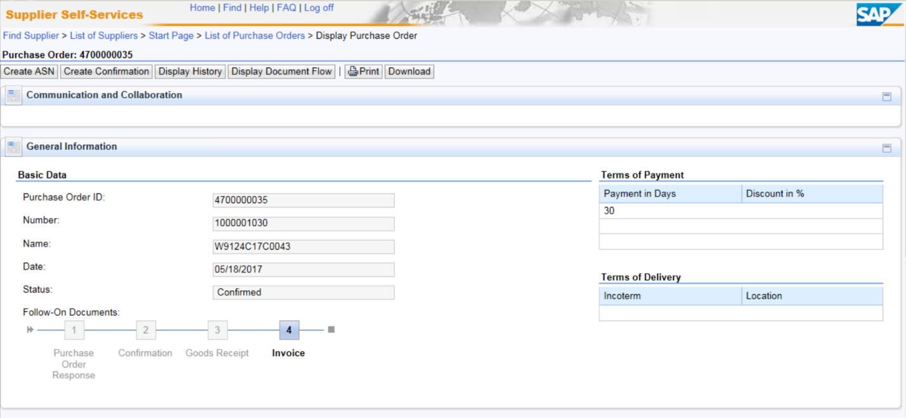
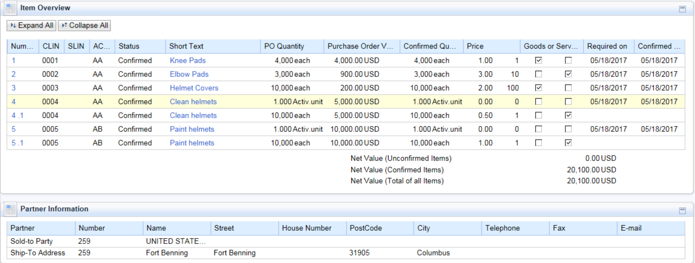
Step 1c. PO Acknowledgment
1c. Review new “Goods or Services” Field and update the fields as necessary to appropriately label each CLIN.
For Goods – a delivery date will be required
For Services – a period of performance will be required
Note: The system checks the box it believes to be the accurate based upon the contract Unit of Measure. CLINS with a Unit of Measure ‘Activity Unit’ must be a Service.

Slide 19
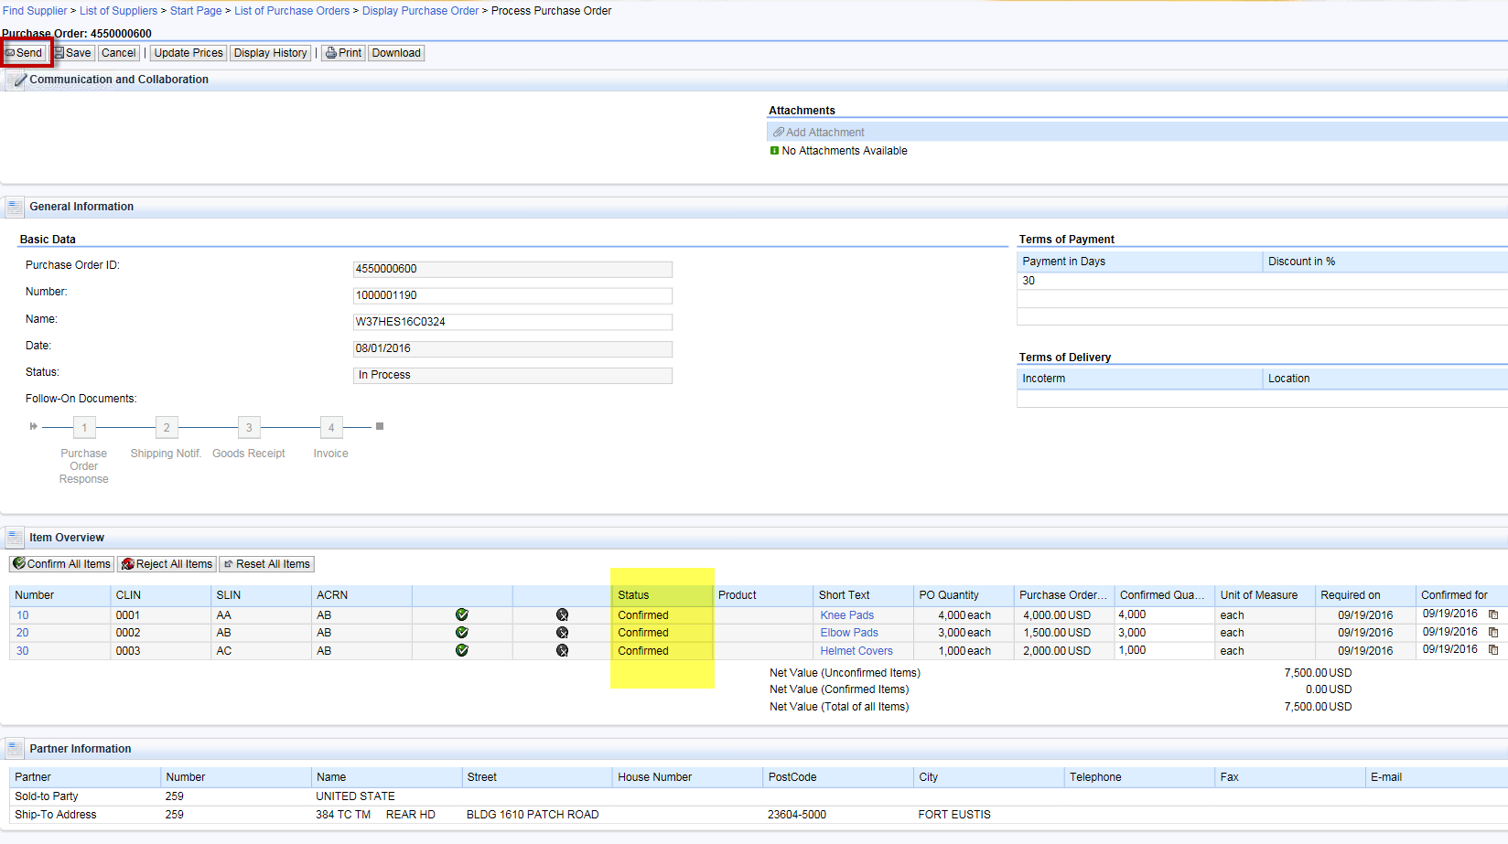
Step 1d. PO Acknowledgment
1d. Verify status updated to “Confirmed”, then select “Send” to submit.

Slide 20
Step 2a. Create Confirmation for Quantity or Amount
Verify message shown at the top of page indicates a successful posting.
NOTE: Yellow warning messages can be ignored.
2a. Next step, select “Create Confirmation”.
This action creates a document similar to WAWF Receiving Report.

Slide 21
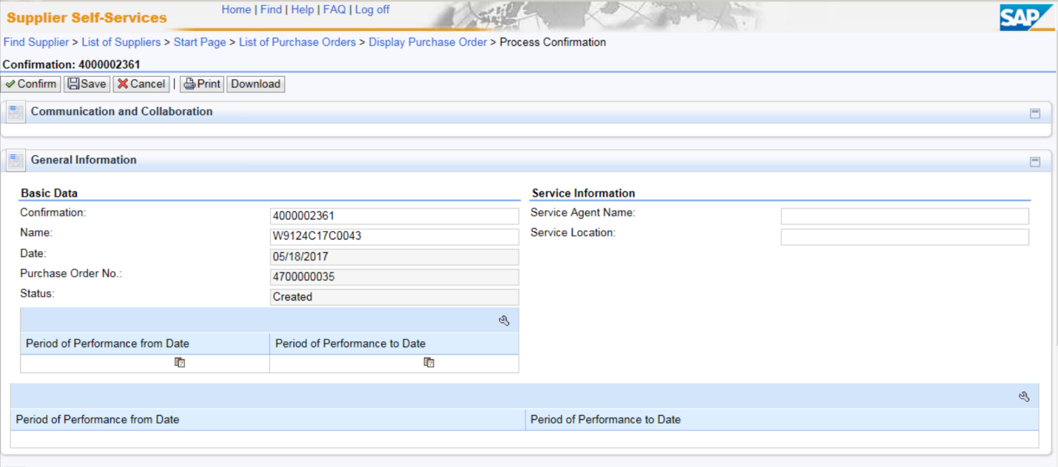
Step 2b. Create Confirmation for Quantity or Amount
2b. Enter the Period of Performance (to and from) dates of any CLINS provided using the calendar drop down.

Slide 22
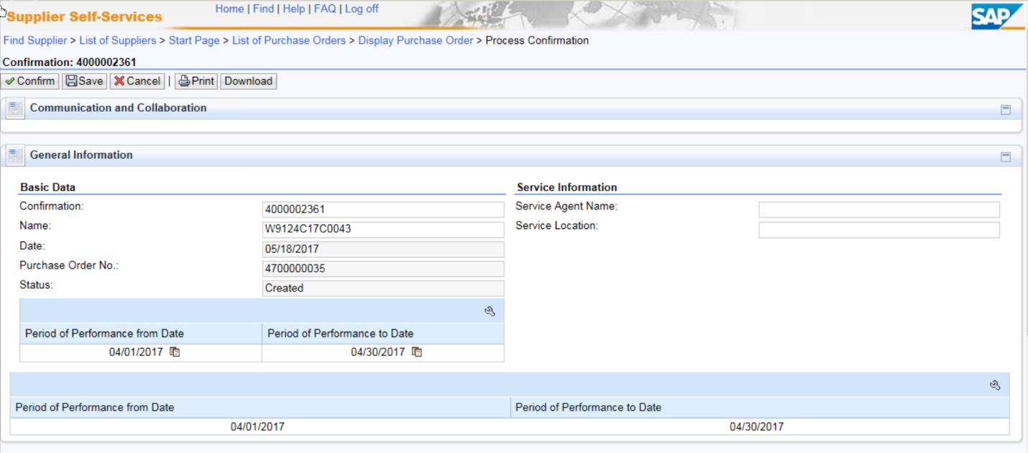
Step 2c/d. Confirmation for Quantity or Amount
Option: If you are unsure of quantity or amount remaining on the CLIN, click the Item Selection then “Propose Outstanding Quantities” button to default the Open amount.
2c. Enter Quantity provided
If CLIN unit of measure is “Activ.unit” (or Job), enter dollar value of service performed in quantity field.
If CLIN unit of measure is “Months, Hours, etc.”, enter quantity of service performed in quantity field.
2d. Verify entries for all CLINs, and select “Confirm” to send the confirmation to acceptor.
NOTES:
Do not change the defaulted 40000* Number.
Common error is to enter “1” for quantity when unit is “Activ.unit”. This is a Confirmation of only $1.00.
If you select “SAVE”, confirmation is NOT sent to acceptor, but saved in SUS for later submission or cancellation.
Acceptor will be notified via email the following morning.
If you are required to send attachments, you must send an email with attachments directly to acceptor listed on contract.

Slide 23
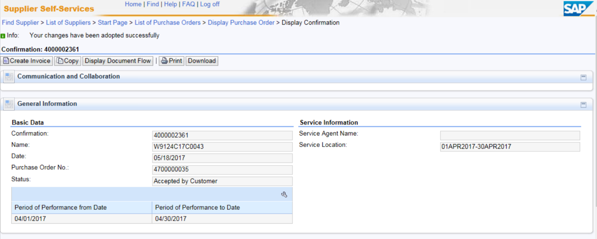
Step 3a. Create E-Invoice
Verify message shown at the top of page indicates a successful posting.
NOTE: Yellow warning messages can be ignored.
3a. Next step, select “Create Invoice”
**ALERT**
Invoice data is defaulted from the submitted Confirmation.
DO NOT change Quantity or Net Value on the invoice because it must match Confirmation for payment certification.
If invoice is incorrect, select “Cancel” before sending invoice, then go back and “Cancel Confirmation”. Create a new Confirmation for the corrected quantity delivered, then submit a matching invoice.

Slide 24
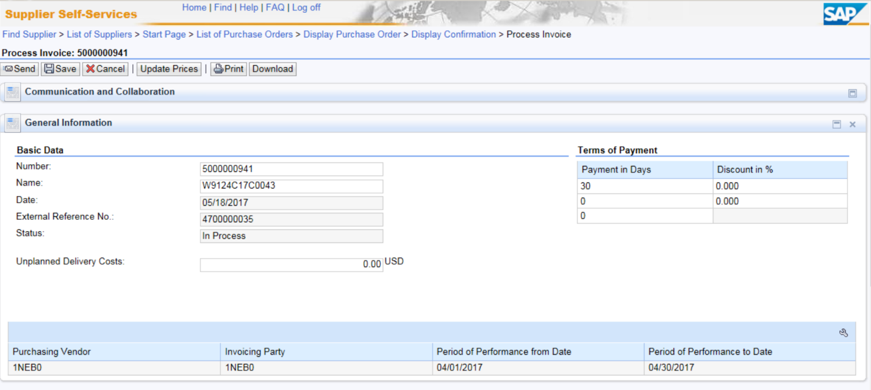
Step 3b. Create E-Invoice
3b. A system generated sequential Number is assigned to the invoice.
Optional: You may change the defaulted sequential Number to your internal vendor reference number to help you recognize your payment. The Number will be on the payment addenda record. Number must be unique, so suggest to begin with your 5 digit vendor CAGE code.
New PoP fields auto-populate from Confirmation
23

Slide 25
Step 3c. Create E-Invoice
3c. When Gross Price is verified, select “Send” to send the document to DFAS for payment.
NOTE: If “SAVE”, document is NOT sent to DFAS, but saved in SUS for later submission or cancellation.
NOTE:
DO NOT change Quantity or Net Value on invoice since it must match Confirmation for payment certification.
DO NOT enter “Unplanned Delivery Costs” since delivery costs must have a separate funded CLIN. Scroll down to enter payment terms for discounts offered if included on awarded contract.
If Quantity or Net Value is incorrect, “Cancel” and do not send invoice. Go back to “Cancel Confirmation” and notify Acceptor to reject.
Must “Create Confirmation” again for the corrected quantity delivered, then submit a matching invoice.
24

Slide 26
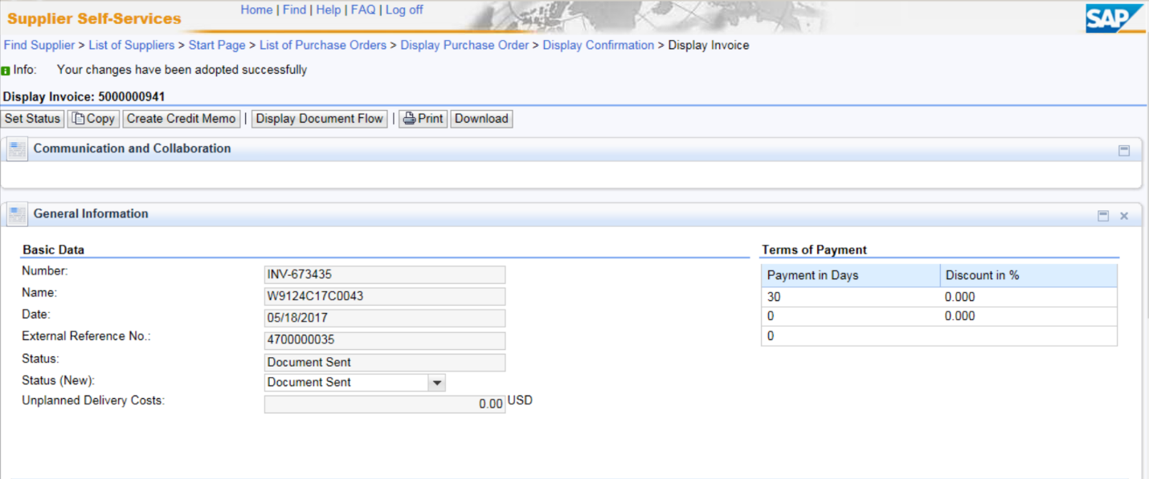
Step 3e. Create E-Invoice
Verify message shown at the top of page indicates a successful posting.
NOTE: Yellow warning messages can be ignored.
3e. SUS notification to Acceptor and invoice submission complete.
NOTE:
Status = “Accepted by Customer” means successfully sent to GFEBS. No need to change.
Acceptor is notified of Inbound Delivery created from Confirmation submitted after nightly background job.
Email acceptor with any required attachments or to notify earlier than next day of submitted documents.
Acceptor should post acceptance (or rejection) within 7 days per the DFARS.
Notification of acceptance should be received via WAWF email and shown in “Display Document Flow” (see examples – Slide # 29)

Slide 27
Verify Documents Posted Check Payment Status
Printing & Saving SUS Documents Create Credit Memo to Cancel Invoice

Slide 28
Verify Documents Posted
Select “Home”
Select “All Invoices and Credit Memos” to view listing of documents and status Select “All Purchase Orders” to view listing of PO documents
27

Slide 29
Display Document Flow
NOTES:
Lists all documents posted against the PO.
If document status “In Process”, document is NOT sent, but saved in SUS for later submission or cancellation.
If no documents are shown, ensure “army.mil” is added to Internet Explorer > Compatibility View Settings.
To refresh, select Home > Display All Purchase Orders, select PO and “Display Document Flow”.

Slide 30
SUS “Check Payment Status”
Select Invoice from listing to Display Invoice.
Scroll down and select “Check Payment Status” for real-time status
NOTE: you will receive an error as shown below until acceptance has been performed
Invoice will show “Submitted” with GFEBS document number after acceptance
After certified for payment and disbursed, SUS Display Invoice Pymt Status is “PAID” with date and EFT payment reference/TRACE number

Slide 31
Printing or Saving SUS Documents (Optional)
Select “Print” to view/save a PDF of your shipping document or invoice
30

Slide 32
Example of PDF for ASN

Slide 33
Creating a Credit Memo to Cancel Invoice
Display Invoice and select “Create Credit Memo” to cancel an invoice
Sequential Number will default.
Change to original invoice number + “CM” i.e., 5000000932-CM, 1A234-1000-CM, etc.
Select “Send” to send Credit Memo to DFAS A/P to clear against the invoice

Slide 34
SUS Support Contact Information
For Technical SUS help, contact the GFEBS Helpdesk: army.gfebs.helpdesk@mail.mil or 866-757-9771
SUS Pilot Support team:
usarmy.pentagon.hqda-asa-fm.mbx.sus@mail.mil

Slide 35
WAWF Vendor History Folder
&
Notification

Slide 36
WAWF Vendor History Folder
WAWF vendor folder is updated hourly
Will show Invoice status “Processed” meaning posted in Accounting & Entitlement system Will show Receiving Report status as “Submitted”
XXXXX
XXXX | XXXXXX | XXXXXXXXX
XXXX | XXXXXX | XXXXXXXXX
WAWF Receiving Report status updated “Accepted” when Acceptor posts in GFEBS
XXXXX
XXXX
XXXXXX
XXXXXXXXX

Slide 37
Within approximately 1 hour, should receive E-Mail from WAWF providing Confirmation #
XXXXXXXXXXX XXXXXX
XXXXXXXXXXX
XXXXX

Slide 38
E-Mail from WAWF to vendor showing Invoice Posted in WAWF History
XXXXXXXXXXX XXXXX
XXXXXXXXXXX
XXXXX
CAGE-123456
Meaning posted in the Accounting & Entitlement system

Slide 39
Step 1b.Reject Lines Fully Invoiced in WAWF
NOTE: If any lines shown on SUS PO were fully invoiced in WAWF, must first:
select “Reject” (RED X) in Item Overview section below for each closed CLIN
Click “Send”
Then continue with steps to acknowledge/confirm all items shown on slide #17.
Red X to “Reject”

