Slide 1
Supplier Self-Services (SUS)
Contracting Office
July 2018
Fort Carson, CO

Slide 2
Bringing on new SUS contracts
MICC
Accept
or reject
in GFEBS
P2P Team
1.
O&S Tier II
Identify new potential contracts, opt years, delivery or task orders (use checklist) and provide info such as PR#,
POP dates, COR to P2P Team
Request COR (Acceptor)
to obtain the correct
GFEBS access
Include SUS clause in solicitation and provide contract#, call order# and vendor (when known) to P2P Team
Confirm vendor participation in pilot (use email template)
Award (or mod) contract to SUS (Pay Office HQ0678)
(use checklist)
Validate contract is viable SUS candidate (use checklist)
Submit Tier II request for vendor master and variants updates
Confirm PO matches award and replicated successfully to SUS for vendor to confirm
Provide assistance to vendor and COR for initial login & posting
RM
2.
Update vendor master and replicate to SUS (use checklist)
Update variants to add new vendors for GFEBS ECC
and SUS communication
Vendor
2.
Assist COR (Acceptor) with GRC request to obtain the correct
GFEBS access
Update PO in GFEBS to be SUS relevant (use checklist)
COR
3.
4.
Login to SUS via WAWF, acknowledge PO, submit acceptance to COR & invoice
5.
6.
7.
8.
9.
11.
10.
13.
12.
14.

Slide 3
Contracts for SUS
Need listing of upcoming awards with assigned COR/acceptors
Requirements for SUS consideration:
      Current Pay Office HQ0490 (GFEBS)
      No GFEBS PO history
        New contract award or call off / task order (TO) / delivery order (DO)
        If new option year on C/F/P instrument, the previous year CLIN(s) must be fully invoiced
      Contracts where multiple invoices are expected (preferred, not required)
      Firm Fixed Price (FFP) or Indefinite Delivery/Indefinite Quantity (IDIQ)
      GFEBS PO matches award since PO data used by SUS vendor for invoicing
      GFEBS PO updated to be SUS relevant
Other contracts with specific requirements to remain in WAWF:
      MOCAS, construction, progress pay, RFID, IUID, GFE
Contractor must have DUNS number assigned
Acceptor/COR must have GFEBS access
      Training Requirements:
        GR Processor role estimate is 2.5 hours
Notes:
MOCAS – DCMA managed contracts, pay office <> HQ0490 so not entitled (certified for payment) in GFEBS
RFID – Radio Frequency Identification
IUID – Item Unique Identification
GFE – Government Furnished Property

Slide 4
DFARS Class Deviation to use SUS
As of 02 January 2018, Army contracting officers at locations below may use the solicitation and contract clauses provided for SUS in lieu of the clauses for WAWF (DFARS 252.232-7003 and 252.232-7006) for:
New awards, new option year, call off or delivery order/task order
Currently paid through GFEBS (HQ0490)
Excludes contracts that:
Are administered by DCMA;
Are for construction;
Provide Gov’t Furnished Property;
Contain RFID or IUID requirements;
Include progress payments; or
Provide contract financing.
Ft Sam FDO | 418th CSB | 419th CSB | MEDCOM | 413th CSB | FDO Eustis
Ft. Belvoir, VA | Ft. Bliss, TX | Ft. Bragg, NC | USAHCA(P) – Atlantic | Ft. Shafter, HI | Ft. Benning, GA
Ft. Knox, KY | Ft. Carson, CO | Ft. Campbell, KY | USAHCA(P) – Pacific | Ft Wainwright, AK | Ft. Eustis, VA
JBSA, TX | Ft. Hood, TX | Ft. Drum, NY | USAHCA(P) – Central |  | Ft. Gordon, GA
 | JBLM, WA | Ft. Stewart, GA | USAHCA(P) – HRCO |  | Ft. Lee, VA
 | Ft. Riley, KS | Ft. Jackson, SC | USAMRAA |  | Ft. Leonard-Wood, MO
 |  | Ft. McCoy, WI |  |  | West Point, NY

Slide 5
Class Deviation Clauses
252.232-7003 Electronic Submission of Payment Requests and Receiving Reports.
…
(c) The Contractor may submit a payment request and receiving report using other than WAWF only when –
…
  Submitting payment requests and receiving reports to the Supplier Self-Services (SUS) system accessible via the Wide Area Workflow (WAWF) website as an authorized participant in the vendor portal invoicing pilot program.
252.232-7006 Wide Area Workflow (WAWF) Payment Instructions.
…
(b) Electronic invoicing. The WAWF system is the method to electronically process vendor payment requests and receiving reports, as authorized by DFARS 252.232-7003, Electronic Submission of Payment Requests and Receiving Reports (DEVIATION 2018-A0001)(DEC 2017) –
  The WAWF system shall be used to electronically process vendor payment requests and receiving reports, in accordance with paragraph (c) through (g) of this clause; or
  The General Fund Business Enterprise System (GFEBS) Supplier Self-Services (SUS) system shall be used, in accordance with paragraph (h) of this clause, if the Contractor is an authorized participant in the GFEBS SUS invoicing pilot program.
…
(h) GFEBS SUS.
  Access.
  Training.
  Payment Instructions.
  Manual transmission.
  Points of contact.

Slide 6
SUS Contract Clause
Confirmation linked to invoice

Slide 7
Back-up

Slide 8
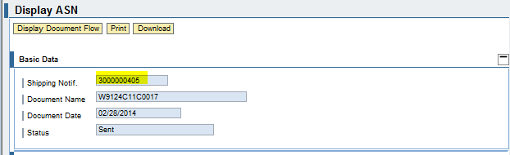
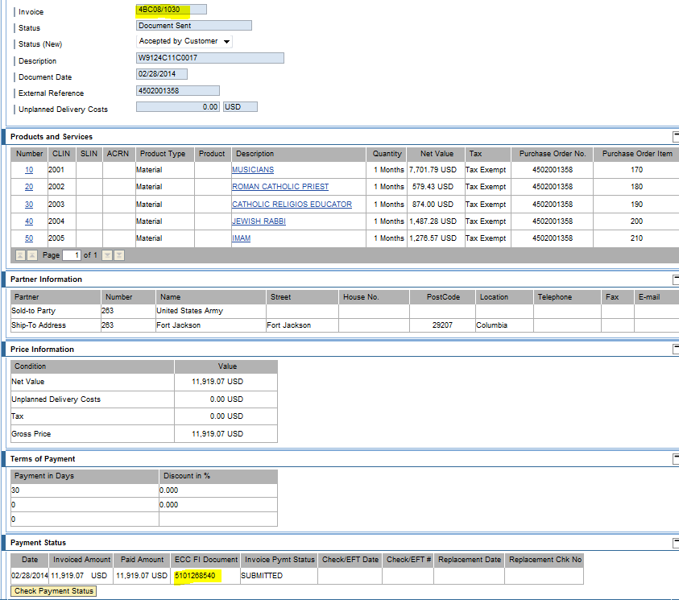
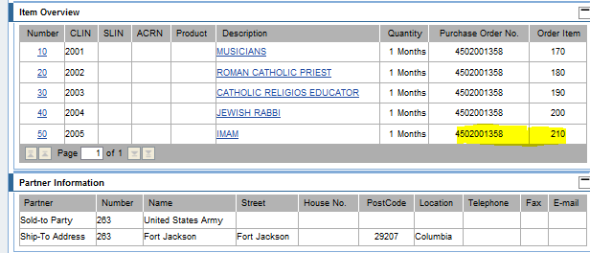
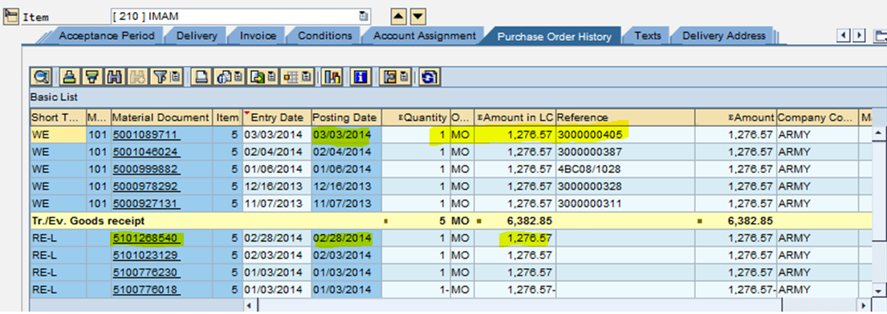
SUS Vendor Documents - Quantity
Advance Ship Notice (ASN) for Quantity Based
Vendor Invoice
ASN linked to invoice
GFEBS PO History
ASN linked to GR in GFEBS
Invoice successfully posted against obligation in GFEBS and
free to pay

Slide 9
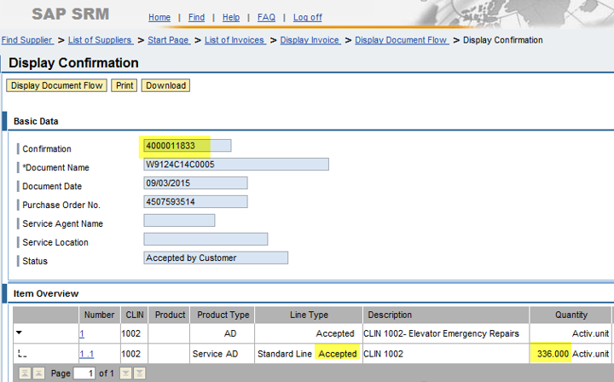
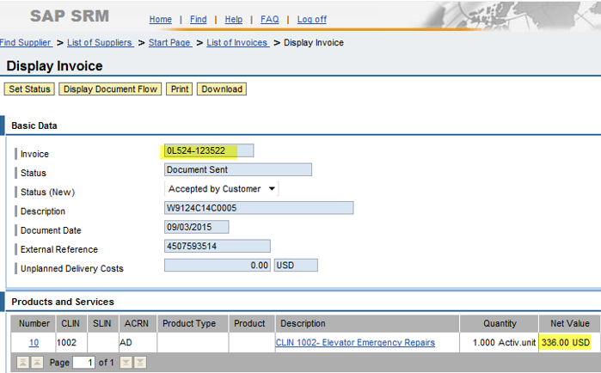
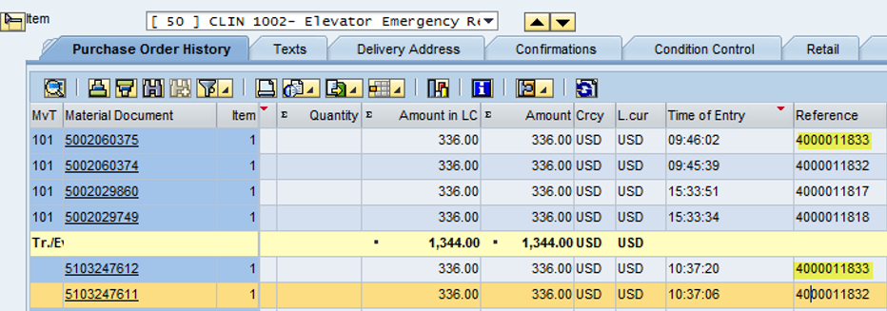
SUS Vendor Documents – Value/Service
Service Confirmation for Value Based
Vendor Invoice
Confirmation linked to invoice
Smith
Building 1000, #1
GFEBS PO History
Confirmation linked to GR in GFEBS
Invoice successfully posted against obligation in GFEBS and
free to pay

Slide 10
Quantity vs. Value Based PO Items
SPS to GFEBS interface to create PO item as Service (Value-Based) if PSC is alpha-numeric (excluding “Q”) - sets:
      Item category to “D”
      Item Order quantity to “1” and Order Unit of Measure to “AU” (Activity Unit)
      Item Net Price is total obligated amount and Order Price Unit to “AU”
      Limits tab populated with obligated amount
GFEBS PO used by SUS vendor, so PO must match the award
      Review of Quantity-based vs. Value-based to determine how to setup PR and PO:
        Ask – How will vendor invoice?
          Exact same amount per EA, MO, etc. = Quantity based
          Varying amount based on number of days, weight, etc. = Service based
    If Vendor will invoice quantity:
      Award as quantity-based
        If PSC is alpha-numeric (excluding “Q”) either:
          Add quantity items to Services tab
    If Vendor will invoice value or varying amount:
      Award as value-based using the Services tab
        Setup PR as 1 “AU” for total obligated amount, then award as 1 Job for total
Notes:
FSC – Federal Supply Classification
PSC – Product or Service Code
If Product Service Code (PSC) is alpha and does not begin with Q
SPS interface designed to create PO as a Service item (value based)
Item Category = D, Order Quantity = 1 and Unit of Measure = AU
Total value of obligation on the limit tab

Slide 11
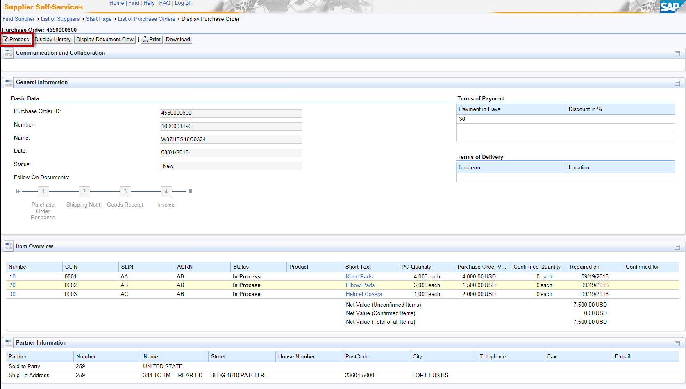
GFEBS PO Replicated to SUS
Near-real time PO data available to the vendor to acknowledge

