Slide 1
Supplier Self-Services (SUS) Resource Manager Training
July 2018
Fort Carson, CO

Slide 2
Bringing on new SUS contracts
MICC
Accept or reject in GFEBS
P2P Team
1.
O&S Tier II
Identify new potential contracts, opt years, delivery or task orders (use checklist) and provide info such as PR#, POP dates, COR to P2P Team
Request COR (Acceptor) to obtain the correct GFEBS access
Include SUS clause in solicitation and provide contract#, call order# and vendor (when known) to P2P Team
Confirm vendor participation in pilot (use email template)
Award (or mod) contract to SUS (Pay Office HQ0678) (use checklist)
Validate contract is viable SUS candidate (use checklist)
Submit Tier II request for vendor master and variants updates
Confirm PO matches award and replicated successfully to SUS for vendor to confirm
Provide assistance to vendor and COR for initial login & posting
RM
2.
Update vendor master and replicate to SUS (use checklist)
Update variants to add new vendors for GFEBS ECC and SUS communication
Vendor
2.
Assist COR (Acceptor) with GRC request to obtain the correct GFEBS access
Update PO in GFEBS to be SUS relevant (use checklist)
COR
3.
4.
Login to SUS via WAWF, acknowledge PO, submit acceptance to COR & invoice
5.
6.
7.
8.
9.
11.
10.
13.
12.
14.

Slide 3
Contracts for SUS
Requirements for SUS consideration:
Current Pay Office HQ0490 (GFEBS)
No GFEBS PO history
New contract award or call off / task order (TO) / delivery order (DO)
If new option year, previous year CLINs must first be fully invoiced
Contracts where multiple invoices are expected
Firm Fixed Price (FFP) or Indefinite Delivery/Indefinite Quantity (IDIQ)
GFEBS PO matches award since PO data used by SUS vendor for invoicing
GFEBS PO updated to be SUS relevant
Other contracts with specific requirements to remain in WAWF:
MOCAS, construction, progress pay, RFID, IUID, GFE
Contractor must have DUNS number assigned
Acceptor/COR must have GFEBS access
Training Requirements:
GR Processor role estimate is 2.5 hours
Notes:
MOCAS – DCMA managed contracts, pay office <> HQ0490 so not entitled (certified for payment) in GFEBS
RFID – Radio Frequency Identification
IUID – Item Unique Identification
GFE – Government Furnished Property

Slide 4
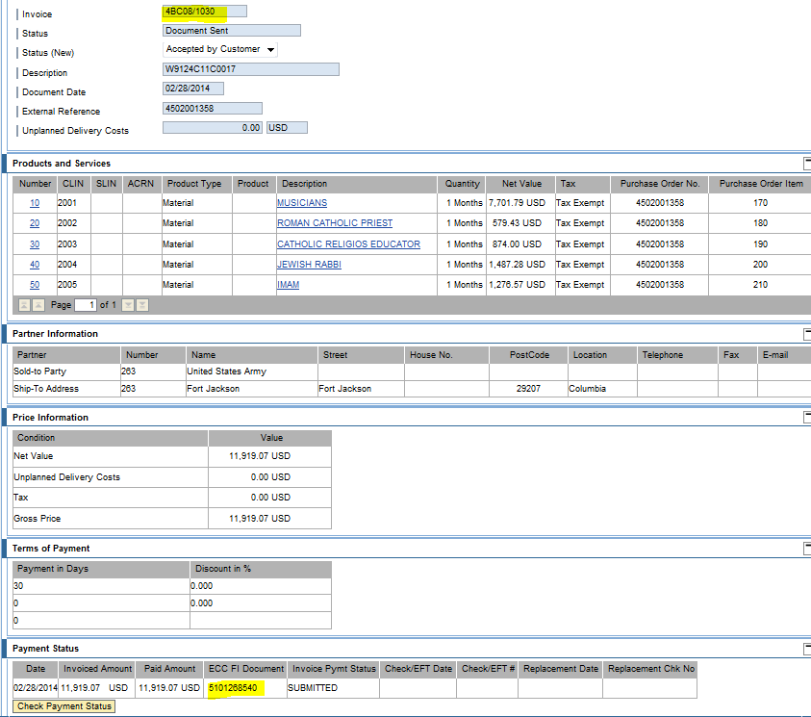
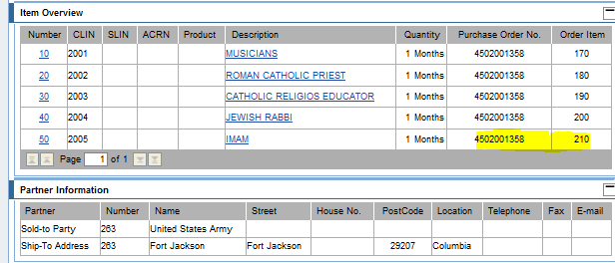
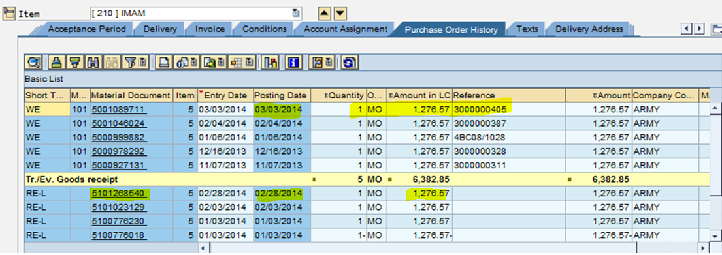
SUS Vendor Documents - Quantity
Advance Ship Notice (ASN) for Quantity Based
Vendor Invoice
ASN linked to invoice
GFEBS PO History
ASN linked to GR in GFEBS
Invoice successfully posted against obligation in GFEBS and
free to pay

Slide 5
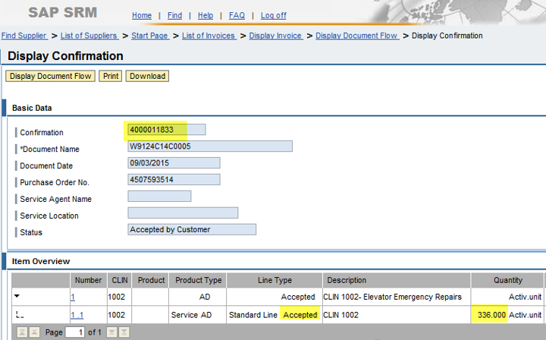
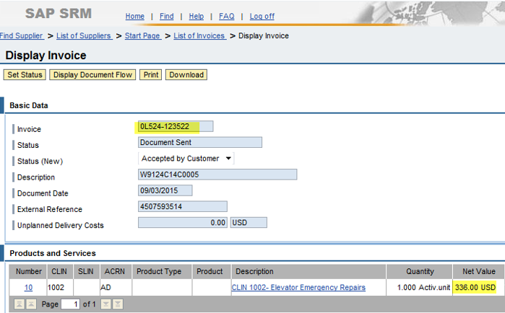
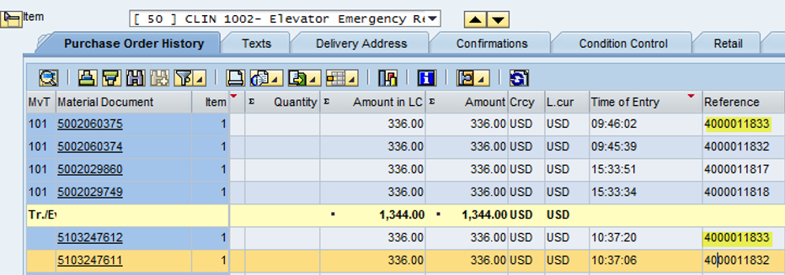
SUS Vendor Documents – Value/Service
Service Confirmation for Value Based
Vendor Invoice
Confirmation linked to invoice
Smith
Building 1000, #1
GFEBS PO History
Confirmation linked to GR in GFEBS
Invoice successfully posted against obligation in GFEBS and
free to pay

Slide 6
Quantity vs. Value Based PO Items
SPS to GFEBS interface updated to now create PO item as Service (Value-Based) if PSC is alpha-numeric (excluding “Q”) - sets:
Item category to “D”
Item Order quantity to “1” and Order Unit of Measure to “AU” (Activity Unit)
Item Net Price is total obligated amount and Order Price Unit to “AU”
Limits tab populated with obligated amount
GFEBS PO used by SUS vendor, so PO must match the award
Review of Quantity-based vs. Value-based to determine how to setup PR and PO:
Ask – How will vendor invoice?
Exact same amount per EA, MO, etc. = Quantity based
Varying amount based on number of days, weight, etc. = Service based
If Vendor will invoice quantity:
Award as quantity-based
If PSC is alpha-numeric (excluding “Q”) either:
Create/update PO to match award since SPS interface creates as value based or
Add quantity items to Services tab
If Vendor will invoice value or varying amount:
Award as value-based using the Services tab
Setup PR as 1 “AU” for total obligated amount, then award as 1 Job for total
Notes:
FSC – Federal Supply Classification
PSC – Product or Service Code
If Product Service Code (PSC) is alpha and does not begin with Q
SPS interface designed to create PO as a Service item (value based)
Item Category = D, Order Quantity = 1 and Unit of Measure = AU
Total value of obligation on the limit tab

Slide 7
GFEBS PO Data Needed for SUS
Header
Pay Office
Item Overview
Unit of Measure
Delivery Date *recommended end of Period of Performance (POP)
Item Details
Delivery Schedule tab (if applicable)
Confirmation tab
Limits vs. Services tab (item category = D)
Customer data tab for POP

Slide 8
PO Header: Pay Office DoDAAC
Header > Customer Data > Pay Office = HQ0678 for SUS
Header > Communication > Your Reference = HQ0678 for SUS
NOTE: Data typically updates via SPS interface from award or modification
Customer Data Pay Office added at later date.

Slide 9
PO Item Overview: UoM / Delivery Date
Item Overview > Order Unit (OUn) / Order Price Unit (OPU)
Order Unit and Order Price Unit must match
Item Overview > Delivery Dates
End of Period of Performance on PR & PO

Slide 10
Item Details: Delivery Schedule
Item Detail > Delivery Schedule (if applicable)
End of Period of Performance (POP)
Delivery Dates sort ascending
Stat. Del Date can be updated for the actual award/mod date
Did you know? This is the “PReq. Closed” field. If you need the PR line closed, you can come into the PO and click on this box. Once you see the ‘Checkered Flag’ this will set the close box on the PR line and de-commit any open amount. Remember you need to save the PO before this will update the PR.

Slide 11
Item Details: Confirmations
Item Detail > Confirmations
Conf. Control: Select “Confirmations” (0001)
NOTE: No PO history (or all reversed) to change the Confirmation Control key. Key allows communication between GFEBS and SUS.

Slide 12
Item Details: Limits / Account Assign tab
If Service, Item Category = D (value-based) in Item Overview,
On the “Account Assignment” tab, first select to copy data
On the “Limits” tab select delete to allow amount on the “Services” tab
Required to avoid “Budget Exceeded” errors

Slide 13
Item Details: Services tab
Select “Services” tab, based on UOM either:
Copy Short Text from Item Overview and set Net Price to Quantity when unit of measure (UOM) is either JOB (JA) or LOT and enter Gross Price as 1
Copy Short Text and enter Quantity, unit and Price from Contract
Notes:
NOTE: Services allows the vendor to invoice multiple times without consuming the entire quantity of 1 AU

Slide 14
Item Details: Services tab
On “Account Assignment” tab, verify the LOA info was copied / retained
Notes:
NOTE: Services allows the vendor to invoice multiple times without consuming the entire quantity of 1 AU

Slide 15
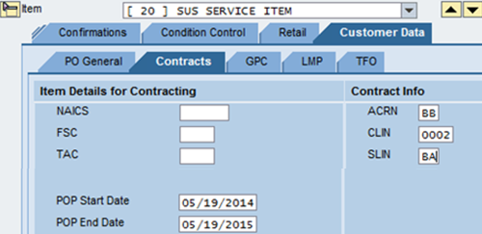
Item Details: Customer Data tab
If Service, Item Category = D (value-based) in Item Overview,
Ensure “Period of Performance” (PoP) dates are populated on Contracts sub-tab
NOTE: Data typically updates via SPS interface from award or modification

Slide 16
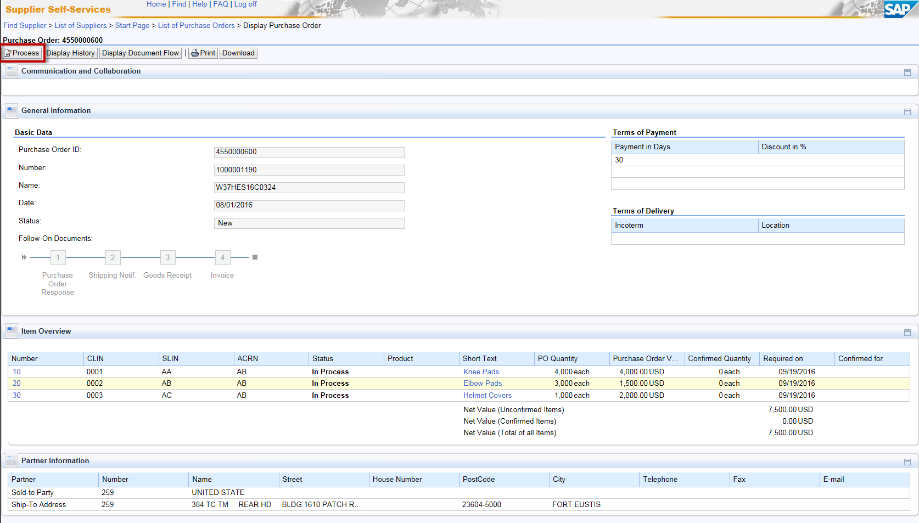
GFEBS PO Replicated to SUS
Near-real time PO data available to the vendor to acknowledge

